Slide 1
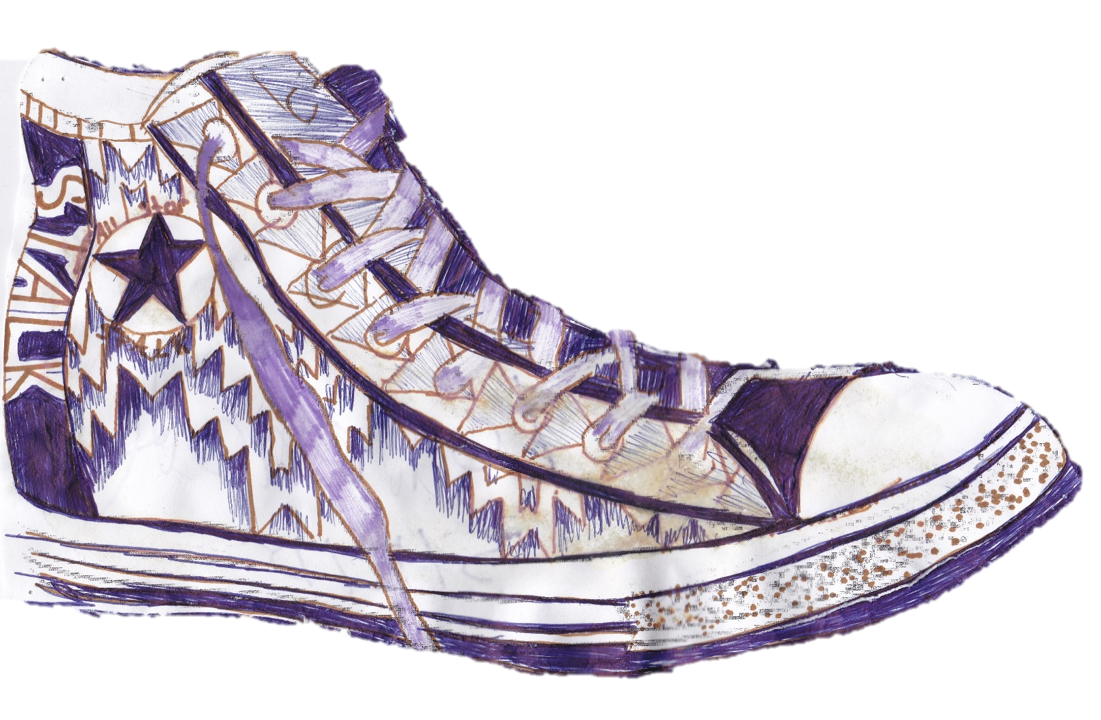
New Beauty Old Designs traditional and contemporary art

Slide 2
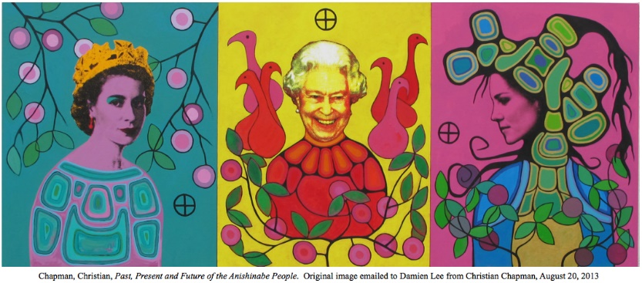
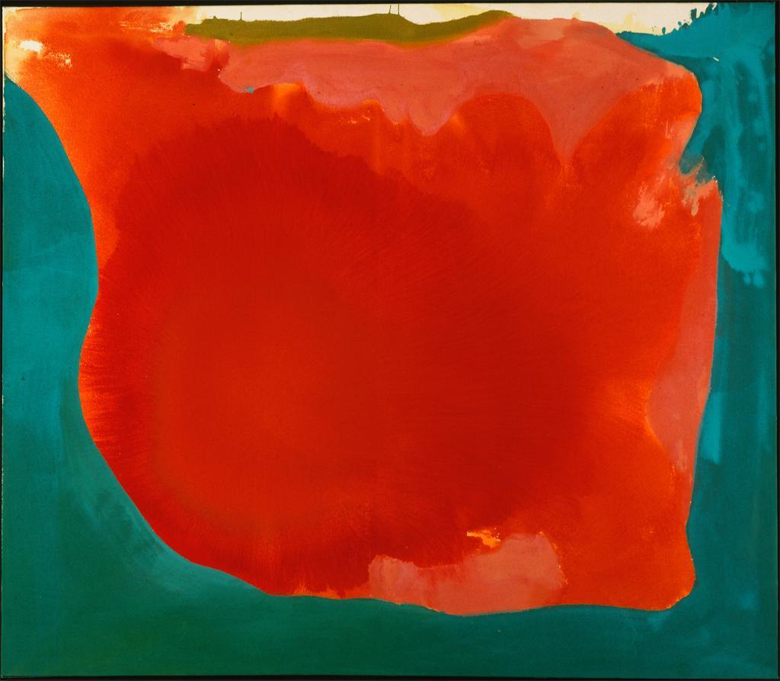
Visual Arts Framework for California Public Schools Visual and Performing Arts Content Standards
GRADE 7
Students focus on developing a series of related works to express a personal statement. As they develop their works, they describe how their application of the elements of art and principles of design contribute to what they want to express. Aware that art is not created in isolation, they compare and contrast works from different time periods and cultures and reflect on the artists’ styles in relation to time and place. In the process they are identifying what they believe to be important to look for in works of art and what criteria they want to apply as they critique those works.
Canyon, 1965
Helen Frankenthaler
GRADE 8
Christian Chapman
Past, Present and Future of the Anishinabe People, 2013
Students combine their skills in artistic perception and aesthetic valuing to analyze and justify the artistic choices they make about their own work and determine how those choices contribute to the expressive quality of the work. Learning how art can make a social comment or protest a social condition in their research of art from various times and places affects their discussions of the effects on society of all visual communication, including television, videos, film, and the Internet. They also become aware of the power of the visual arts as they design a public artwork appropriate to and reflect- ing the location for which it is designed. Their ability to present a reasoned argument about the artistic value of a work of art can be applied to the works they create or the works of others past or present.

Slide 3
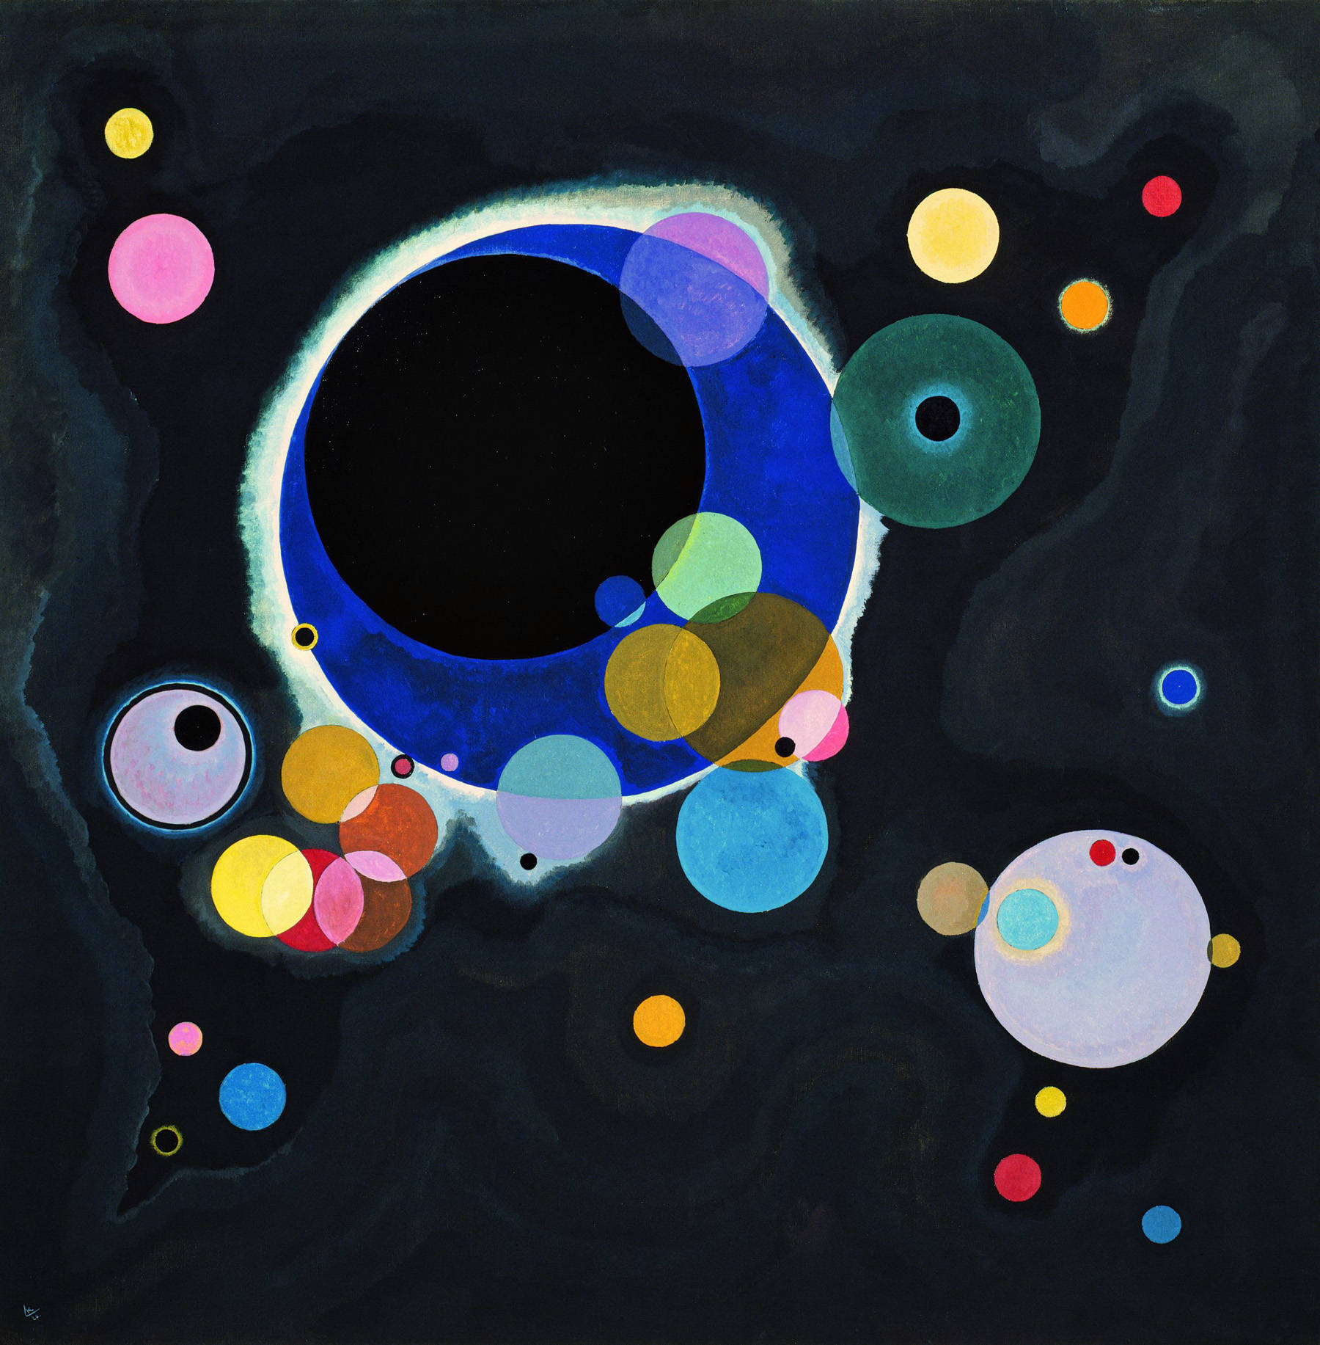
Preparation
Students participated in rounds of Telephone, Beginning, Middle or Ending, I see, I wonder, I think, and What is going on this picture?--- artful thinking strategies/activities to introduce, explore and familiarize them with modern and postmodern art, while whetting their critical thinking skills.
Accompanying work sheets
Extended Telephone activity

Slide 4
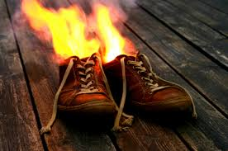
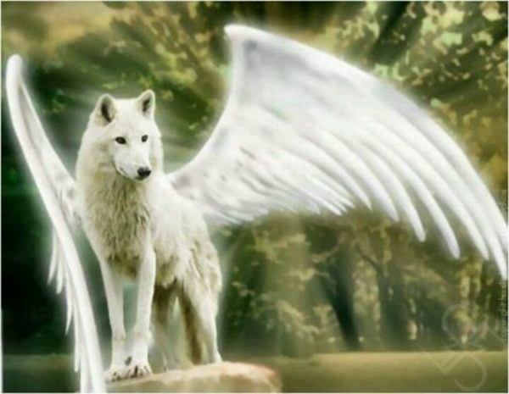
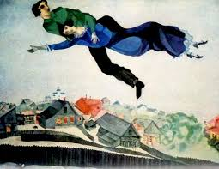
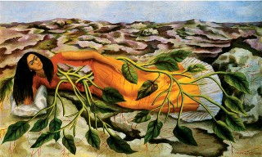
Images: Artful Thinking Strategies

Slide 5
Telephone Extended ….

Slide 6
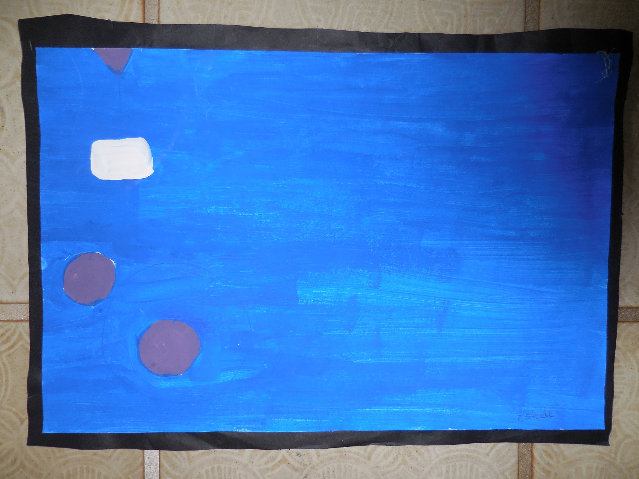

Slide 7
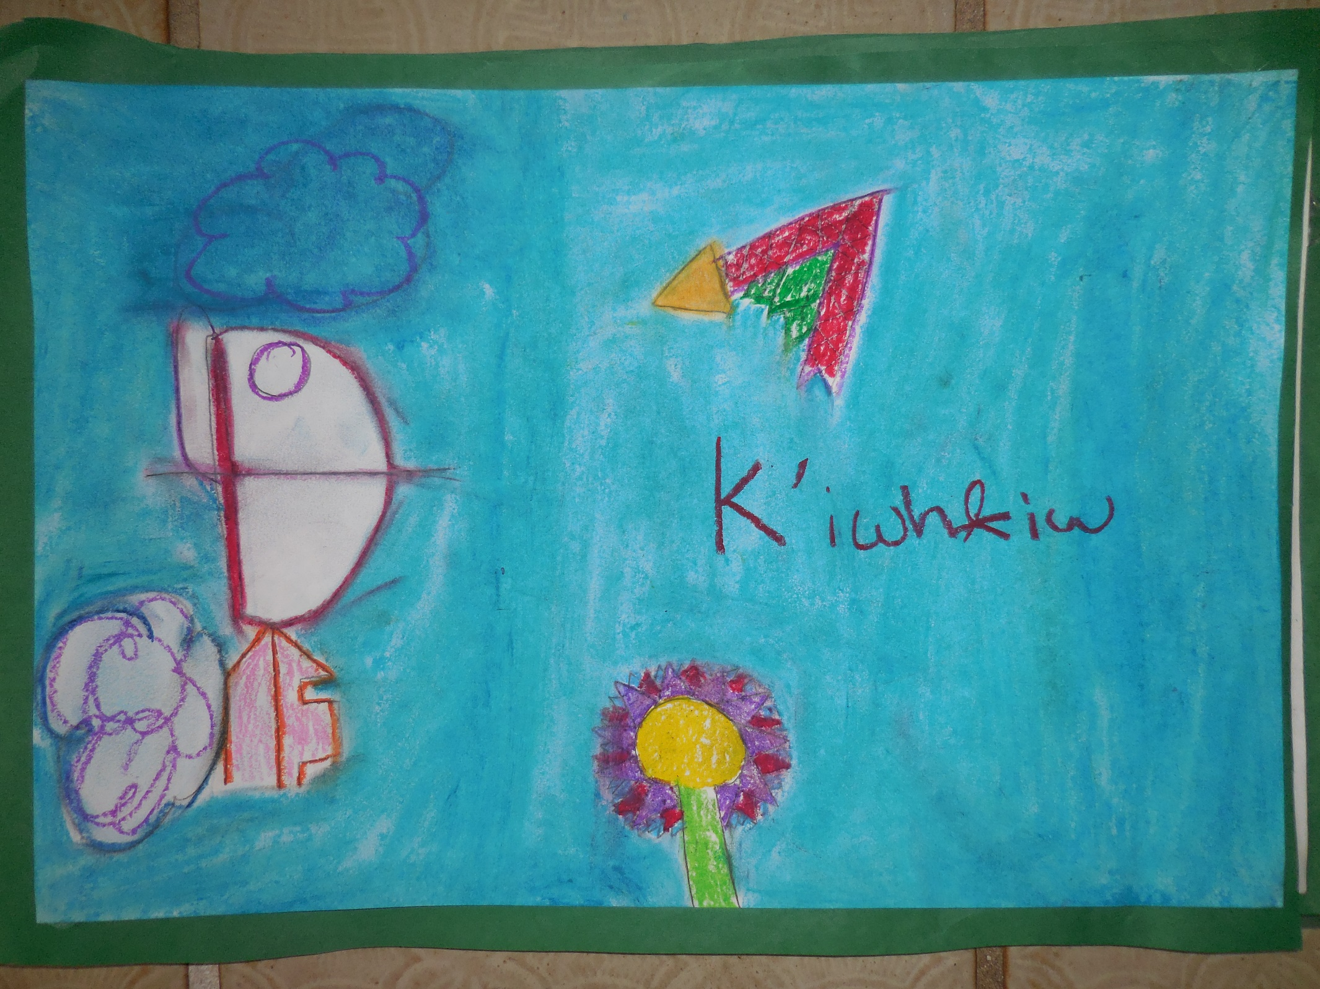

Slide 8
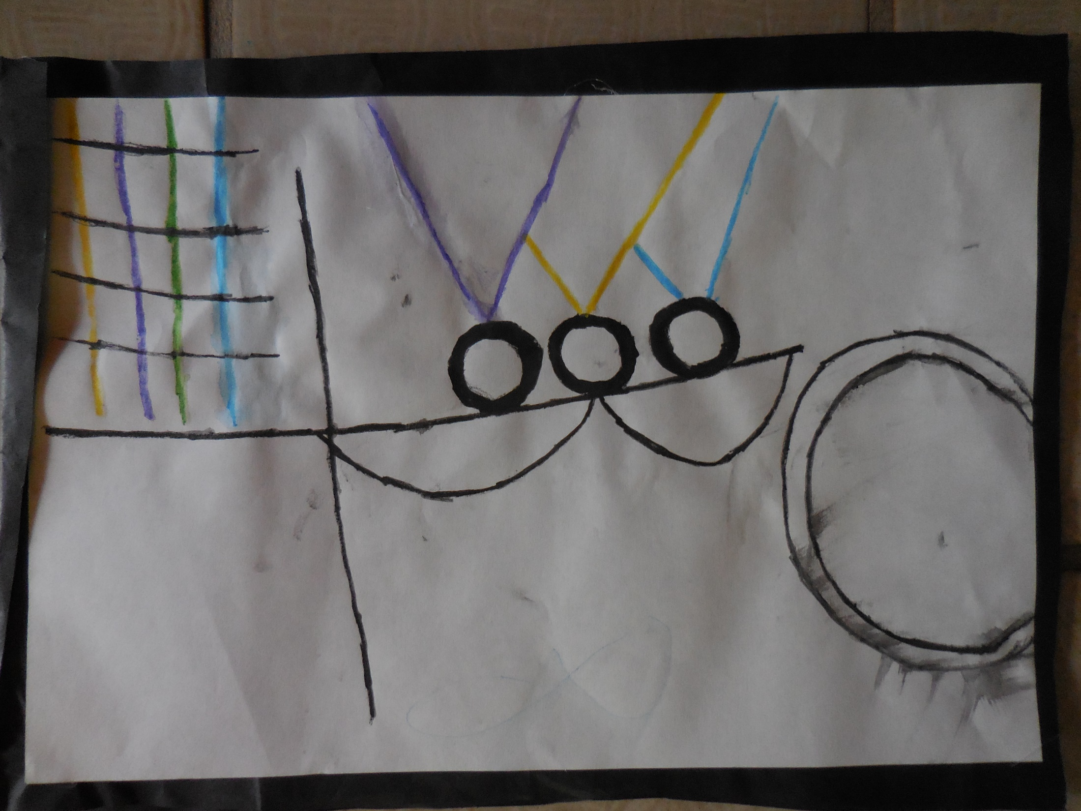

Slide 9
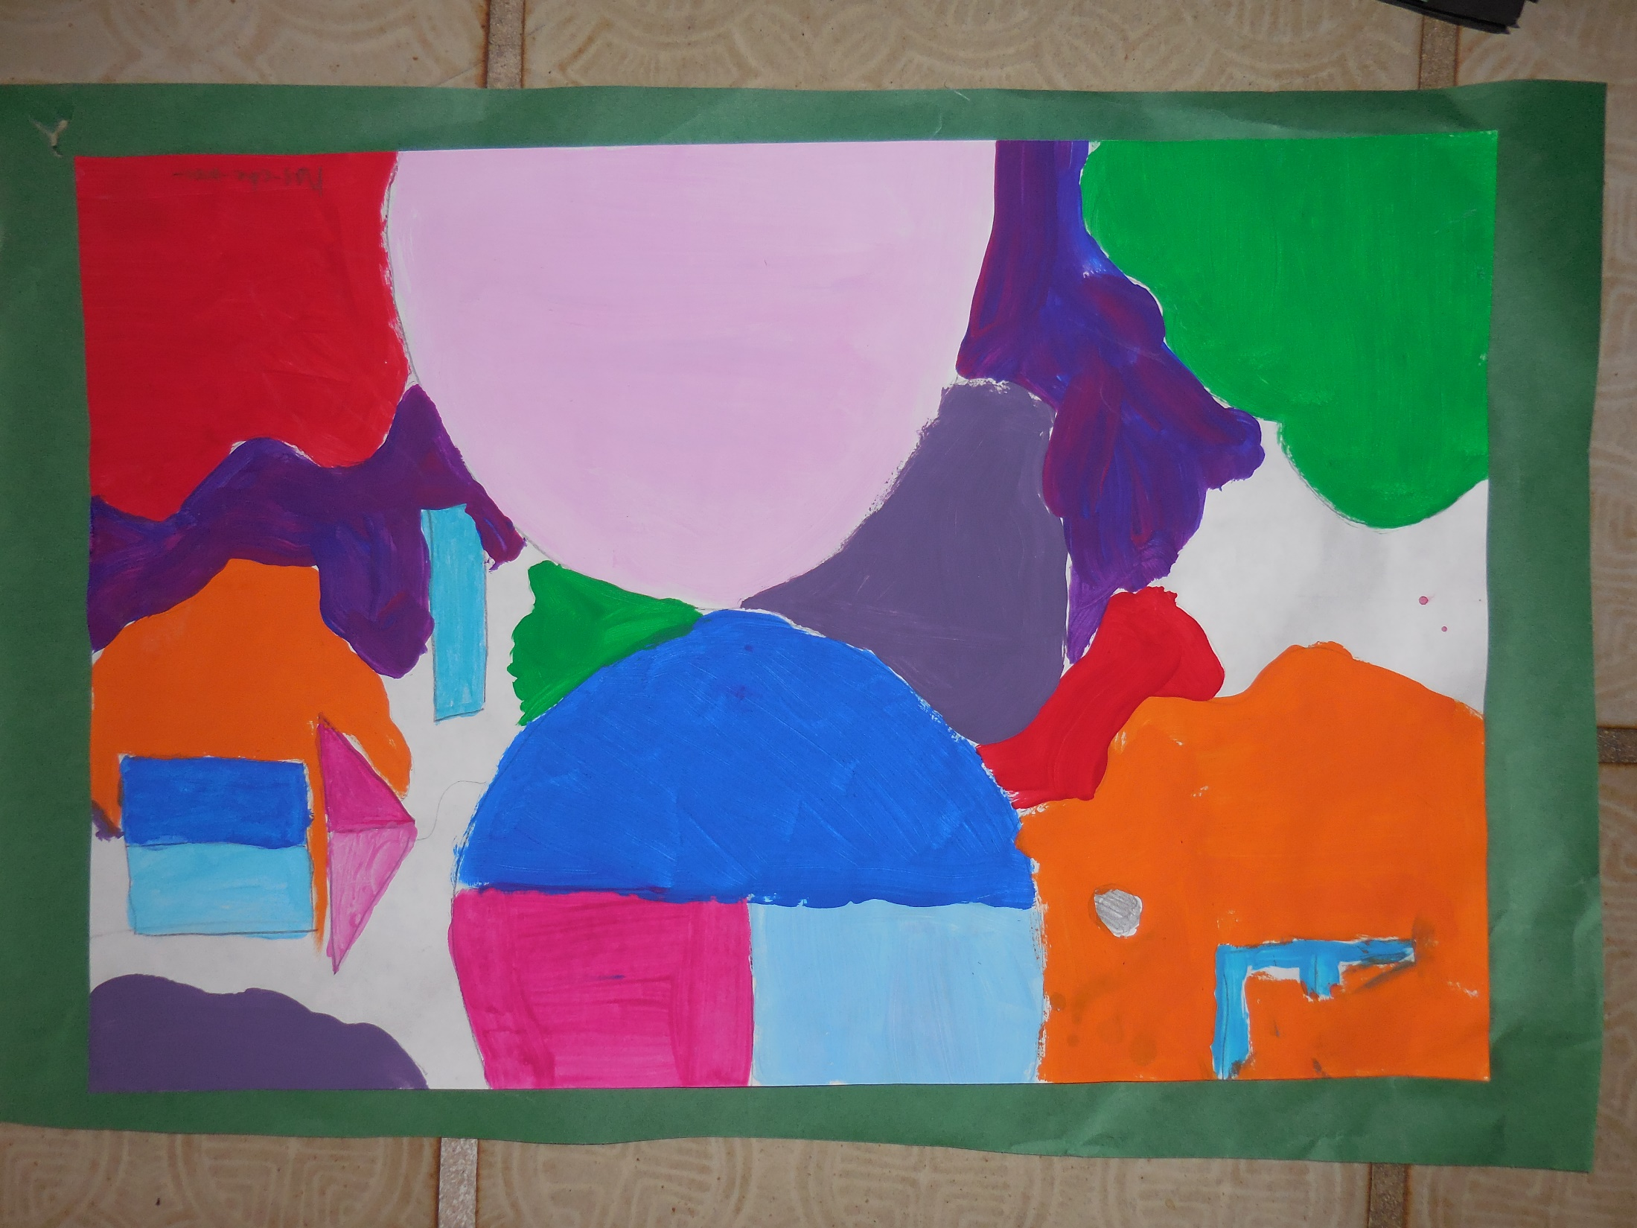

Slide 10
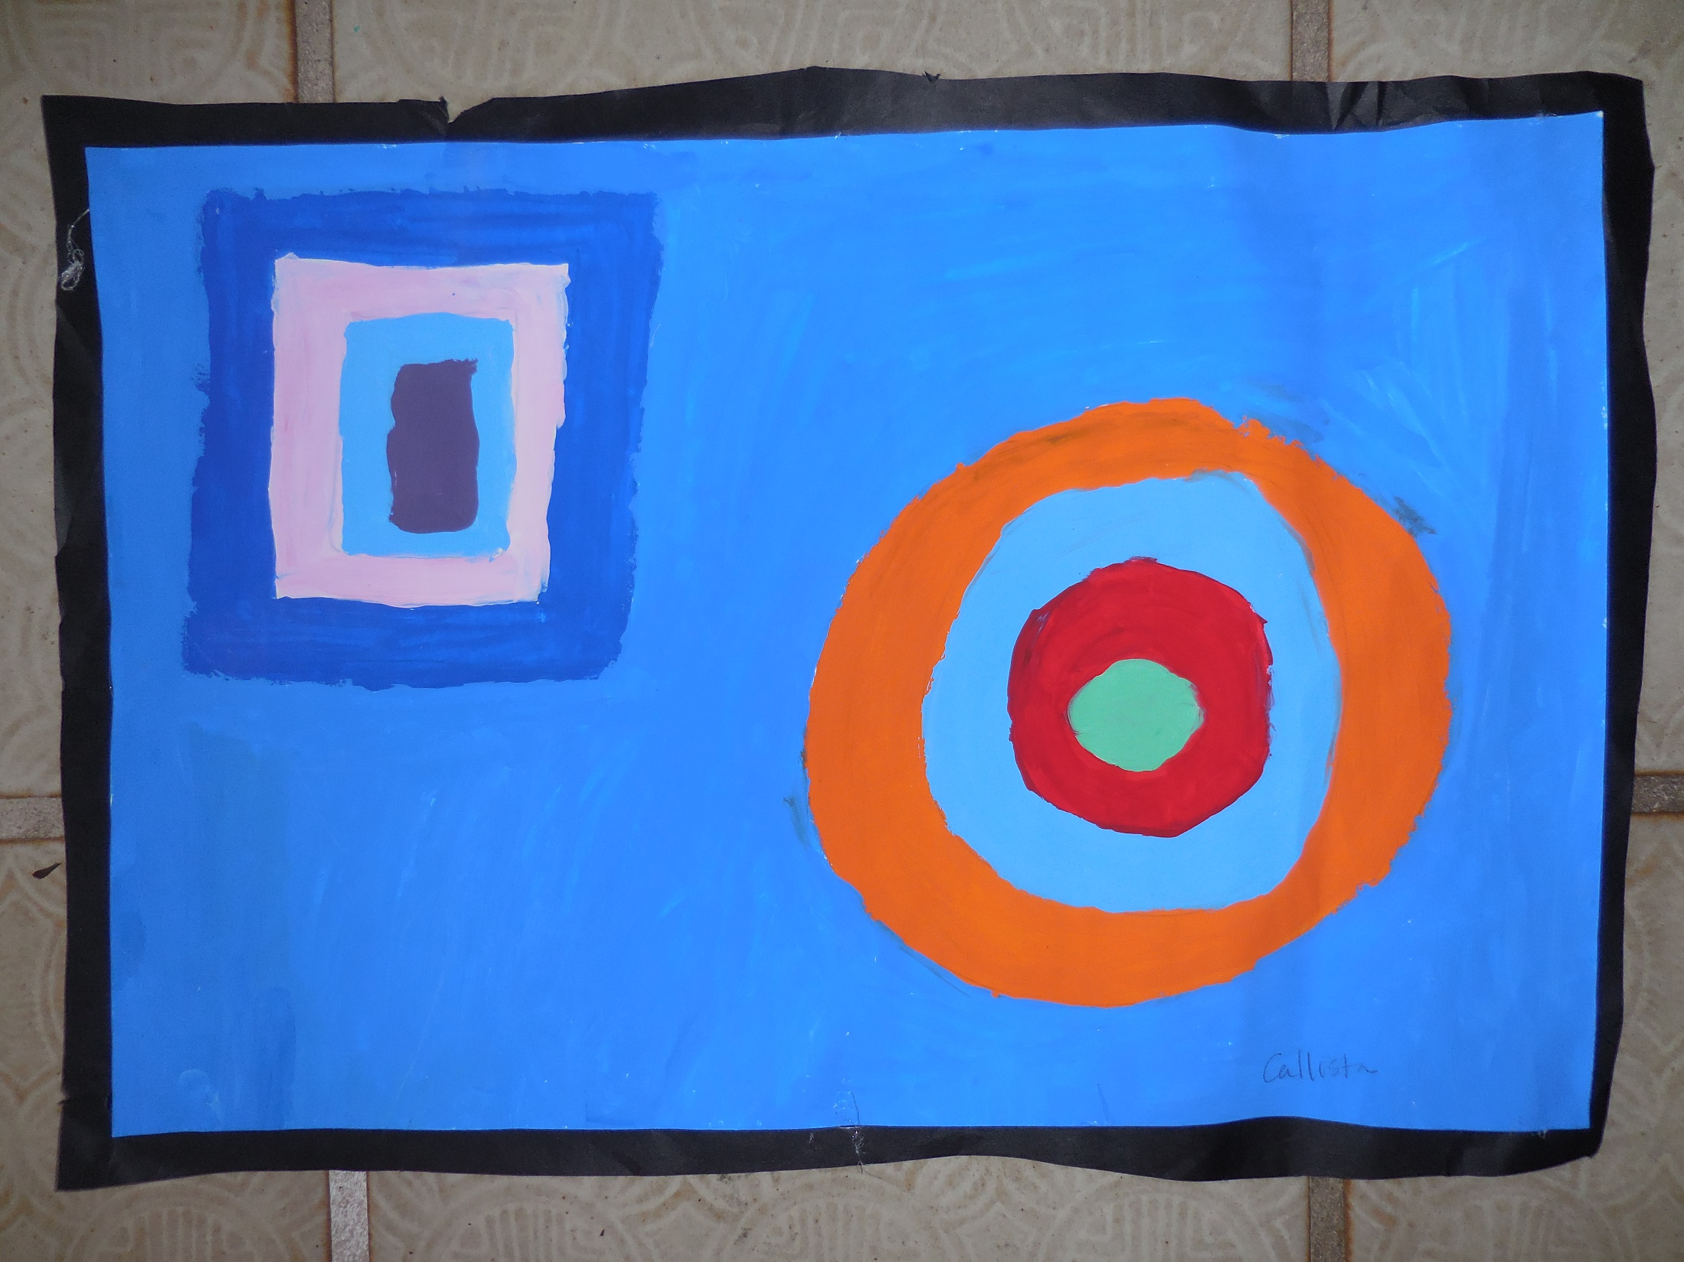

Slide 11
1. I see, I wonder, I think …
artful thinking strategy
I see …
I wonder …
I think …

Slide 12
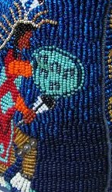
I see …

Slide 13
I wonder …

Slide 14
I think …

Slide 15
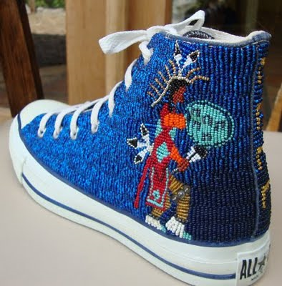

Slide 16
2. Define/discuss vocabulary
archetype
motif
traditional
contemporary

Slide 17
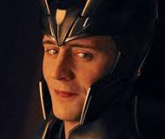
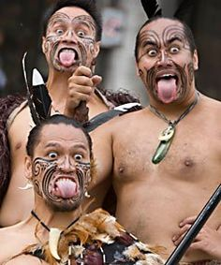
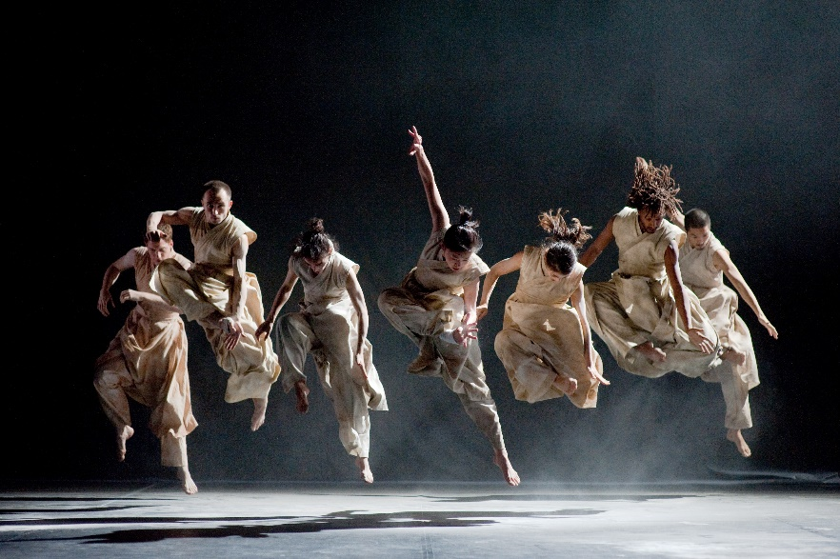
Loki, the trickster
Norse Mythology
archetype – 1. a typical, ideal or classic example of something, 2. an image or symbol that is used repeatedly in mythology, art or literature
motif – a repeated design, shape or pattern
traditional – relating to or based on very old customs, beliefs, or stories
contemporary – modern, or relating to the present time
Greek Wave Design
Traditional Maori
Pukana Dancers
Akram Khan's Vertical Road
Modern Dance

Slide 18
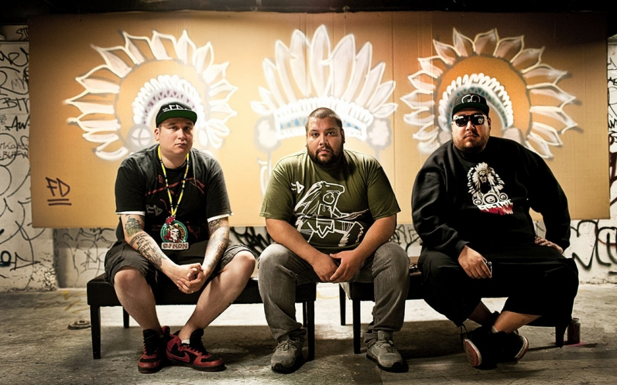
3. Contemporary Native American artists
Slide show of contemporary Native American artists
Music accompaniment: A Tribe Called Red, Electric PowWow Drums, Indigenous Dub-Step
Directions: look for examples of archetypes and motifs for a pair/share: take 3 notes

Slide 19
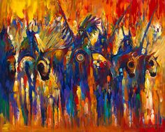

Slide 20
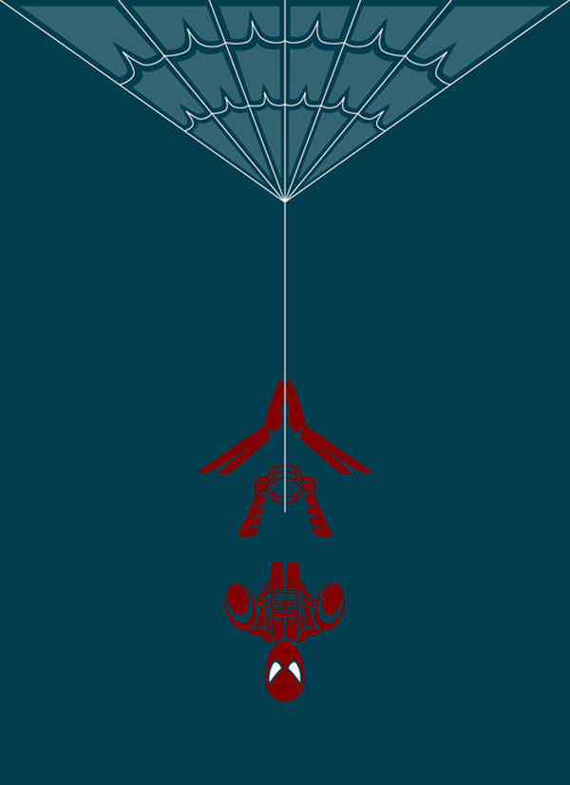

Slide 21
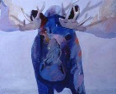

Slide 22
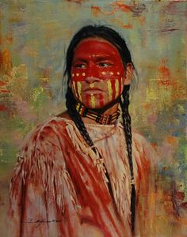

Slide 24
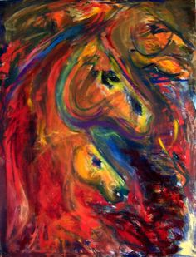

Slide 25
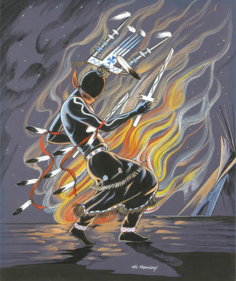

Slide 26
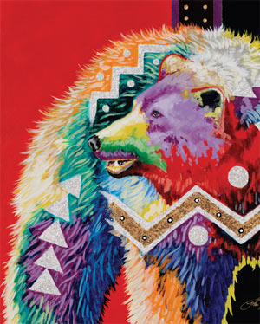

Slide 27
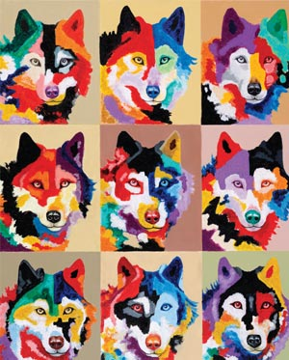

Slide 28
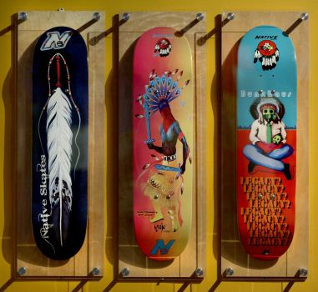

Slide 29
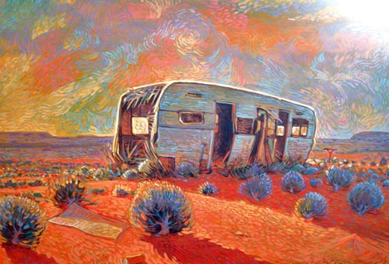

Slide 30
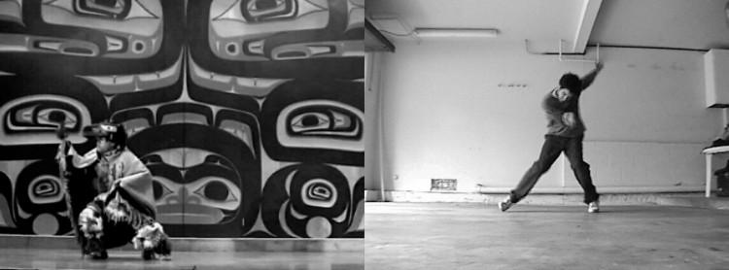

Slide 31
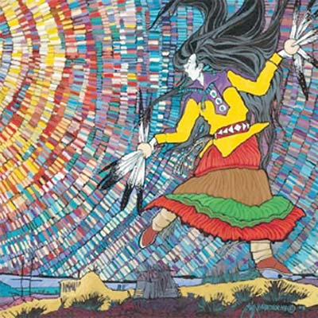

Slide 32
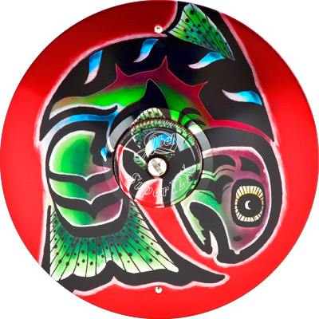

Slide 33
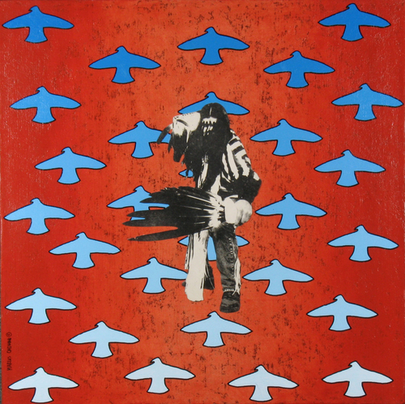

Slide 34
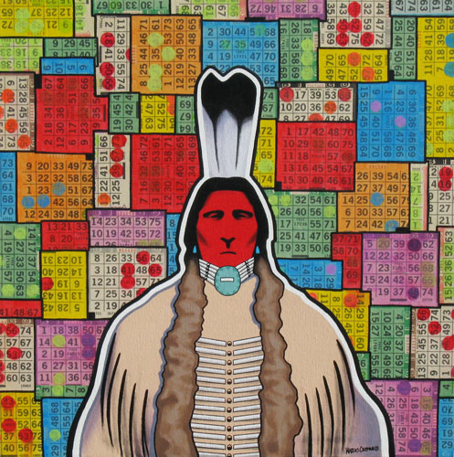

Slide 35
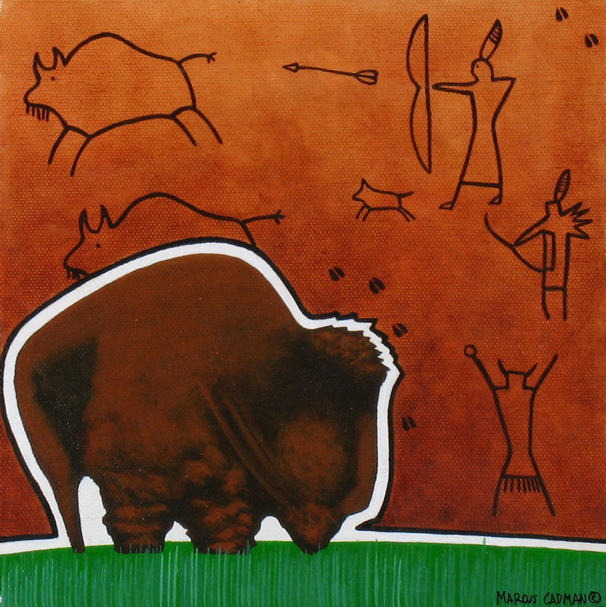

Slide 36
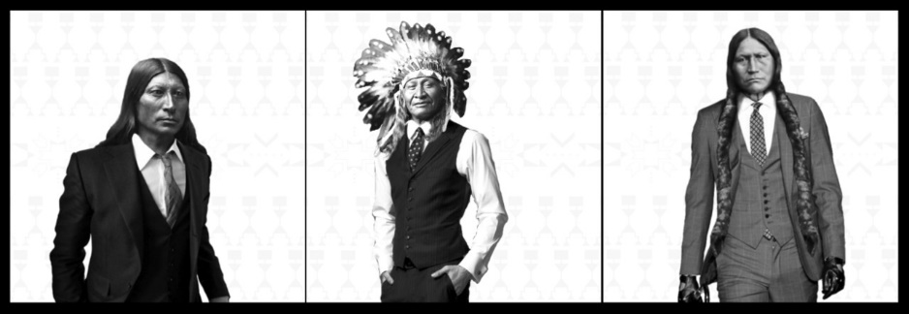

Slide 37
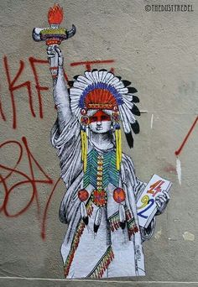

Slide 38
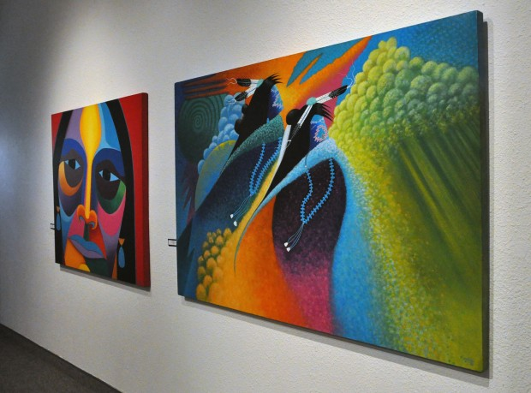

Slide 39
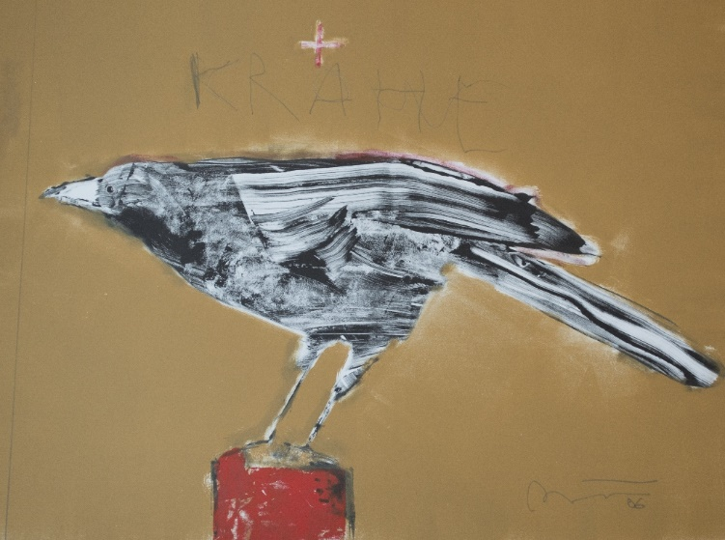

Slide 40
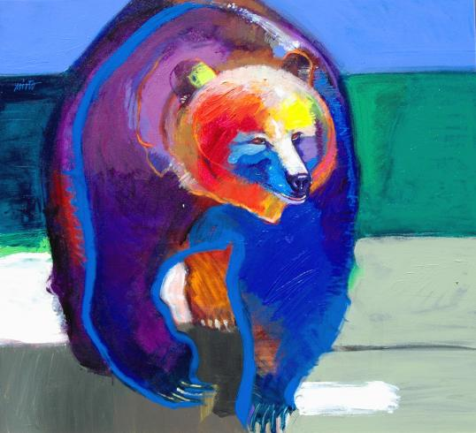

Slide 41
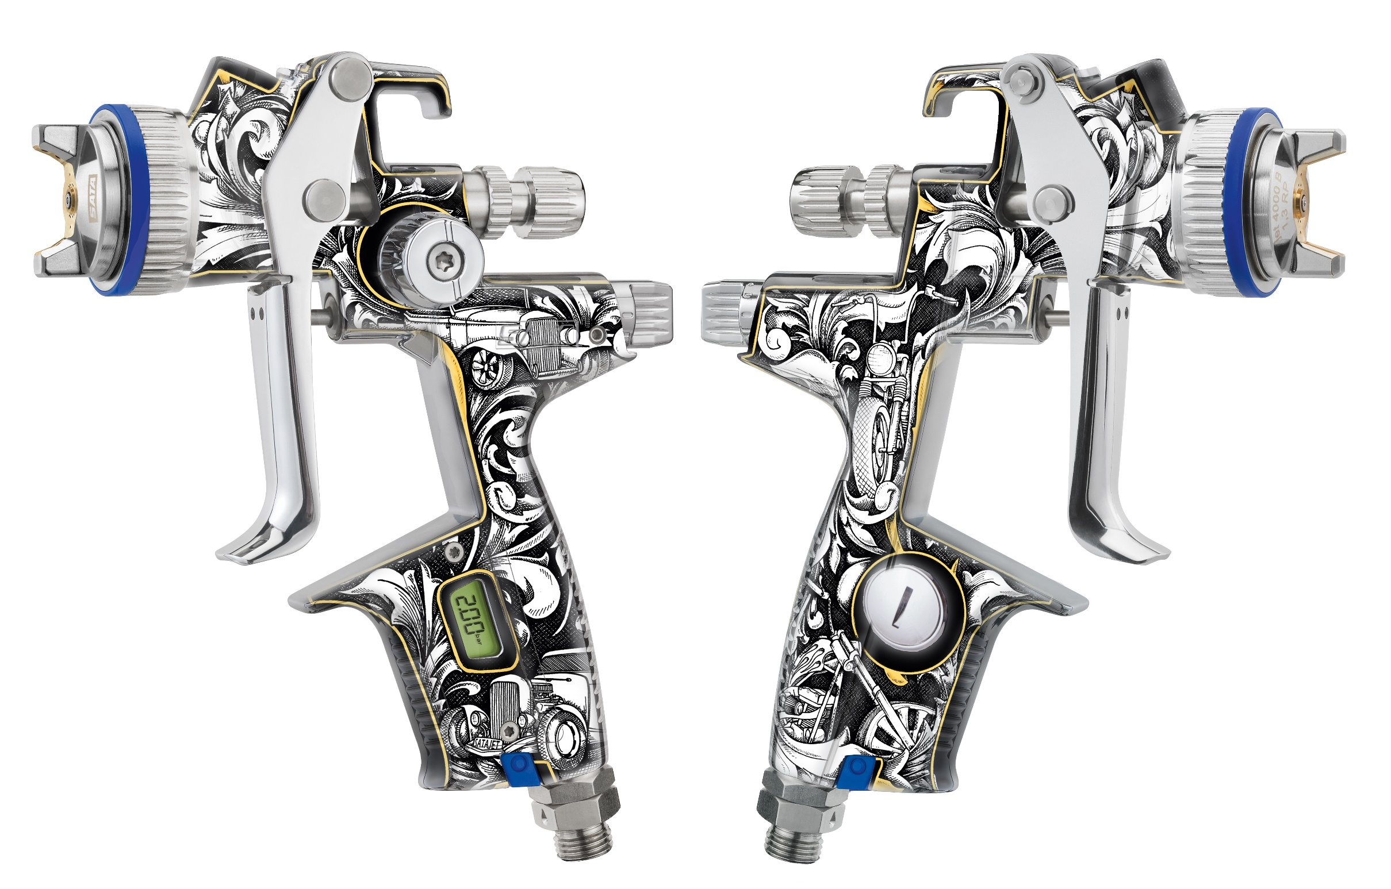

Slide 42
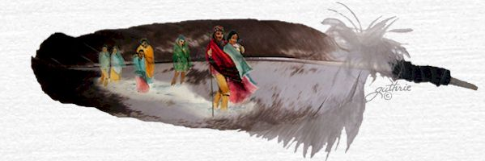

Slide 43
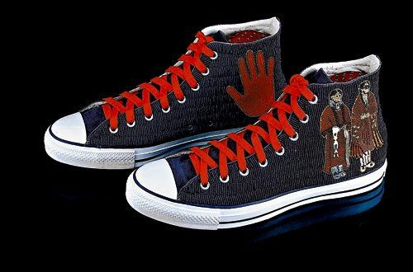

Slide 45
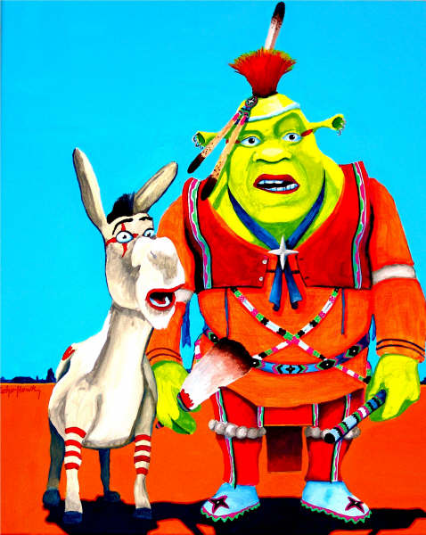

Slide 46
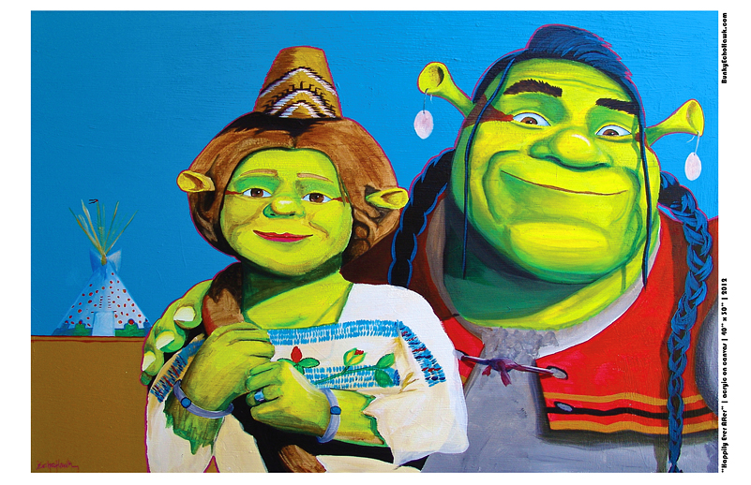

Slide 47
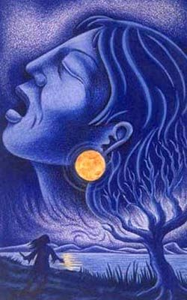

Slide 48
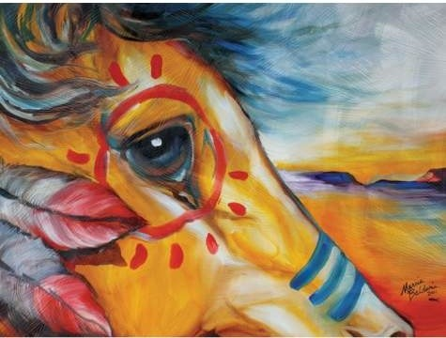

Slide 49
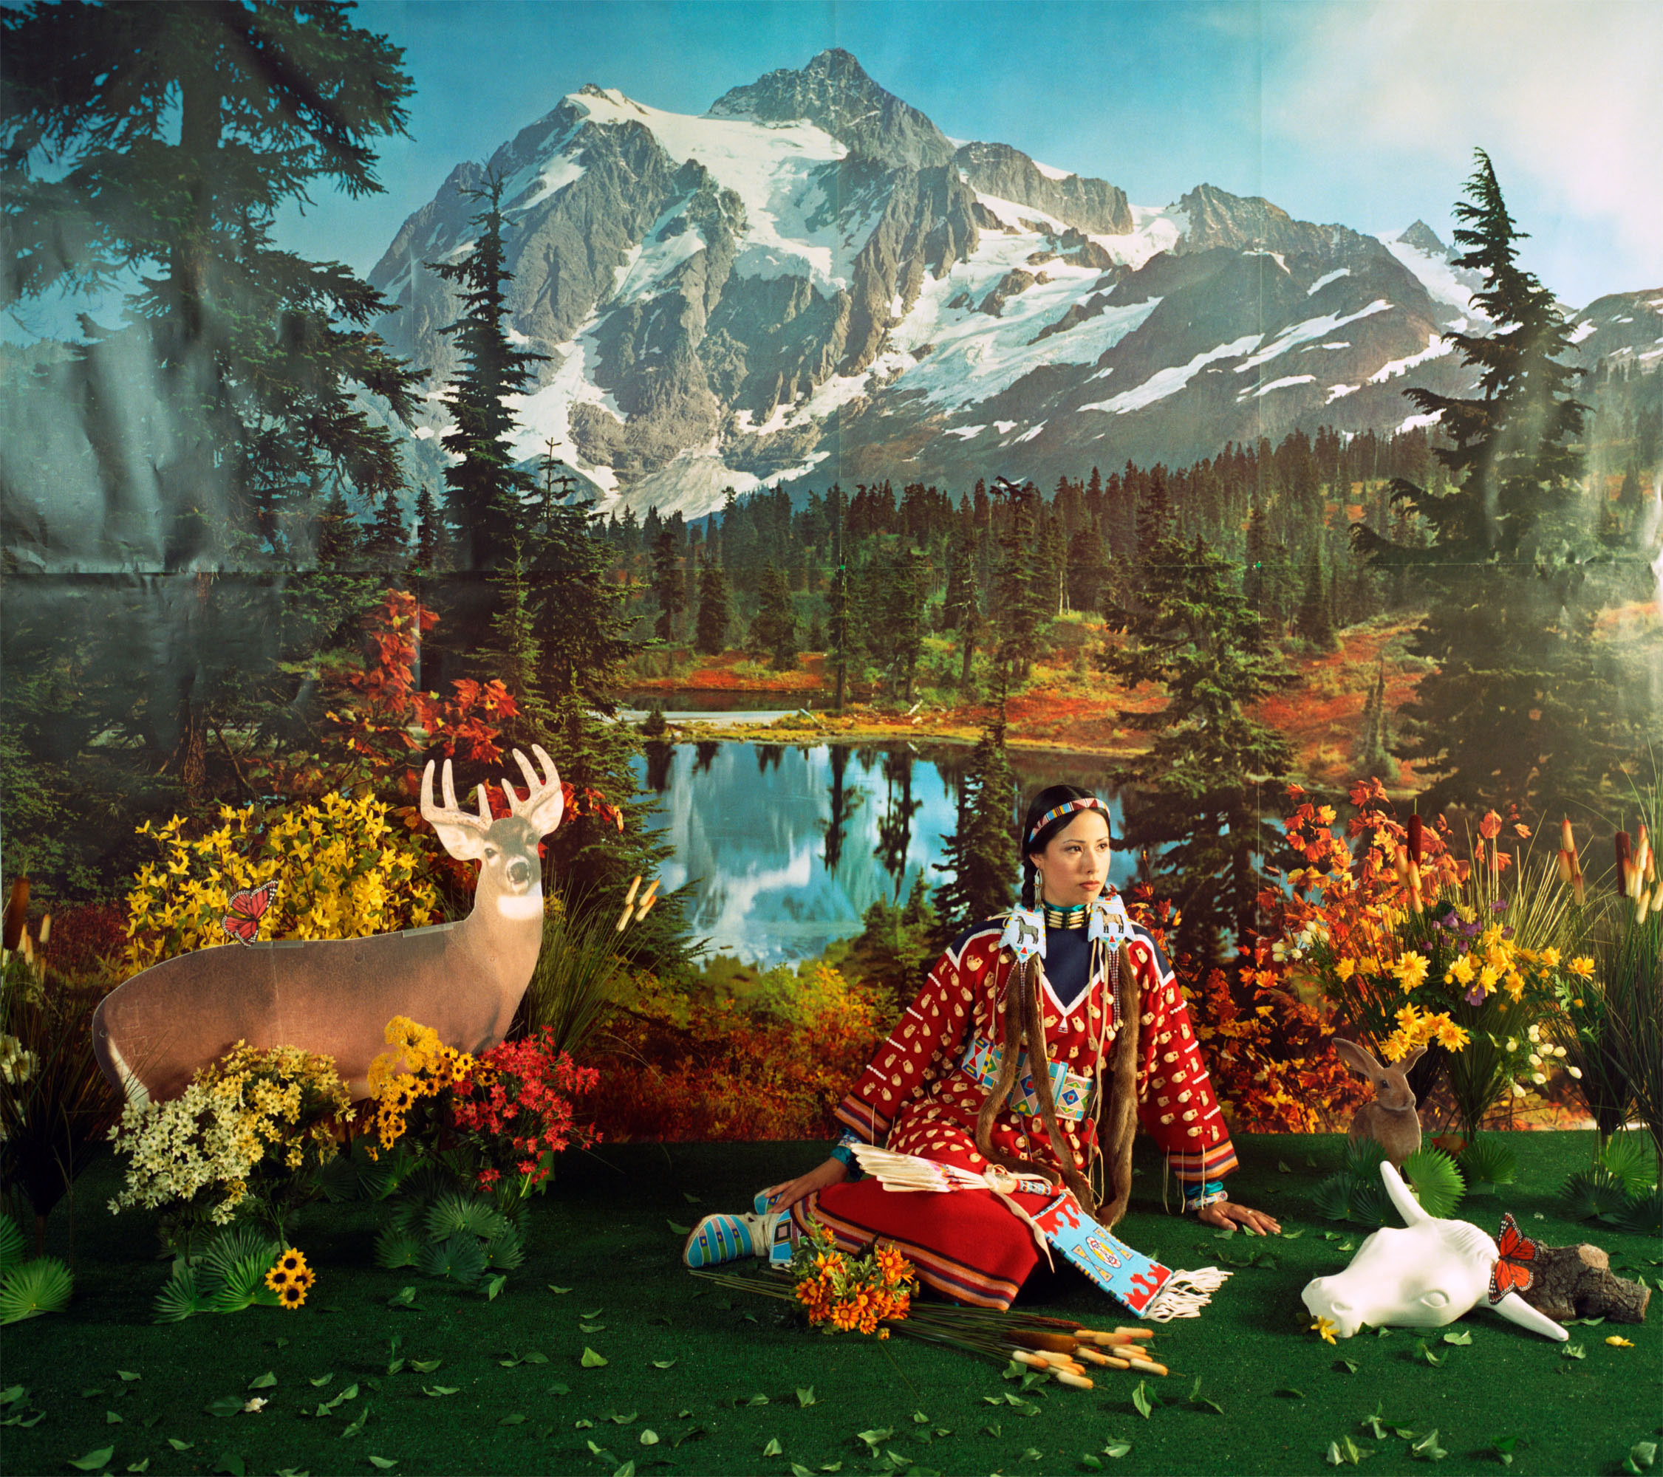

Slide 51
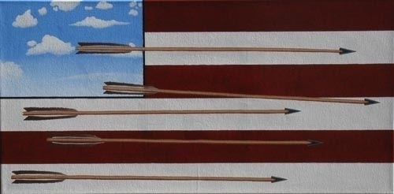

Slide 52
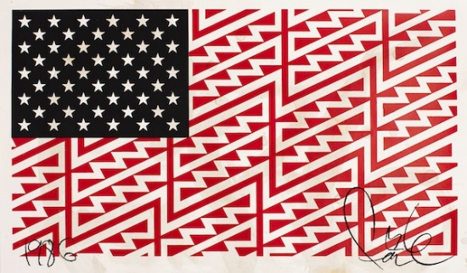

Slide 84
4. Art Project
Complete hand-out
Draw a picture or design an object that draws from both traditional and contemporary ideas
Write a description or a story about your artwork

Slide 85
Samples pages from Traditional and Contemporary Art Sheet
Draw and label an example of traditional art or artifact.
Decorate the hummingbird.

Slide 86
Samples pages from Traditional and Contemporary Art Sheet
How can a traditional basket also be contemporary?
Write and draw.
__________________________
__________________________
__________________________
Decorate the bears with a traditional motif.

Slide 87
5. Curate a show
In groups, curate a show using the Art Box cards
Complete the accompanying chart
Take a museum tour around the tables
Try to name the categories

Slide 88
Curate a Show
Group __________________________________________
Theme___________________________________________
Write the title and painter of each work in your show in a box.
Optional: Draw a detail from the painting.

Slide 89
What are the possible themes of this show?

Slide 90
6. Curate a show of original artwork
Categorize the art work
Curate/Hang the show
Title the show
Stand back and ADMIRE…

Slide 109
7. Extensions
Sort the work into categories
Curate a show using work from the slide show

Slide 110
Research one of the artists in the slide show, their cultural roots and artistic influences, including more examples of their work

Slide 111
Research the larger history of ancient geometric motifs, like triangles
Mathematics and art have a long historical relationship

