Slide 1
Recursive art & inquiry
PROJECT
heather gaiera & bill Funkhouser
DATE
1/8/16
Client
steam conference

Slide 2
The best way to learn a new word is to experience it,
not hear the definition.

Slide 3
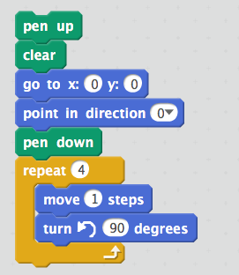
Experiencing “recursion”
With “Scratch” programming
1) Stand & clear area
2) Face front of room
3) Go forward 1 step
4) Turn Left 90°
5) Repeat steps 3 & 4 three more times.
B

Slide 4
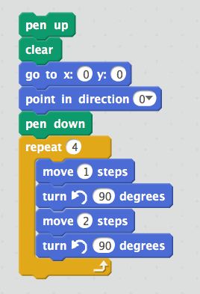
Experiencing “recursion”
2
B

Slide 5
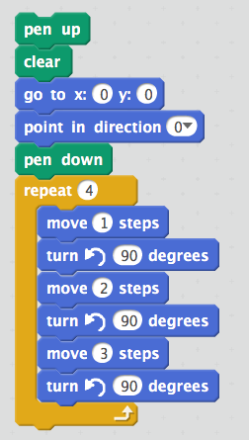
Experiencing “recursion”
B

Slide 6
Do you need graph paper to visualize more complex designs?
H

Slide 7
Create the 1, 2, 3 pattern on graph paper.
H

Slide 8
1, 2, 3 pattern
Convergent
H

Slide 9
1, 2, 3, 4 pattern
Divergent
How does this compare?
H

Slide 10
Inquiry-based learning
starts by posing questions, problems or scenarios—rather than simply presenting established facts.
B

Slide 11
Inquiry-based learning
 | Name | Teacher | Student
1 | Confirmation | Teaches concept Provides questions & procedure to confirm | Collect & confirm data to support concepts taught
2 | Structured | Provides question & outline of structure | Formulates concepts from data analysis
3 | Guided | Provides question | Design & follow own procedures to explore the question
4 | Open/ true | Assists as needed | Formulates question, designs & follows procedures
B

Slide 12
Today
You will be introduced to a variety of inquiry questions.
Some we will solve now and others you will have time at the end of the class to explore.
H

Slide 13
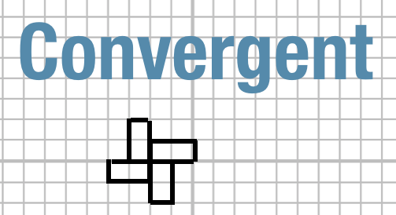
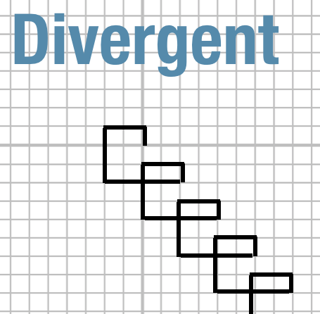
Level 3 inquiry:
What makes a pattern
Notice: Question posed
but structure not provided
H

Slide 14
Level 2 inquiry:
What sequence generated this image?
Notice: Question posed
AND structure provided
Left __ spaces
Down __ spaces
Up __ spaces
Start
Does repeating work?
Write down your sequence and compare
H

Slide 15
Level 2 inquiry:
What sequence generated this image?
3,2,5
B

Slide 16
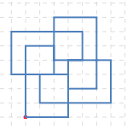
Level 2 inquiry:
What sequence generated this image?
H

Slide 17
How do you predict
2, 3, 4, 5, 6
will compare to
1, 2, 3, 4, 5 ?
Level 2 inquiry:
H

Slide 18
Draw either
2, 3, 4, 5, 6 or
1, 2, 3, 4, 5
(different from elbow partner)
H

Slide 19
Sentence frame: “I noticed my pattern is ______ and your pattern is _____”
Word Bank
Convergent
Divergent
Side lengths
Compact
Elongated
Perimeter
Enclosed areas
Overlapping lines
Congruent shapes
H

Slide 20
2,3,4,5,6 pattern
Compact
Convergent
1 area of 4
4 areas of 6
4 areas of 12
3 shapes/ enclosed areas
Perimeter of 40
Area of 76
Many overlapping lines
B

Slide 21
1, 2, 3, 4, 5 pattern
Elongated
Convergent
1 area of 49
4 areas of 2
2 shapes/ enclosed areas
Perimeter of 36
Area of 57
No overlapping lines
B

Slide 22
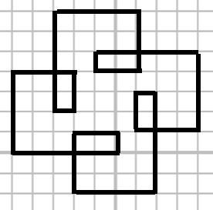
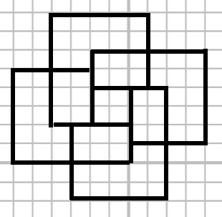
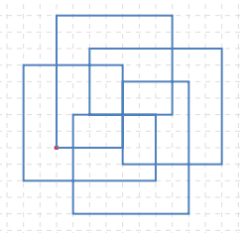
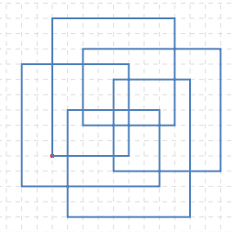
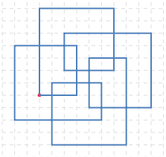
2,3,4,5,6
1,2,3,4,5
3,4,5,6,7
4,5,6,7,8,
5,6,7,8,9
B

Slide 23
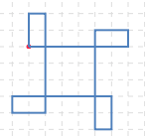
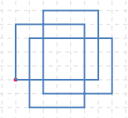
Possible level 3 inquiry:
What makes some images elongated
and others more compact?
B

Slide 24
Possible level 3 inquiry:
How do you flip an image?
(opposite chirality)
1, 2, 3
?
B

Slide 25
Level 3 inquiry:
What other sequences will generate a shape congruent to a given sequence?
(such as 1, 2, 3, 4, 5)
H

Slide 26
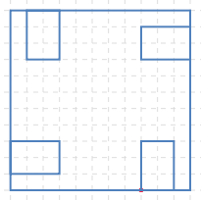
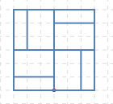
Possible level 3 inquiry:
How was this 5 number sequence changed?
H

Slide 27
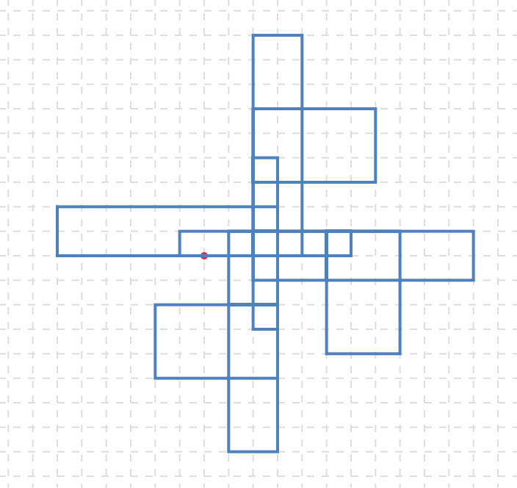
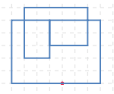
Level 3 inquiry:
How do you make
asymmetrical images?
H

Slide 28
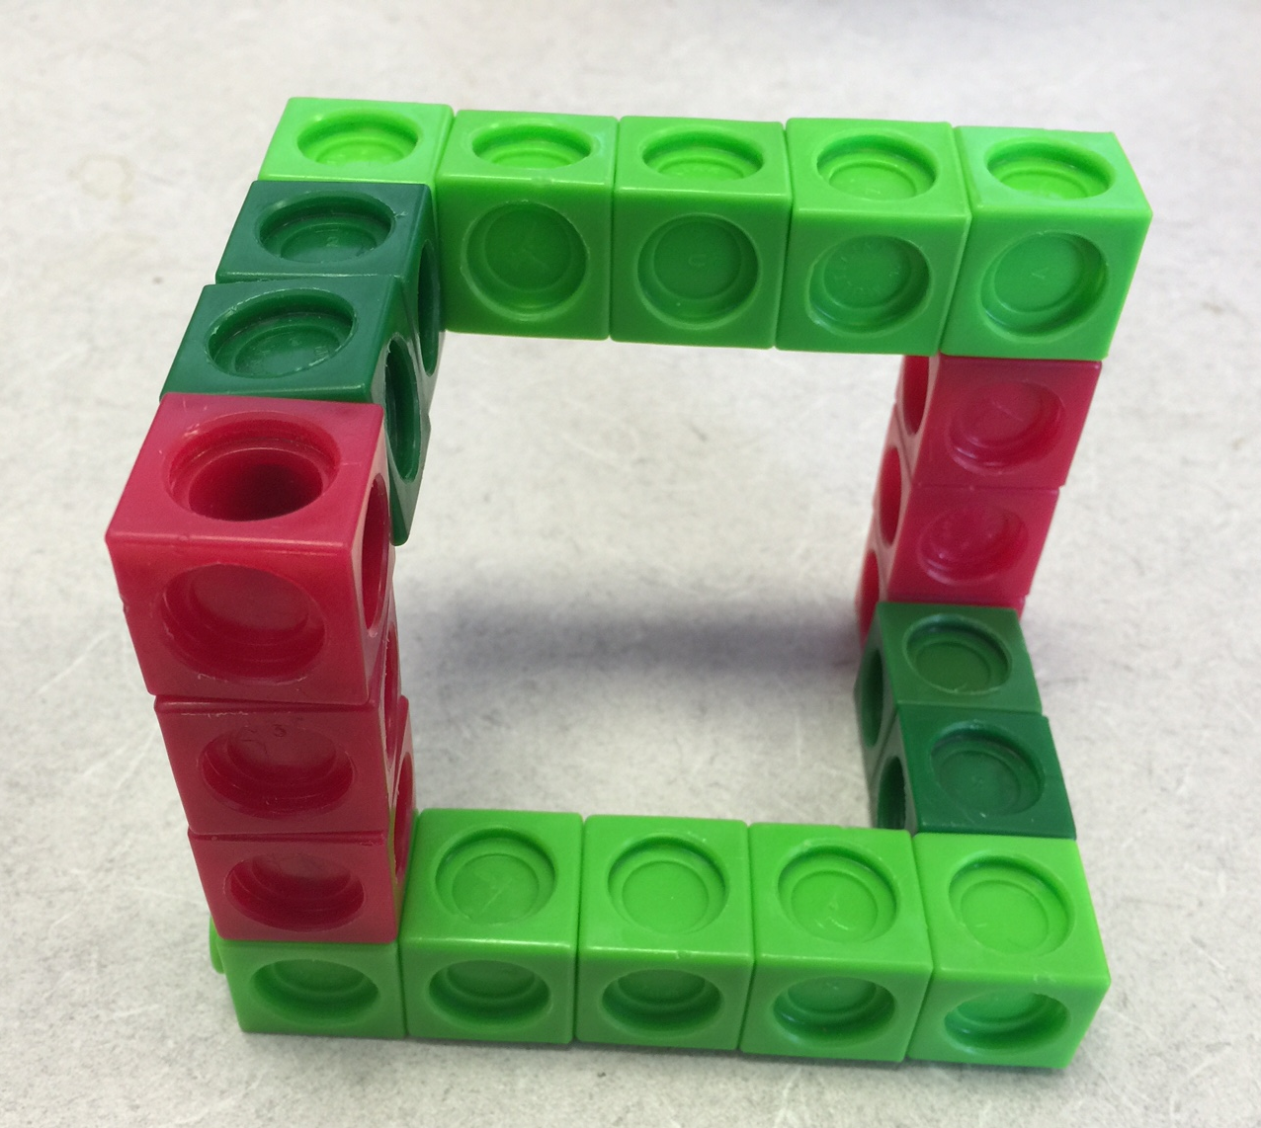
Can these patterns be explored in 3-dimensions? Example: 5, 2, 3
+5 (x axis)
+2 (y axis)
+3 (z axis)
–5 (x axis)
–2 (y axis)
–3 (z axis)
z
y
x
B

Slide 29
Level 3 inquiry:
Can you design and build a 3-D pattern?
3
2
5
B

Slide 30
Recursive engineering
B

Slide 31
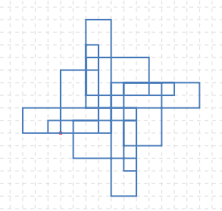
Let’s try the first digits of pi on this site.
3,1,4,1,5,9,2,6,5,3,5
http://dev.chrislusto.com/loops/
B

Slide 32
A,B = 1
C,D = 2
E,F = 3
G,H = 4
I,J = 5
K,L = 6
M,N = 7
O,P = 8
Q,R = 9
S,T = 10
U,V = 11
W,X = 12
Y,Z= 13
What does your name or initials look like?
http://dev.chrislusto.com/loops/
H

Slide 33
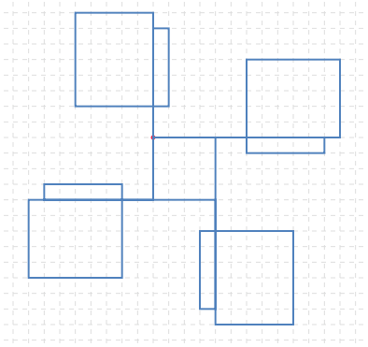
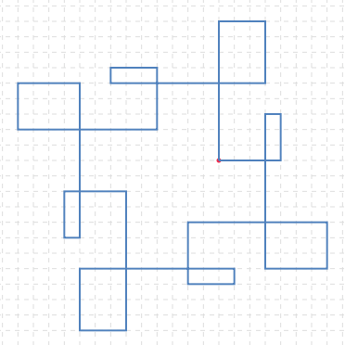
What does your name or initials look like?
A,B = 1
C,D = 2
E,F = 3
G,H = 4
I,J = 5
K,L = 6
M,N = 7
O,P = 8
Q,R = 9
S,T = 10
U,V = 11
W,X = 12
Y,Z= 13
WILLIAM
HEATHER
http://dev.chrislusto.com/loops/
H

Slide 34
Recursion- mathematically
Always has a starting value
3
Same rule applied indefinitely
3, 6, 12, 24, 48… what’s the rule?
What if you need the 100th term?
Explicit formula
B

Slide 35
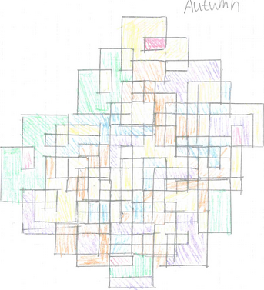
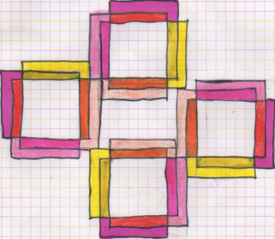
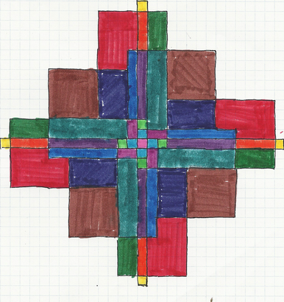
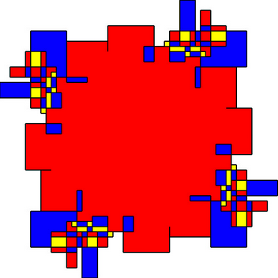
Visual art and patterns
H

Slide 36
How can these be explored more artistically?
B

Slide 37
Process
B

Slide 38
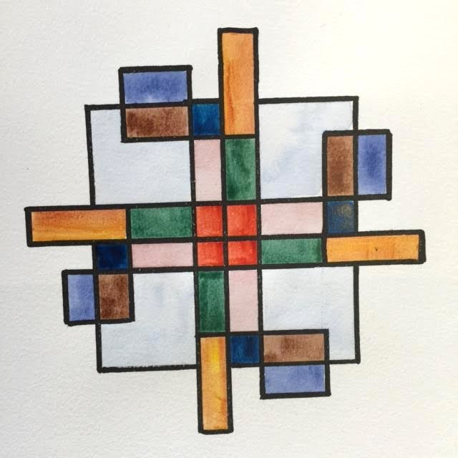
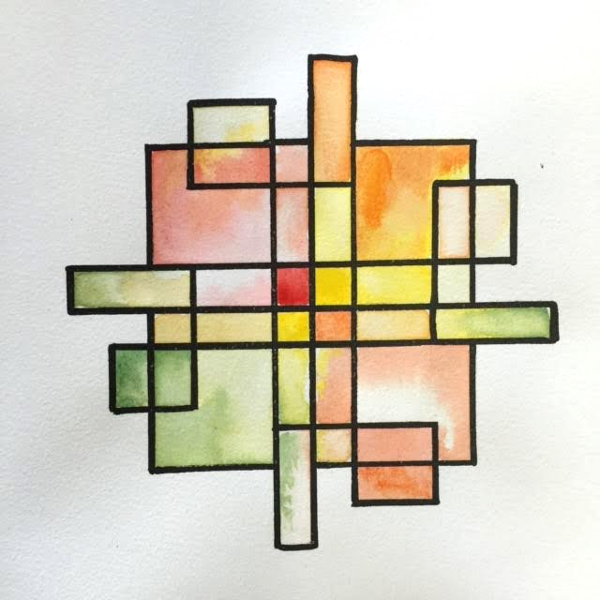
Design process/ iterations
B

Slide 39
What is “recursion”?
Latin: recurrere or recursio (run back)
English (1930s): recur
The repeated application of a procedure
B

Slide 40
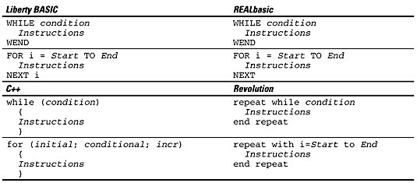
B

Slide 41
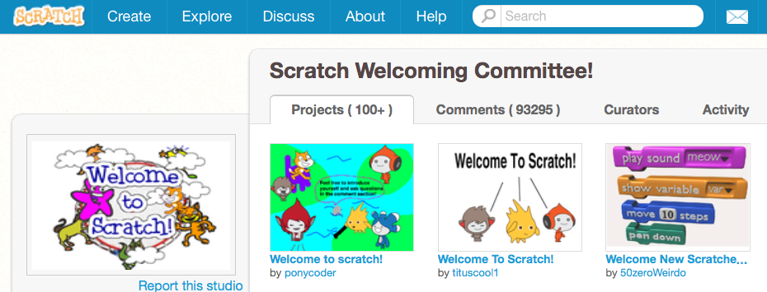
How can students learn to code programs to draw images like these?
https://scratch.mit.edu/projects/84212628/
B

Slide 42
Pros of inquiry based learning
Automatic differentiation
Fast learners aren’t “done”- they explore their next question
High engagement
Choice=empowerment
H

Slide 43
This STEAM presentation
Science: inquiry questions & inquiry practice are at the heart of NGSS
Technology: Introduction to Scratch programming & recursive thinking
Engineering: structures & design process/ iterations
Art: unique & beautiful images that can be explored digitally or in traditional ways
Math: “Look for and make use of regularity in repeated reasoning.”, “Make use of structure.”, “Attend to precision”, “Make sense of problems and persevere in solving them.” “Generate and analyze number patterns and relationships.”
H

Slide 44
What would you like to explore?
6:20 share out what you discovered
H

Slide 45
Recursive art & inquiry
PROJECT
heather gaiera & bill Funkhouser
DATE
1/8/16
Client
steam conference

