Slide 1
North Coast Arts Integration Project
A four year collaboration between HSU, Eureka City Schools and
Klamath Trinity Joint Unified School District
B

Slide 2
What is arts integration?
Arts
Curriculum
Arts
Integration
Core
Curriculum
B

Slide 3
What is the grant?
$2.2 million budget federally funded through U.S. Department of Education's Arts in Education Model Development and Dissemination program
Grant targets eight schools
Provides training, coaching and technology to better teach CCSS through the integration of music, drama, dance and visual arts
B

Slide 4
Timeline
Phase one: Zane, Winship, Hoopa Valley and Trinity Valley 6-8 students.
Phase two: four ECS elementary schools & elementary grades in KT
B

Slide 5
What does it look like?

Slide 6
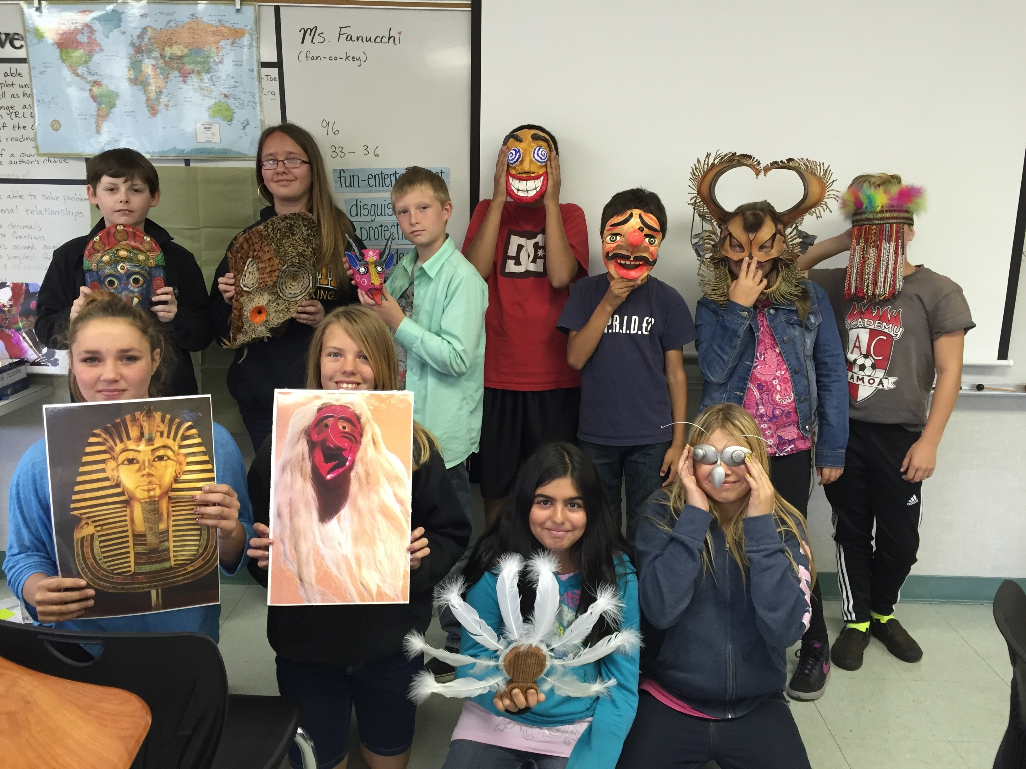
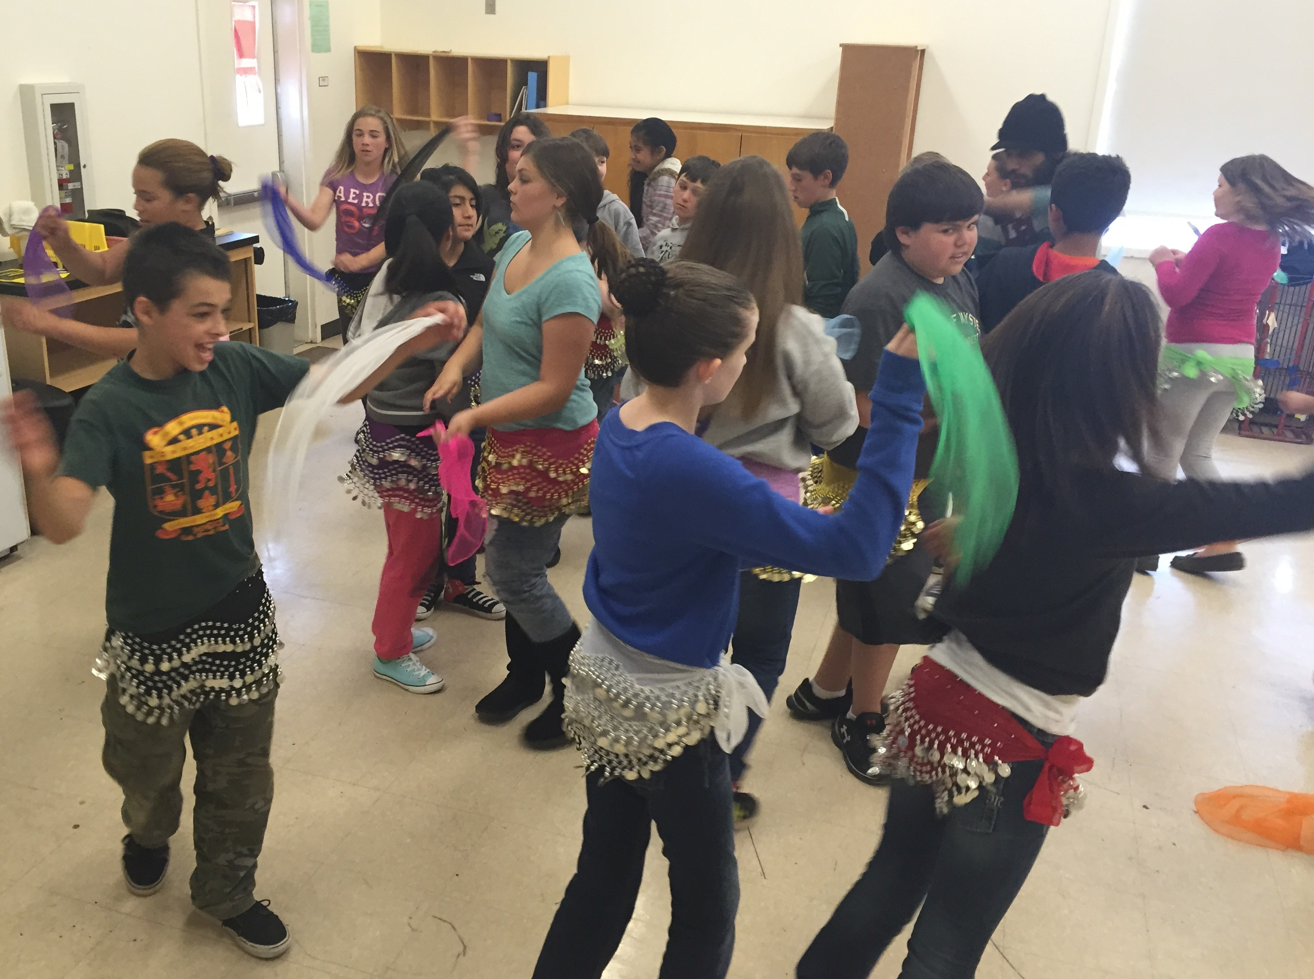
Pilot integration projects
H

Slide 7
Paul Klee and place value
in grade 1
B

Slide 8
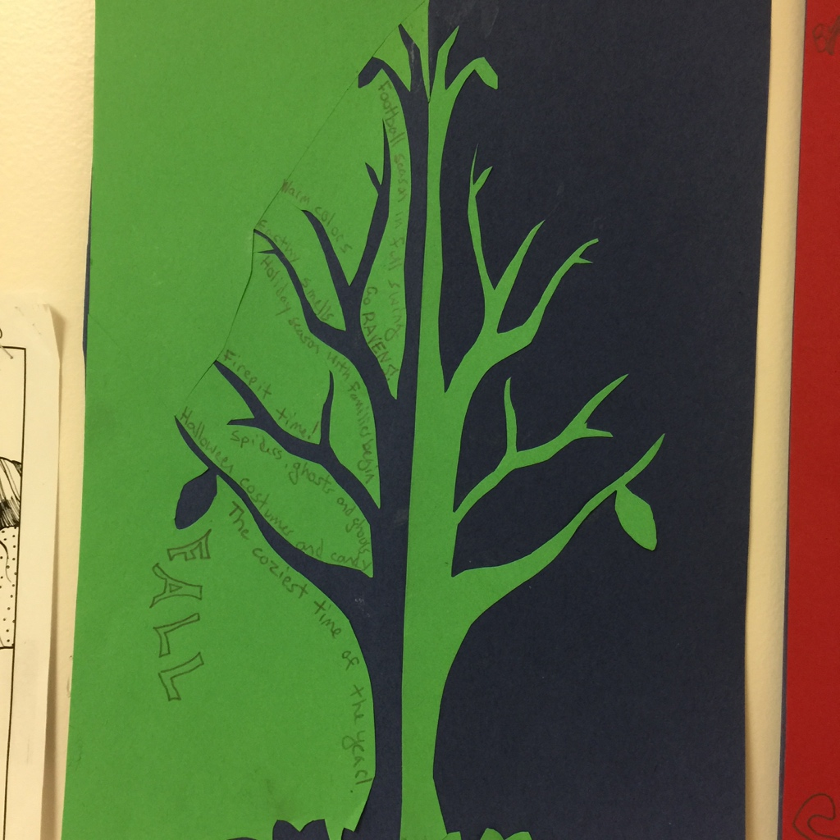
Japanese “notan” art in
Language Arts class
B

Slide 9
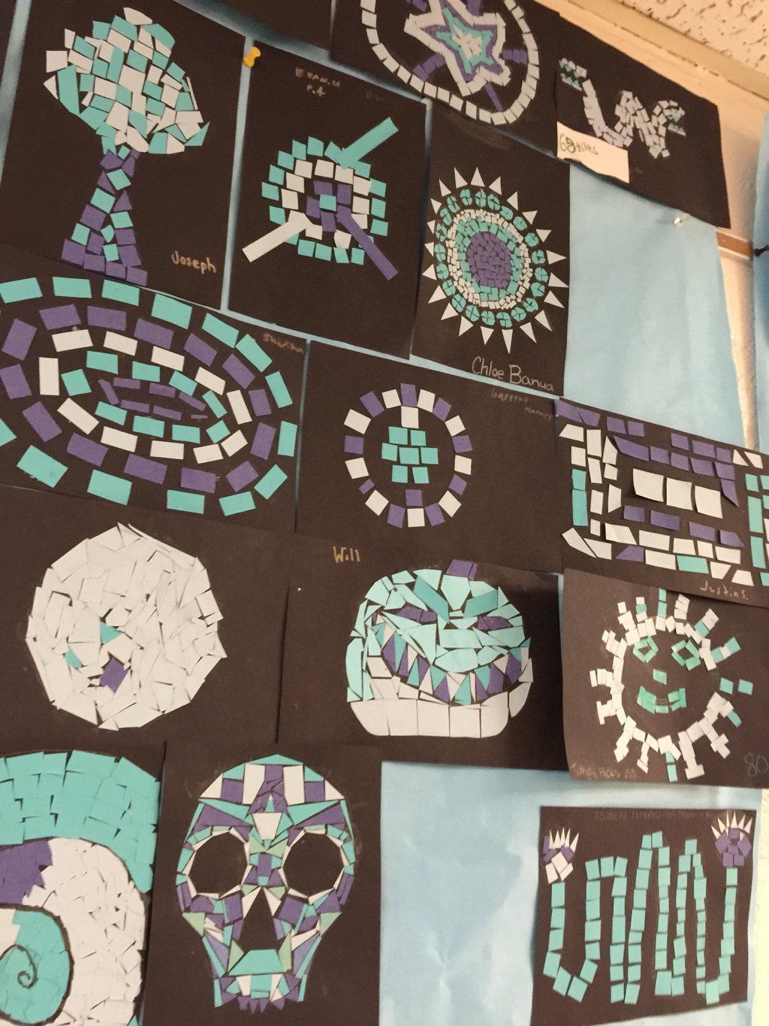
Mezo-American tile art
in grade 6 math class
B

Slide 10
Why arts integration?
CCSS (by design) require deep understanding of concepts best achieved by integrating various content areas
H

Slide 11
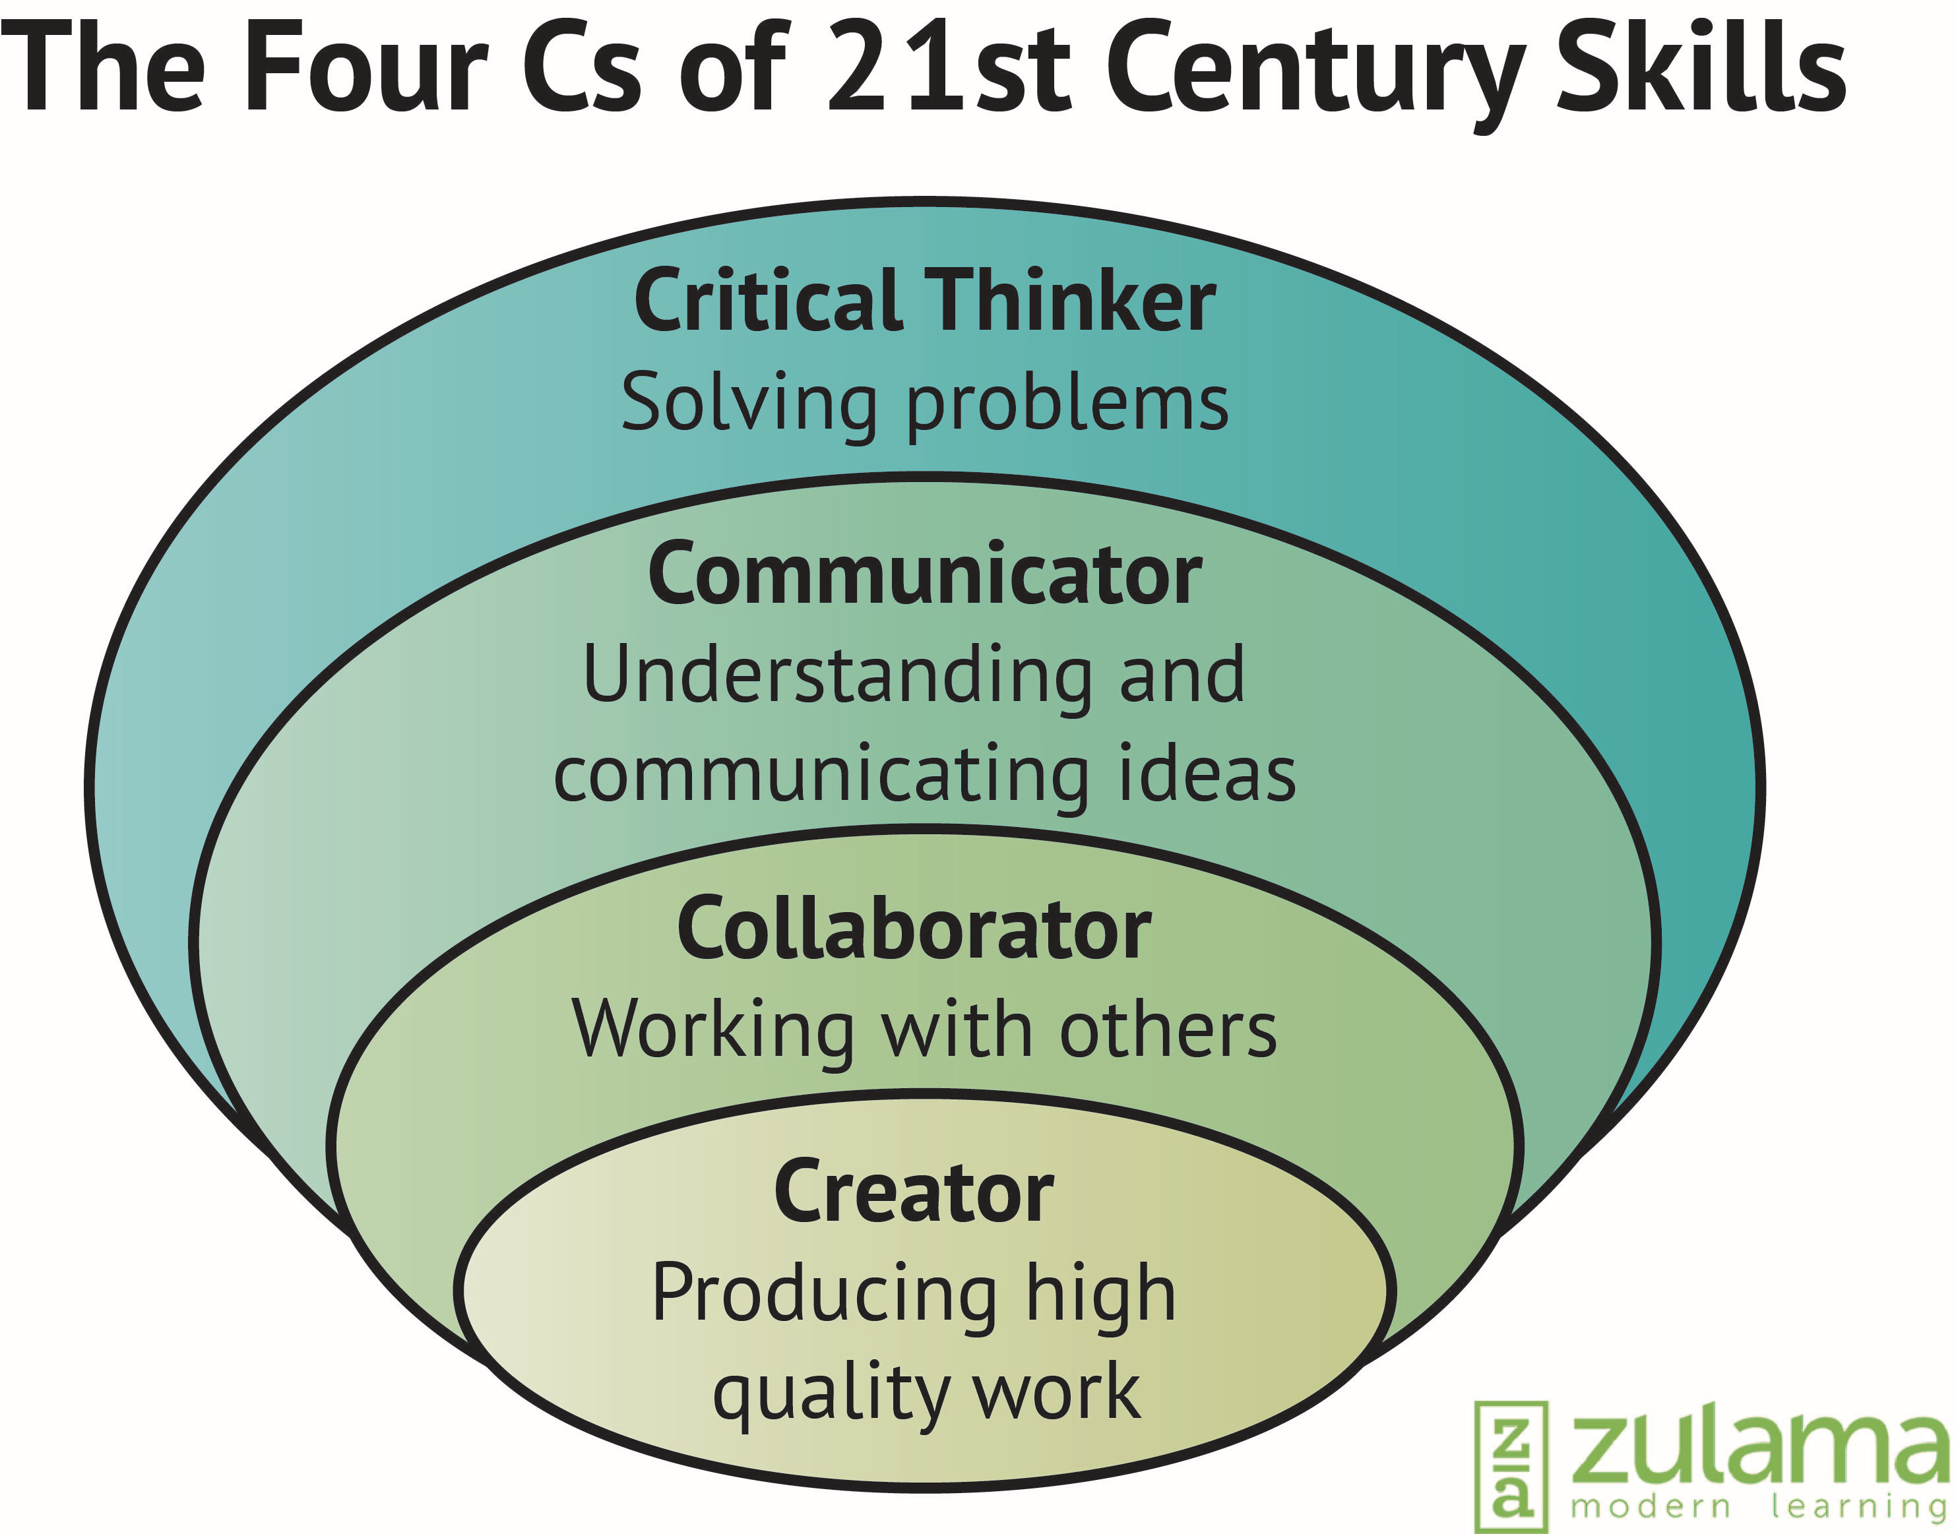
Why arts integration?
Provides access points to engage a diverse student population and connects their world to the classroom
Develops 21st century skills in communication, collaboration, creativity, critical thinking, perseverance and innovation
H/B
H

Slide 12
Why arts integration
Low income children involved with arts integration are 4 times more likely to have high academic achievement than those who don’t.
Without
Arts
With
Arts
B

Slide 13
Why arts integration
Low income children involved with arts integration are 3 times more likely to have high attendance than those who don’t.
Without
Arts
With
Arts
B

Slide 14
Why arts integration
94% of teachers gained “additional ways of teaching critical thinking skills” through arts integration
94%
Journal for Learning Through the Arts 2014
H

Slide 15
Why arts integration
Arts integration techniques that use multiple senses are correlated with more information stored in long term memory.
Journal for Learning Through the Arts 2014
H

Slide 16
Goals of the project & what can be expected
Improve student mastery of Science, Math, Reading and Writing.
Implement effective arts integration lessons in the classroom.
Increase student engagement.
Increase student involvement in creating, performing and responding to the arts.
Develop a sustainable and replicable arts integration model.
H/B

Slide 17
This project strengthens…
PBIS/ restorative justice
STEAM/ 21st Century Skills
CCSS/ NGSS
Culturally Relevant Teaching
ELA/ ELD framework
District Instructional Norms
H

Slide 18
Opportunities
Visiting Artists come to your school for performances/ presentations
Collaborating Artists plan longer units with you so students can connect an art form to another subject.
Students experience visual art, theatre, music or dance through a field trip.
B

Slide 19
Opportunities
Personal tablet computer for each teacher
Tablets for your school
Technology training
Extended education credits available
H
B

Slide 20
Site Leader | Teacher Participant
Training: 2 Days PD during this year, 2 day STEAM conference January 8-9, 2016 4 Day Summer Institute 2016 Regular meetings
Tablet computer & projector connection for your use
Implement arts integrated lessons & artist collaboration starting 2016-17
Summer Institute participant/ presenter | Summer Institute Participant
Be contact/ organizing person Document regular contact with teacher participants | Attend regular meetings to discuss progress
3 year commitment | 1 year renewable
$1000 per 12 month year (1/2 in Dec then 1/2 in June) | $500 per year (paid in June)
H

Slide 21
Should you get involved?
Do you want your students to be creative problem solvers who persevere through the demands of weaving multiple ideas into a final project that demonstrates understanding of core standards?
Do you enjoy collaboration, research, and intentional alignment of your curriculum in ways that challenge and engage students?
B/H

Slide 22
“Arts Integration pulls it all together. It allows students to express their creativity, and their love of music, art, drama, and theater. It gives them choices as they develop their literate and scientific minds. As a result, students feel more valued, and a valued child remains engaged. “
- Eureka City School NCAIP Site Leader
B

Slide 23
What are some positive things about this project that excite you?
H

Slide 24
Please fill out the consent form & questionnaire and
indicate your desired participation level.
Site leader or
Teacher participant or
Not interested at this time
Please note the instructions on question #3

Slide 25
Next steps:
We will review your forms and contact you soon.

Slide 26
Carmen Lomas Garza

Slide 27
CCSS Reading
Anchor Standard #1
Read closely to determine what the text says explicitly and make logical inferences from it.
Cite specific evidence to support conclusions.
H

Slide 28
Read, write and speak grounded in evidence
Construct viable arguments
Engage in argument from evidence
H

