Slide 1
ART VOCABULARY REVIEW
Medium
The material a work of art is made from. _________, _________, and _________ are examples of mediums.
Form
What we actually see in a work of art; the __________ and __________, for example.
Content
The __________ of a work of art; what the artwork __________ to the viewer.
Notes:
STUDENTS HAVE REVIEWED “WHAT DRIVES A CIVILIZATION’ Focus on art; transition to HOW WE TALK ABOUT ART. WHAT I SEE; WHAT I THINK I MEANS
Art Vocabulary Sheet
Form: line, shape, color, texture, balance, pattern
Content: message, meaning, communicates, expresses
Paper, paint, wood, etc.

Slide 2
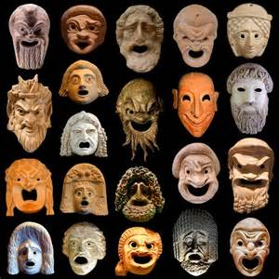
History Alive! Masks from Ancient Civilizations
Notes:
Egypt
Greece
Rome

Slide 3
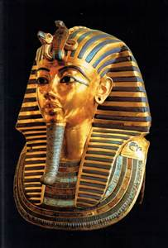
EGYPT Tutankhamen or “King Tut” Mummy Case or Mummy Mask Medium: gold with inlaid gem stones
FORM
Visual Elements
Line
Shape
Color
Principles of Design
Balance
Pattern
Notes:
Tutankhamen (“King Tut”), who died at the age of eighteen, is the best-known Egyptian ruler because his was the only Egyptian tomb discovered in modern times with most if its contents intact. Egyptians believed in eternal life of the soul. The more material wealth that you were surrounded by in the afterlife, the better off you’d be. Hence, the pyramids, mask, jewels. This mask or mummy case is made from gold and inlaid gem stones. Do you remember reading about mummies in the textbook? What Visual Elements and Principles of Design do you see?

Slide 4
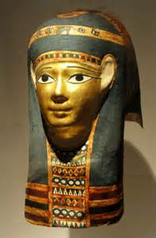
EGYPTIAN MUMMY CASE OR MUMMY MASK
Note that this mask reflects the Principle of Design: _________.
Pattern is the repetition of visual elements such as shape.
Where do you see Pattern on the mask?
What Visual Elements create the Pattern?
Line
Shape
Color
Notes:
What are the shapes? Symbols: shapes that have a deeper meaning particular to the culture, that

Slide 5
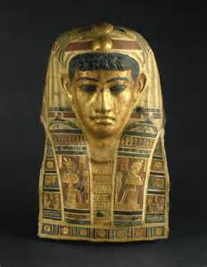
EGYPTIAN MUMMY CASE OR MUMMY MASK
Note that this mask reflects the Principle of Design: __________.
Balance can be symmetrical or asymmetrical.
Symmetrical: when two halves of an artwork are __________.
Asymmetrical: when two halves of an artwork are_________.
Notes:
Balance
Alike, similar
Unequal
Is the mask symmetrical or asymmetrical?
Stand up and pose your body symmetrically; then asymmetrically

Slide 6
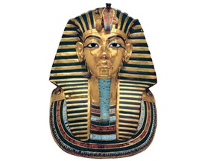
Essential Questions
CONTENT
How does the use of __________ affect your perception of the ruler the mask represents?
What does the mask tell you about the culture it was created in?
Notes:
Balance
We can conclude that the mask has line, shape and color that creates balance and pattern.

Slide 7
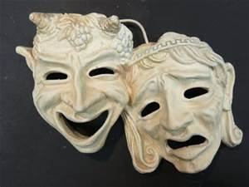
GREECE Greek “Comedy and Tragedy” Masks Medium: Linen, leather, wood or cork
FORM
Visual Elements
Line
Shape
Texture
Principles of Design
Balance
Pattern
Scale and Proportion
Notes:
INTRODUCTION OF TWO NEW TERMS: Texture, Scale and Proportion
Used in Greek dramas to reflect emotion of a character. Men were only allowed to perform. Performance spaces were enormous; masks helped audience to see emotion of character.

Slide 8
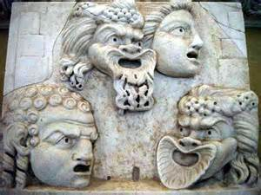
Greek Drama Mask Sculptures
Note that these masks reflect the Principles of Design: __________, __________, _________ and __________.
Scale is the size _______ of one thing to another.
Proportion is the size relationship of _______ to a __________.
Notes:
Balance, pattern, scale and proportion.
Relationship
Parts, whole
Large scale mouths acted as megaphones. Turn to page 284. Look at the Greek theatre. Why do you think the mouths are out of proportion (so much larger)?

Slide 9
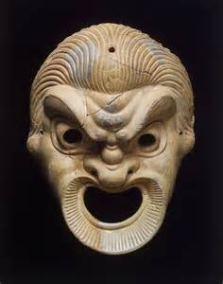
ESSENTIAL QUESTIONS
CONTENT
How does the use of __________ and __________ affect your interpretation of the mask?
What does the mask tell you about the culture it was created in?
Notes:
Scale and Proportion
What do you see? What does it mean?

Slide 10
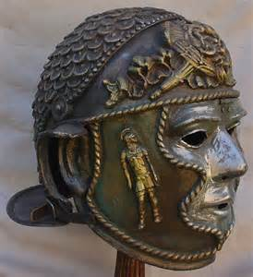
ROME Roman Helmet Mask Medium: Bronze
FORM
Visual Elements
Line
Shape
Texture
Principles of Design
Balance
Pattern

Slide 11
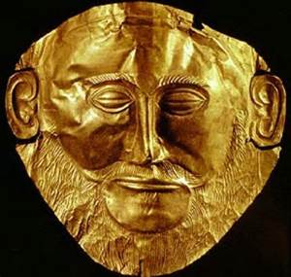
ROMAN PORTRAIT MASK Medium: Metal
The Visual Elements _________, _________, and __________ are creating the
Principles of Design __________ and __________.
Notes:
Line, Shape and Texture
Balance and Pattern

Slide 12
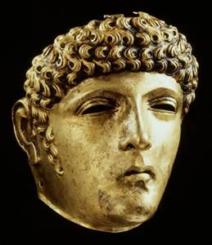
ROMAN PORTRAIT MASK Medium: Bronze
The Visual Elements _________, _________, and __________ are creating the
Principles of Design __________ and __________.
Notes:
Line, Shape and Texture
Balance and Pattern

Slide 13
Essential Questions
FORM AND CONTENT
What Visual Elements and Principles of Design do you see?
What does the mask tell you about the culture it was created in?
Notes:
What do you see? What does it mean?
What do you remember reading about Rome and the Roman Empire that is reflected in this mask?

