Slide 1
Artful Thinking Strategies
From Project Zero, an educational research group at the Harvard Graduate School of Education
B

Slide 2
Who we are
Bill Funkhouser: Math & Art
Heather Gaiera: Elementary and Science
Now: North Coast Arts Integration Project
B

Slide 3
Goals today
Provide foundational thinking strategies for any classroom on any day
Guarantee minimal preparation and no clean up
Increase engagement, creativity and critical thinking in your classroom
Use these four techniques in your class tomorrow
B

Slide 4
Artful Thinking Purposes
Reasoning- cite evidence
Perspective taking- understand point of view
Questioning and investigating- What if, how, why?
Observing and describing- elaborating
Connecting new ideas to prior knowledge- extend
Finding complexity- uncover multiple dimensions
B

Slide 5
Think outside the boundaries of these examples.
B

Slide 6
Beginning,
Middle or End?
Observing & describing
Connecting new ideas to prior knowledge
Perspective taking
Purpose:
Bloom’s Taxonomy
B

Slide 7
Beginning, Middle, End
If this is the beginning of a story, what happens next?
If this is the middle of the story, what happened on either side of this moment?
If this is the end of the story, what was the story about?
H

Slide 8
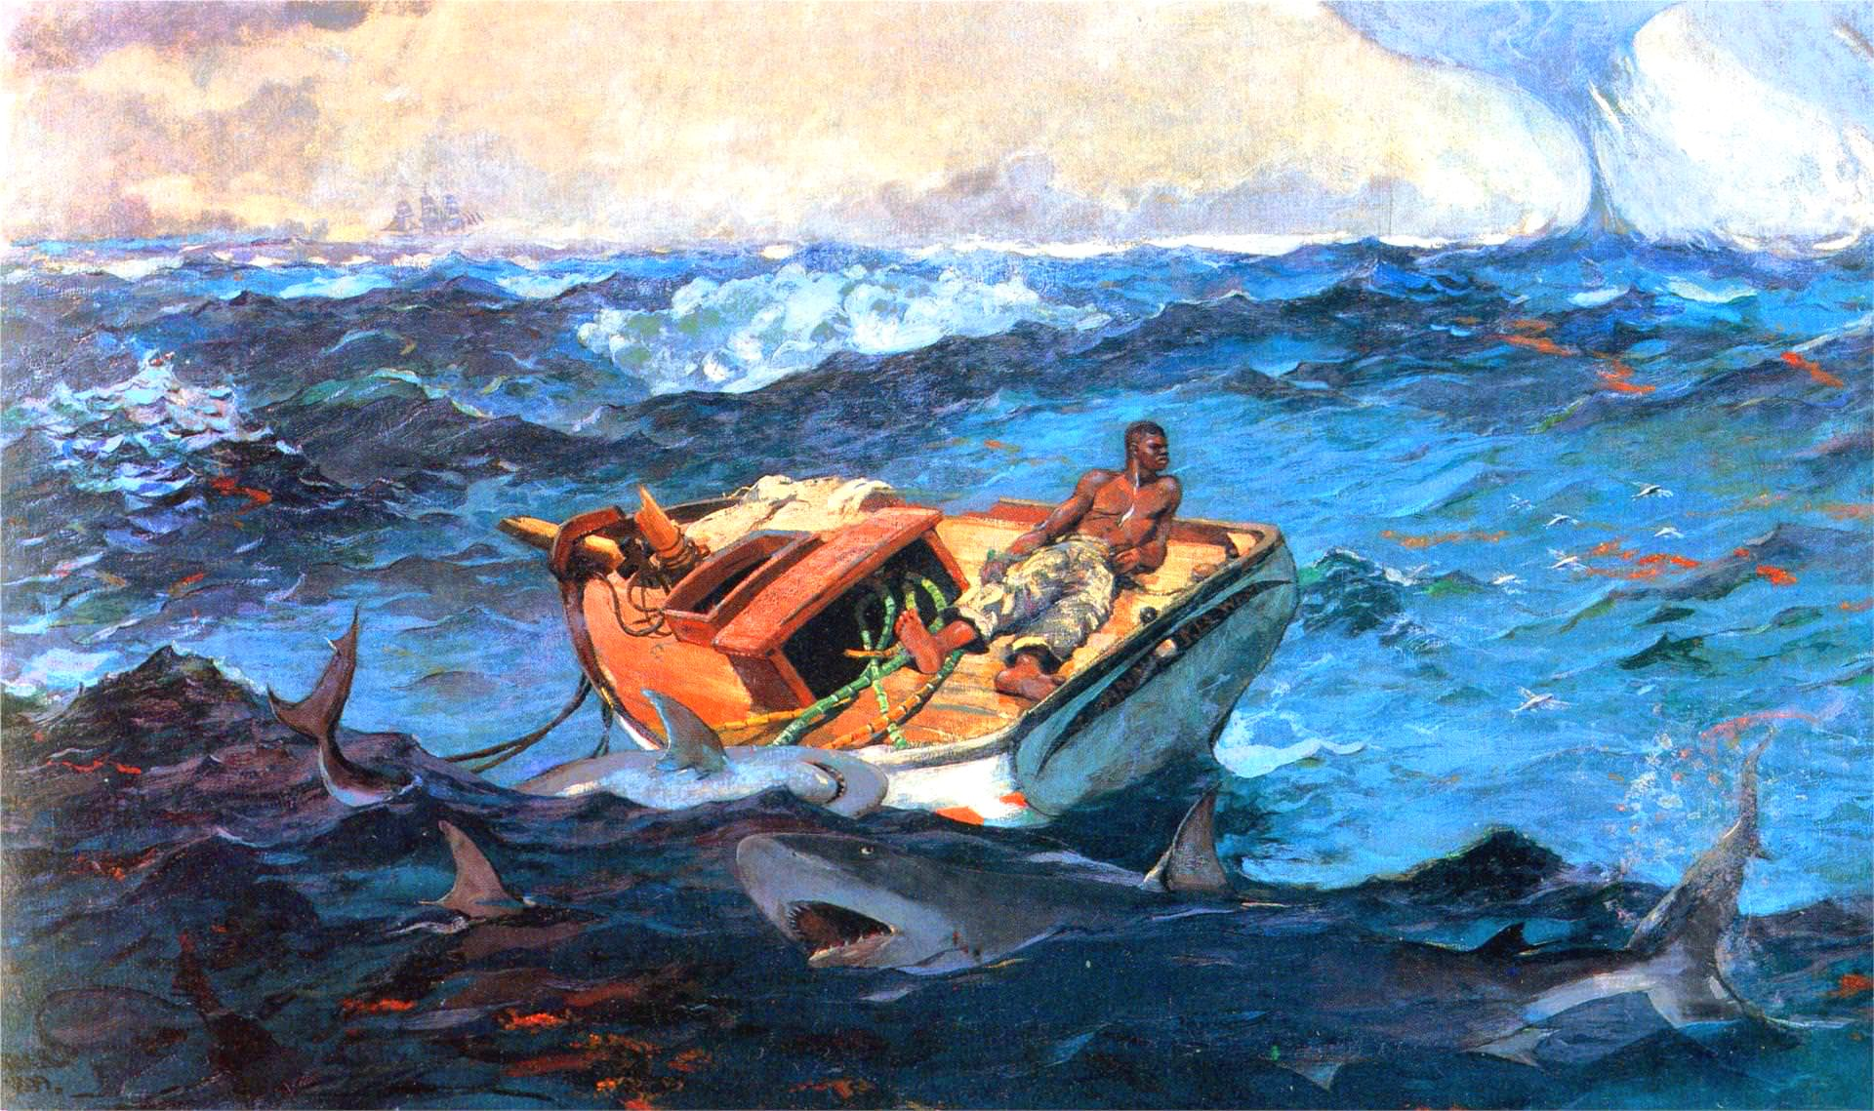
Look closely to write a beginning, middle or end story that uses details you can point to in this image
H

Slide 9
Winslow Homer
“The Gulf Stream”
1899
B

Slide 10
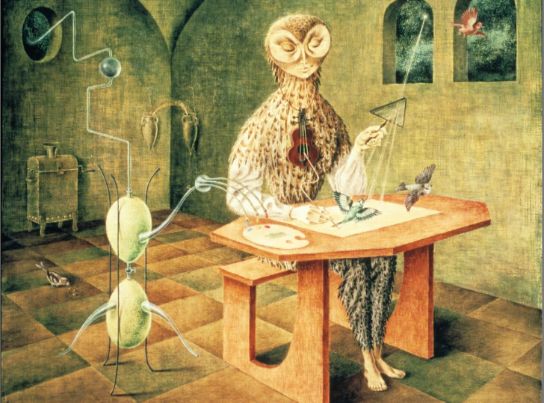
Look closely to write a beginning, middle or end story that uses details you can point to in this image
B

Slide 11
Writing Anchor Standard #3
Write narratives to develop real or imagined experiences of events using effective technique, well-chosen details and well-structured event sequences.
H

Slide 12
Telephone*
Observing & describing
B

Slide 13
B

Slide 14
Telephone
Structured student talk that is primarily descriptive
Reinforces vocabulary concepts
“Receiver” has back to screen and sketches the image
The caller describes the image using as many of the vocabulary words as possible
Math words: parallel, isosceles, scalene, radius
Art words: gradation, solid tone, overlap, shape
B

Slide 15
Ready?

Slide 16
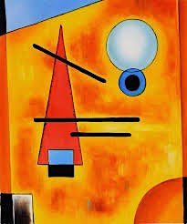
parallel
isosceles
scalene
radius
gradation
solid tone
overlap
shape

Slide 17
Wassily Kandinsky,
Russian painter
and art theorist
B

Slide 18
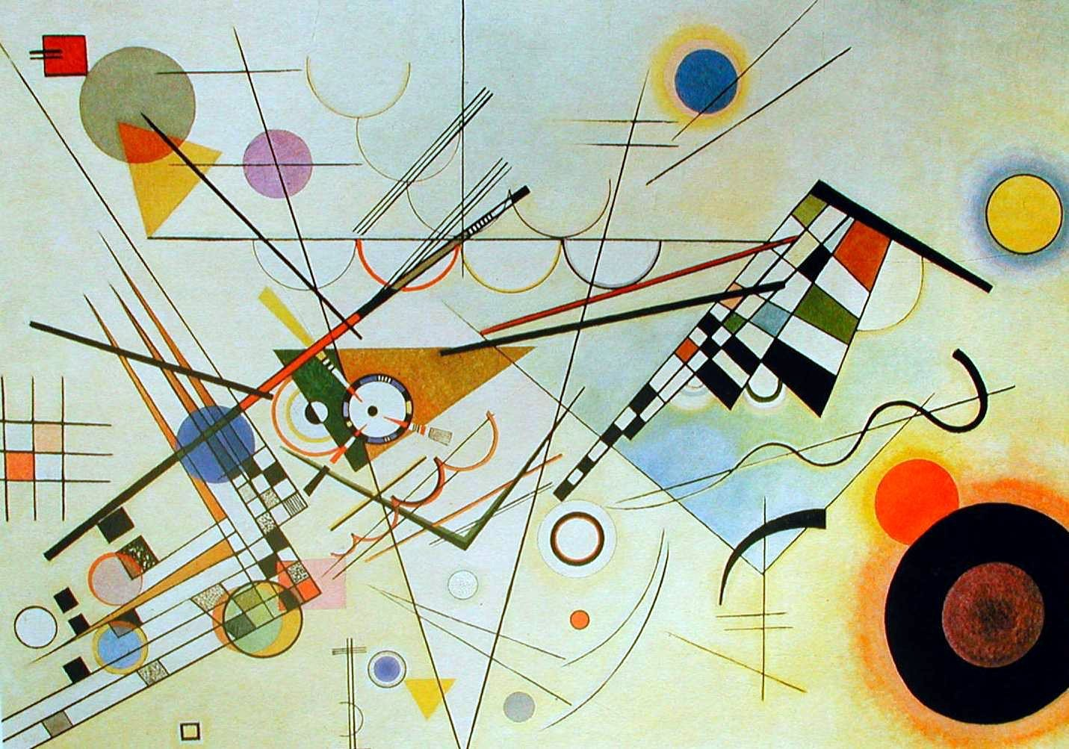
B

Slide 19
Telephone
Excellent strategy for ELL (prepositions, etc)
Extension: produce creative work from a given description with differentiation
Assessment piece
H

Slide 20
Speaking and Listening Anchor Standards #1, 2, 4
Participate in a range of conversations with diverse partners
Integrate and evaluate information presented visually and orally
Present information so that listeners can follow the line of reasoning and organization
H

Slide 21
What Makes
You Say That?
Reasoning
B

Slide 22
What makes you say that?
Start with observation period
Describe what is going on in this picture
You will be asked to support your inference with evidence
H

Slide 23
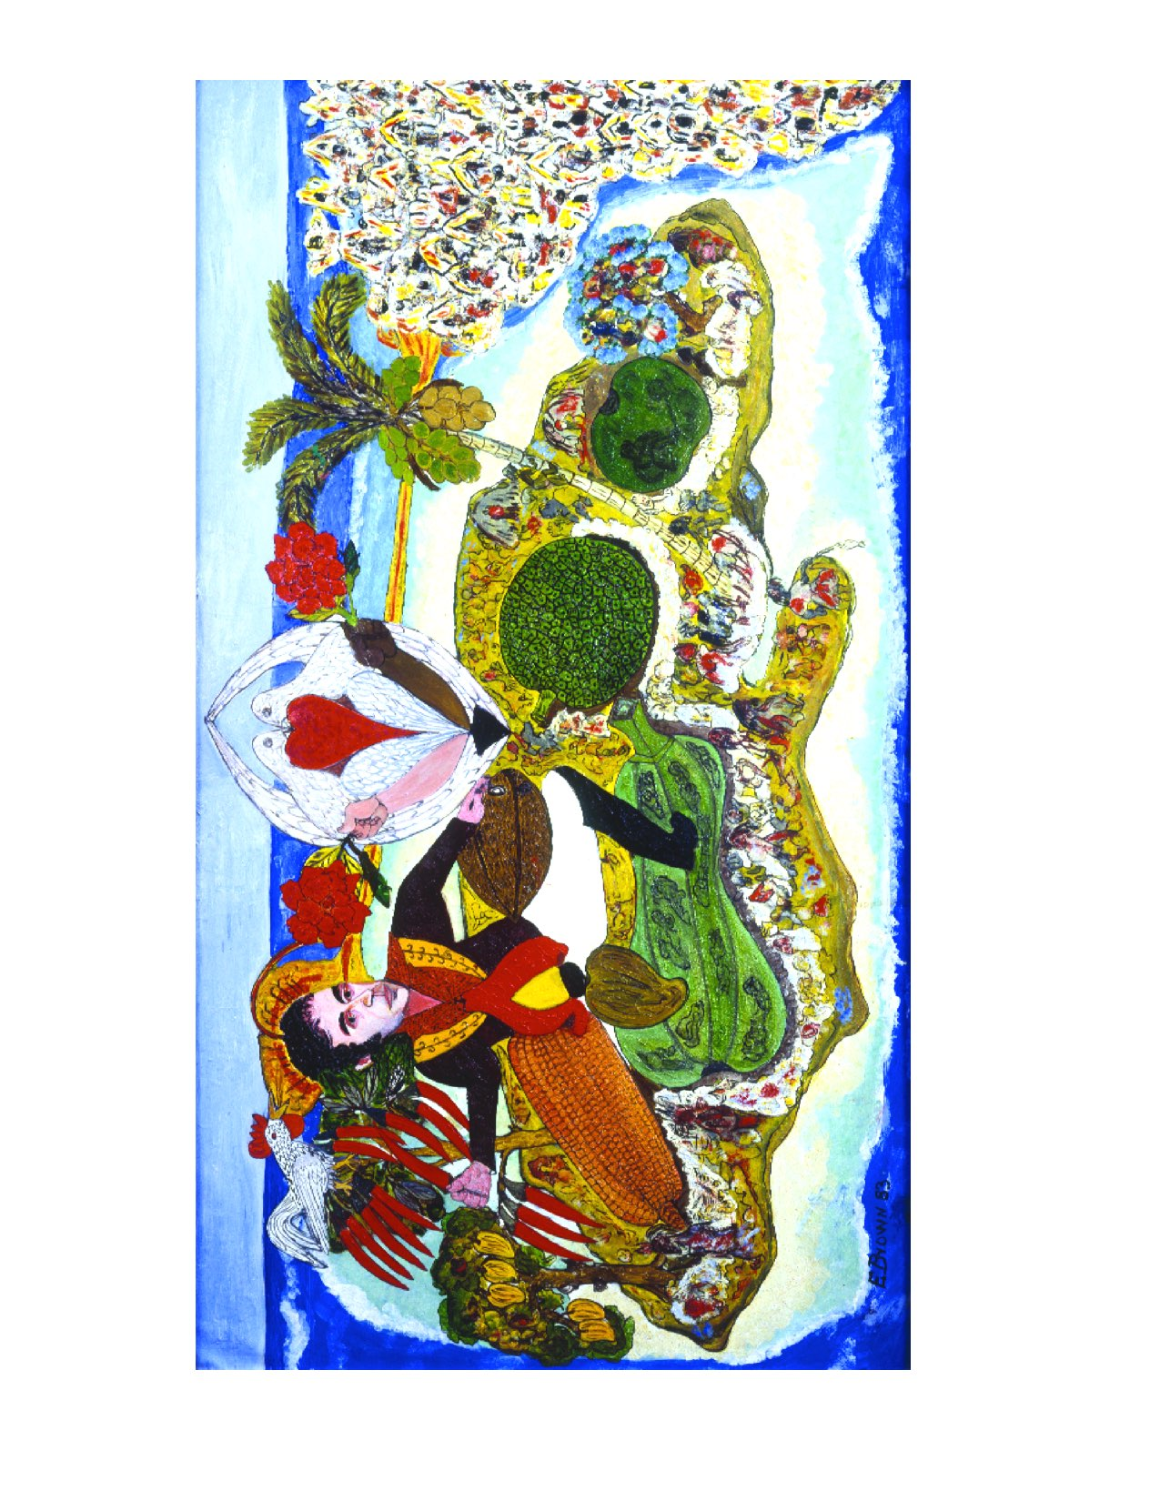
Look carefully at this artwork for 60 seconds.
What do you see that makes you say that?
What do you think is going on here?
H

Slide 24
B

Slide 25
B

Slide 26
THE ASCENSION OF SIMÓN BOLÍVAR ON MOUNT JAMAICA
Everald Brown, a Jamaican artist, painted this portrait of Símon Bolívar in 1983, depicting him larger than life standing on the island of Jamaica. Bolívar is dressed in military regalia and is surrounded by the rich natural resources of the island. In each hand he is holding typical Jamaican produce—a red chili and a coconut. The right side of the painting shows Africa which for centuries was also dominated by colonialism and oppression. This painting may be symbolic of Bolívar’s dream that the spirit of independence, unity, and freedom from colonial rule would travel to and inspire the African colonies. Symbols of the beliefs and ideals Bolívar represents to the artist include two birds that form a heart and white and black arms each holding a rose bouquet as offerings of hope for freedom, equality, and liberation.
B

Slide 27
Three questions
What is going on in this picture?
What do you see that makes you say that?
What more can you find?
B

Slide 28
What is going on in this picture?
Assumes the art has meaning and expects the viewer to read it for this meaning
Inquiry model
Open ended responses
No right or wrong answers
Every interpretation rests on the next question
H

Slide 29
What do you see that makes you say that?
Can change wording to “what can you point to…” or “what evidence do you have for this viewpoint”
Students justify their thinking with evidence
Tremendous value in verbalizing what visual clues led to a particular opinion or hypothesis
B

Slide 30
What else can you find?
Can always go deeper
No limit to the depths of conversation that can be had about the artist, the meaning of the work, why it was made, the intended audience, etc.
Students are used to “You are right…next!” rather than a cycle of hypothesis, justification and further exploration.
H

Slide 31
EVIDENCE
H

Slide 32
Read, write and speak grounded in evidence
Construct viable arguments
Engage in argument from evidence
H

Slide 33
Learning to read
Learning to cite evidence
Images are the original communication method and are critical when learning new skills
B

Slide 34
See, Wonder, Think
Observing & describing, reasoning
H

Slide 35
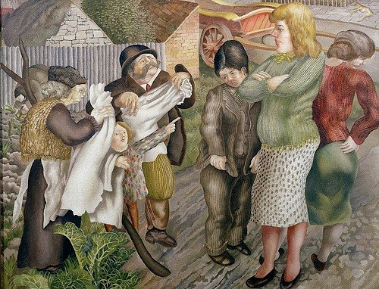
Look carefully at this artwork for 60 seconds.
Describe what you see objectively.
What do you think/ hypothesize?
What do you wonder about?
HB

Slide 36
See, Wonder, Think
See: observation and description
Wonder: process the image sufficiently to come up with a question
Think: construct a hypothesis
Some teachers separate these into separate sections (3 things you see, then 3 things you wonder, etc)
Can combine See, Wonder, Think into one sentence
B

Slide 37
“Village Life”
Painting by
Sir Stanley Spencer
1939/1940
B

Slide 38
CCSS Reading
Anchor Standard #1
Read closely to determine what the text says explicitly and make logical inferences from it.
Cite specific evidence to support conclusions.
H

Slide 39
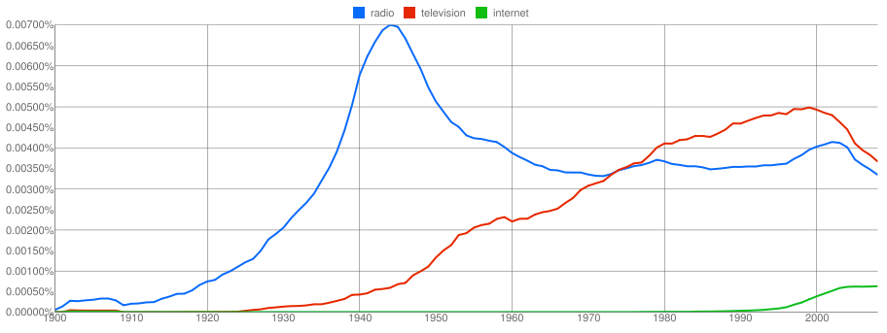
The use of the words “radio”, “television” and “internet” in books 1900-2000
H

Slide 40
See, Wonder, Think w/ David Cooper
teachingchannel.org/videos/thinking-routine-getty
B

Slide 41
Where can you get images?
Online search
_____________ + “painting” or “sculpture”
getty.edu displays art at amazing resolution
Artwork in text is more than decoration
H

Slide 42
Your goal
I can use the strategy called __________________
when teaching ______________
If searching the image online, I will use the following terms
____________________________
I will use this strategy on ________________ (date)
H

