Slide 1
What’s Going On In This Picture?
AKA ‘Visual Thinking Strategy”
H

Slide 2
What’s going on in this picture?
Start with observation period
Explain what is going on in this picture
You will be asked to support your inference with evidence
H

Slide 3
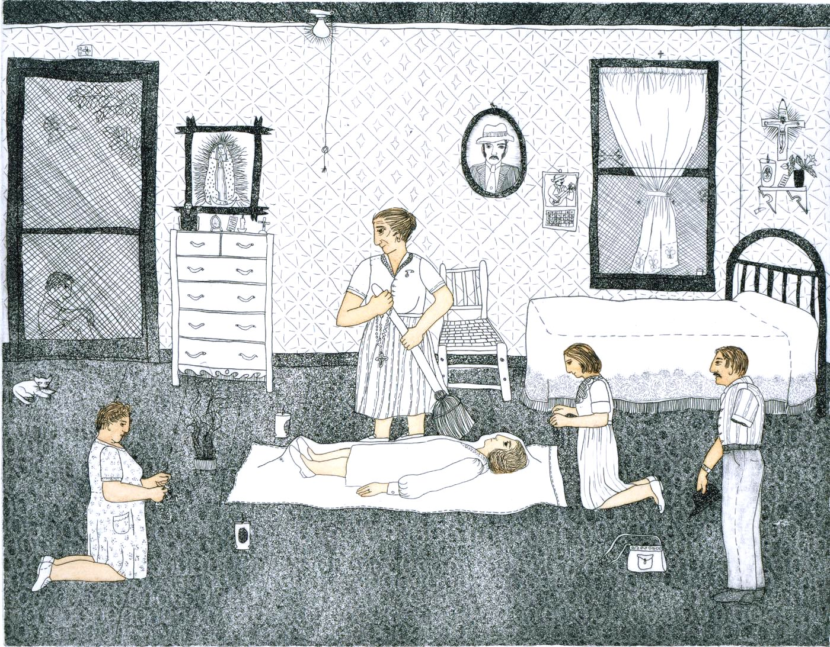

Slide 4
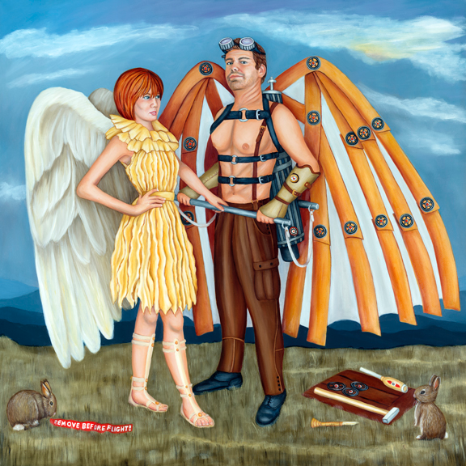
Dawna Boehmer
H

Slide 5
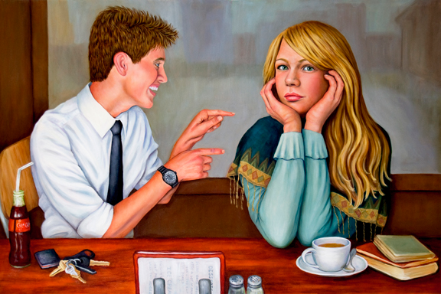
Dawna Boehmer
H

Slide 6
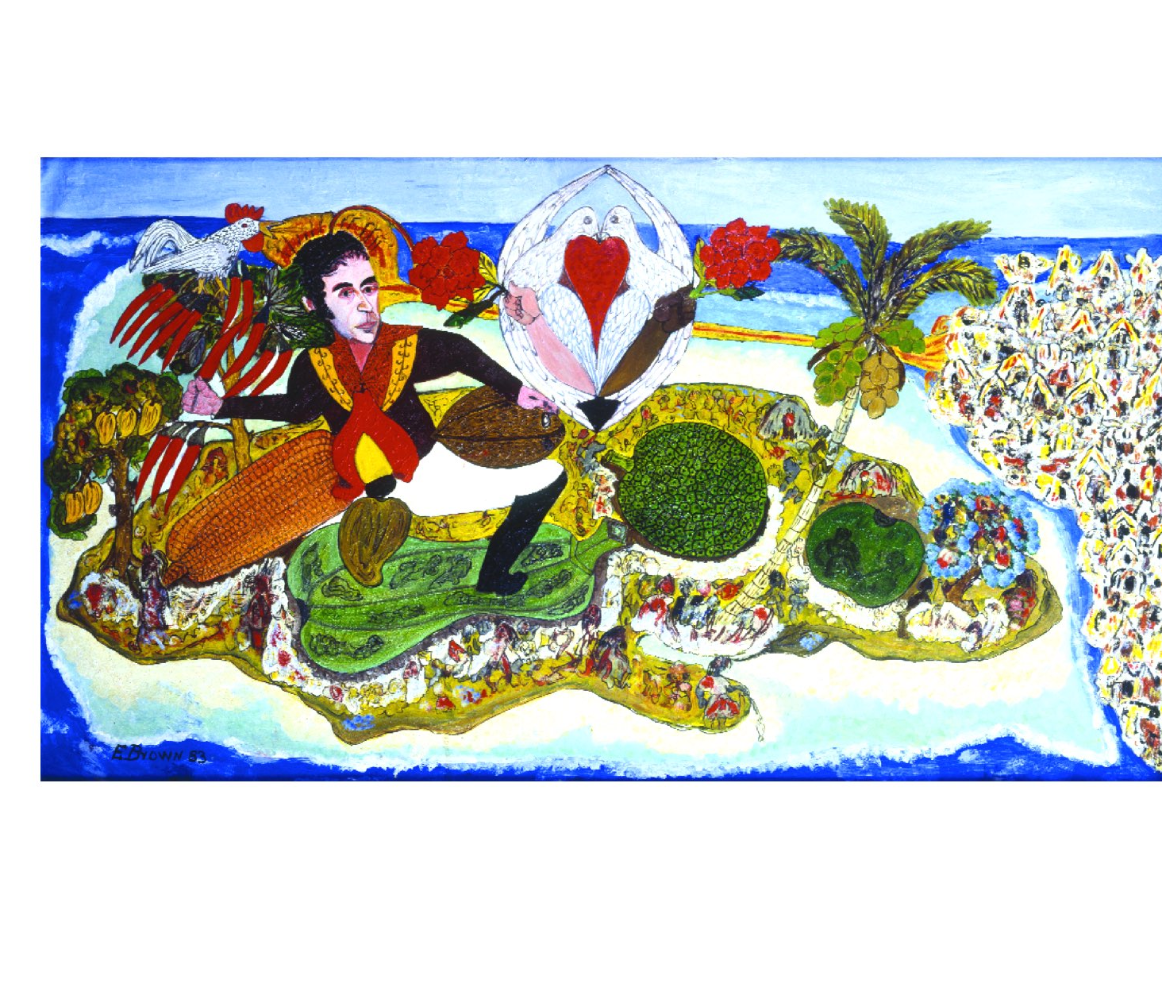
H

Slide 8
http://learning.blogs.nytimes.com/category/lesson-plans/whats-going-on-in-this-picture/?_r=0

Slide 9
Three questions
What is going on in this picture?
What do you see that makes you say that?
What more can you find?
B

Slide 10
What is going on in this picture?
Assumes the art has meaning and expects the viewer to read it for this meaning
Inquiry model
Open ended responses
No right or wrong answers
Every interpretation rests on the next question
H

Slide 11
What do you see that makes you say that?
Evidence
What can you point to?
Visual clues
B
Notes:
Can change wording to “what can you point to…” or “what evidence do you have for this viewpoint”
Students justify their thinking with evidence
Tremendous value in verbalizing what visual clues led to a particular opinion or hypothesis

Slide 12
What else can you find?
Can always go deeper
No limit to the depths of conversation that can be had about the artist, the meaning of the work, why it was made, the intended audience, etc.
Students are used to “You are right, next question” routine rather than a cycle of hypothesis, justification and further exploration.
Right!
Next!
H

Slide 13
CCSS Reading
Anchor Standard #1
Read closely to determine what the text says explicitly and make logical inferences from it.
Cite specific evidence to support conclusions.
H

Slide 14
Read, write and speak grounded in evidence
Construct viable arguments
Engage in argument from evidence
H

Slide 15
Learning to read
Learning to cite evidence
Images are the original communication method and are critical when learning new skills
B

