Slide 1
Visual Thinking Strategy
Start with observation period
Explain what is going on in this picture
You will be asked to support your inference with evidence
H

Slide 2
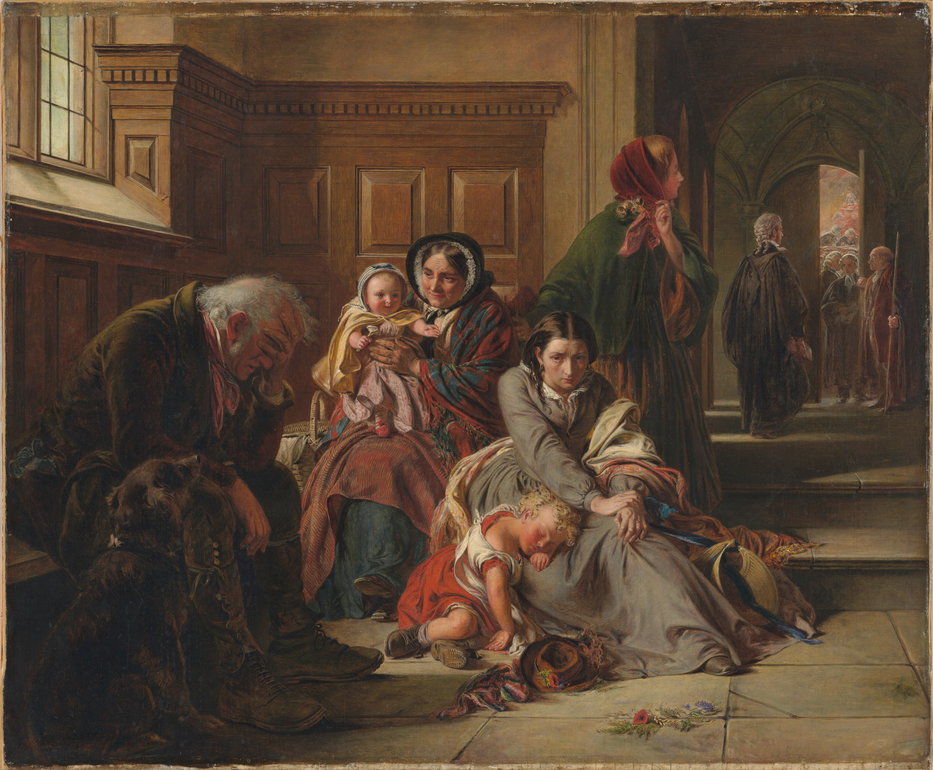

Slide 3
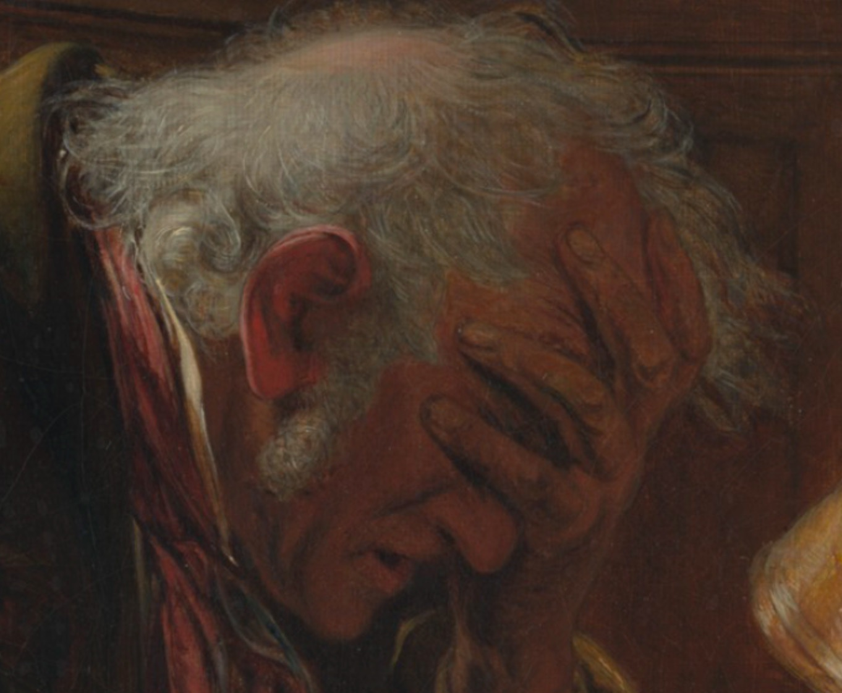

Slide 4
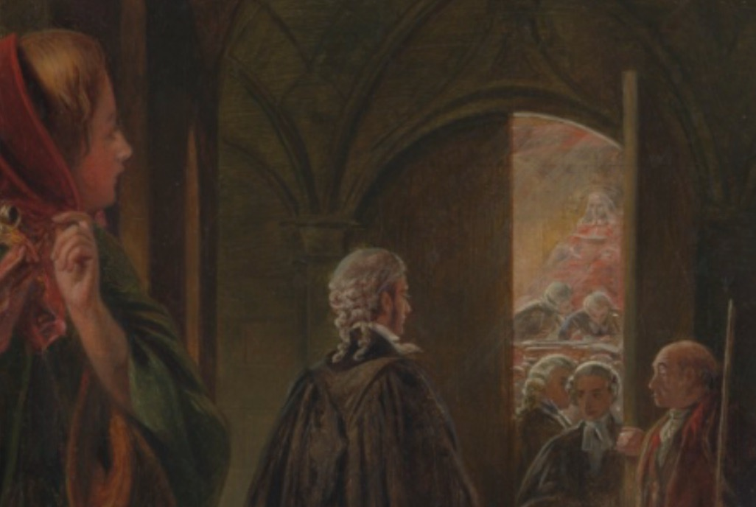

Slide 6
Waiting for the Verdict
by Abraham Solomon
1859

Slide 7
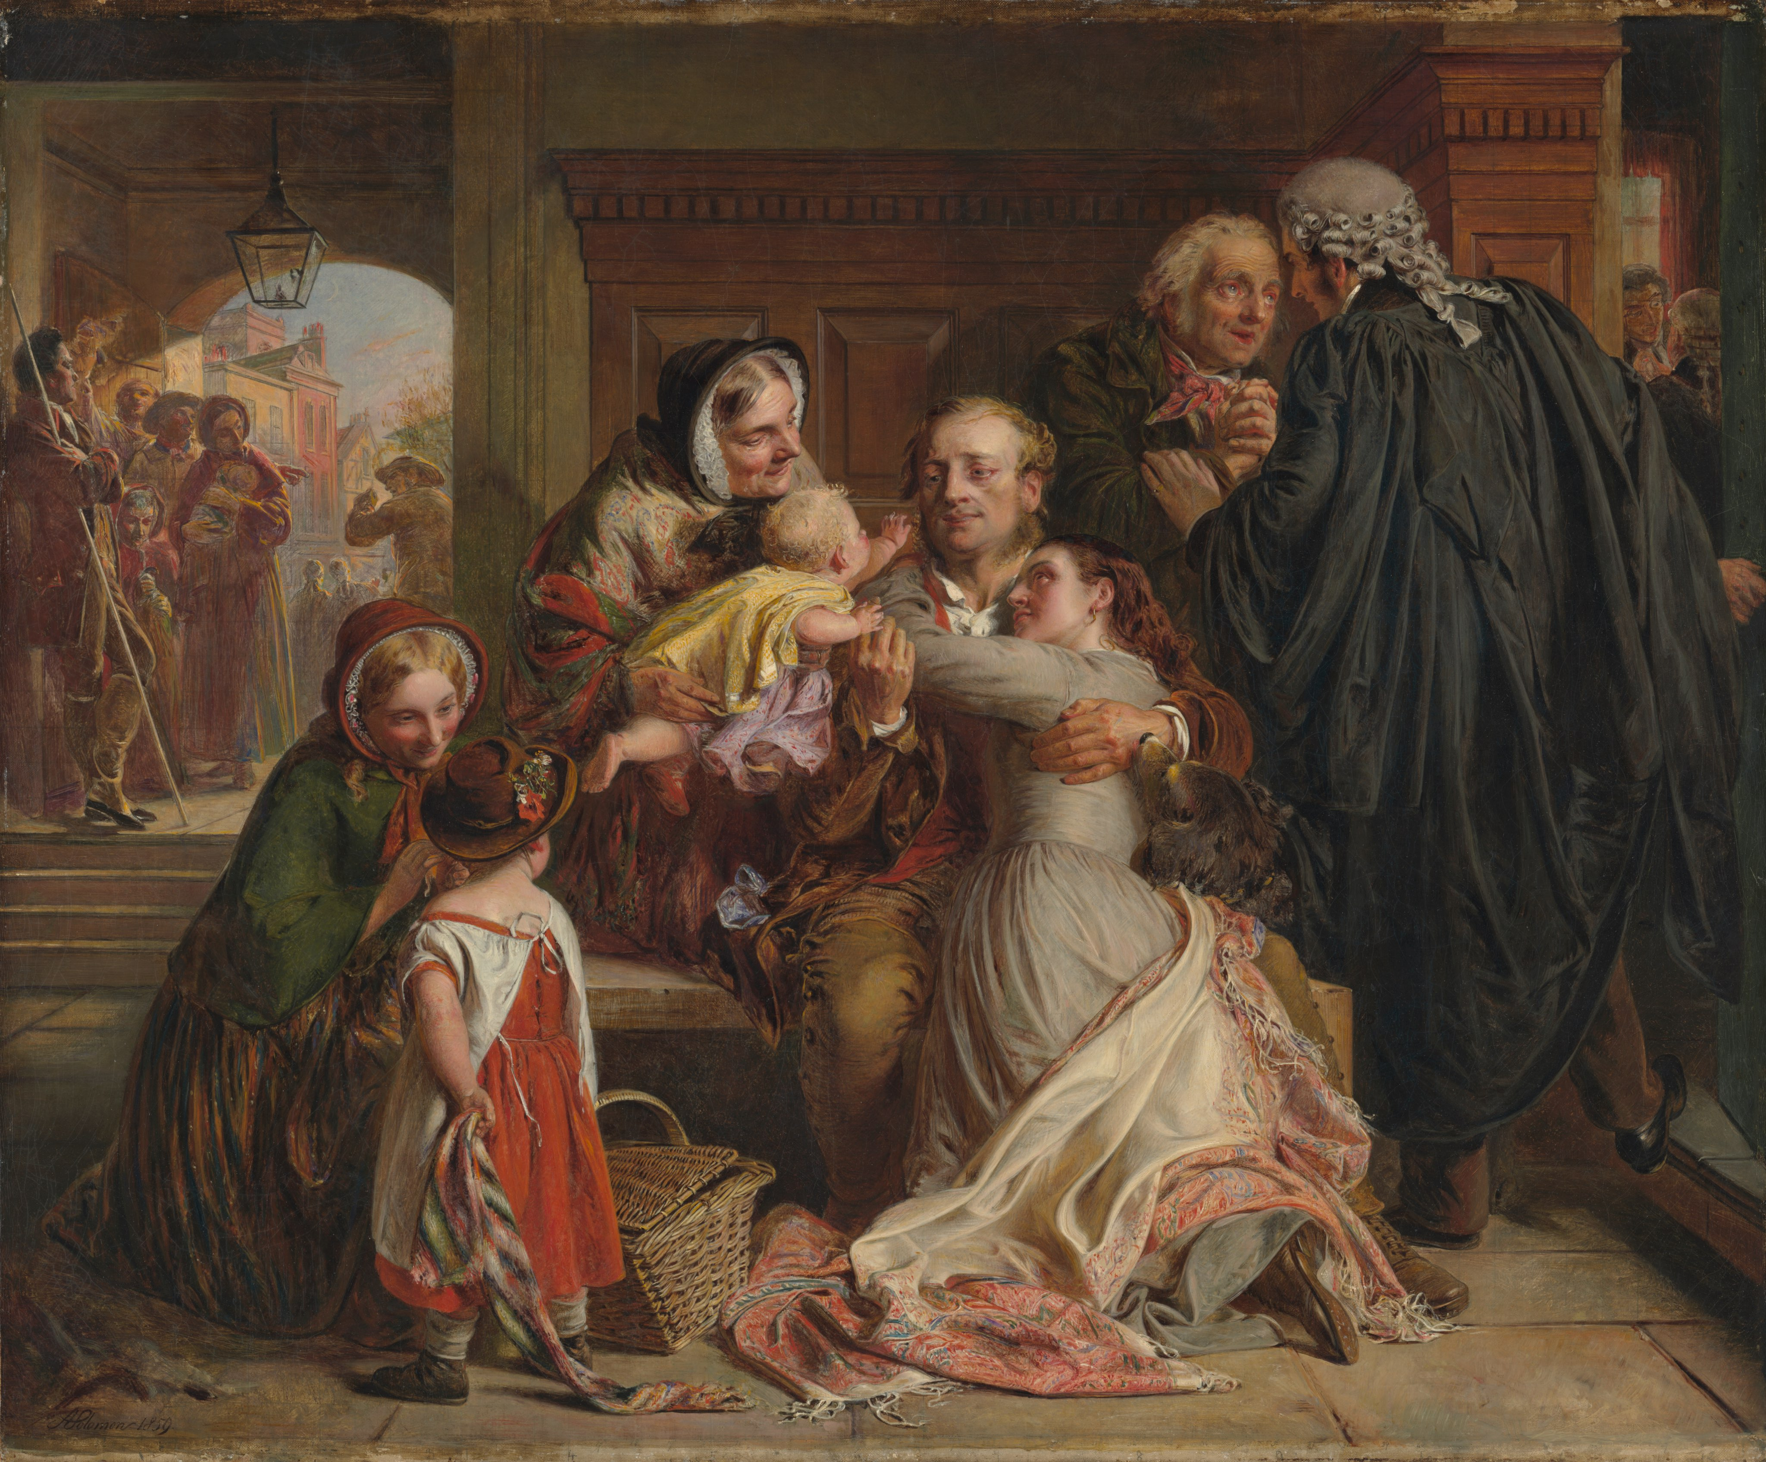

Slide 8
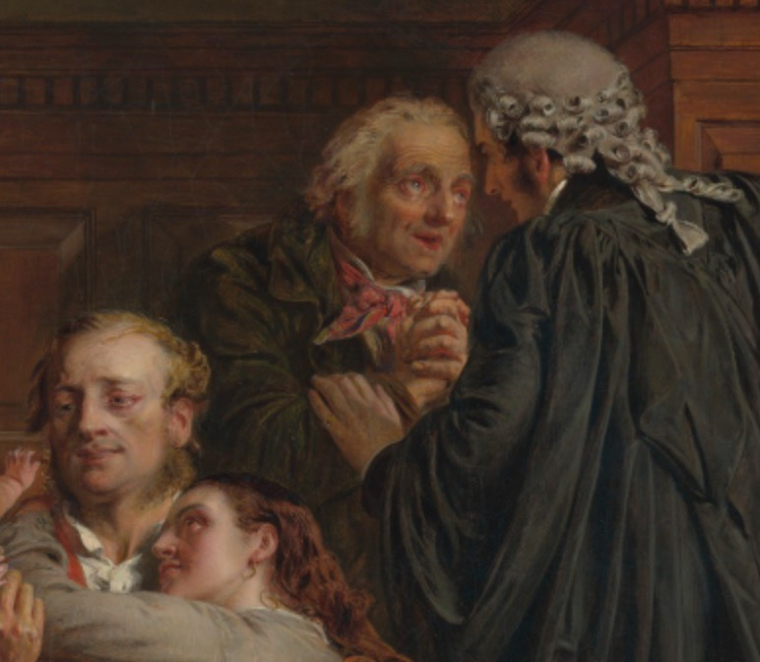

Slide 9
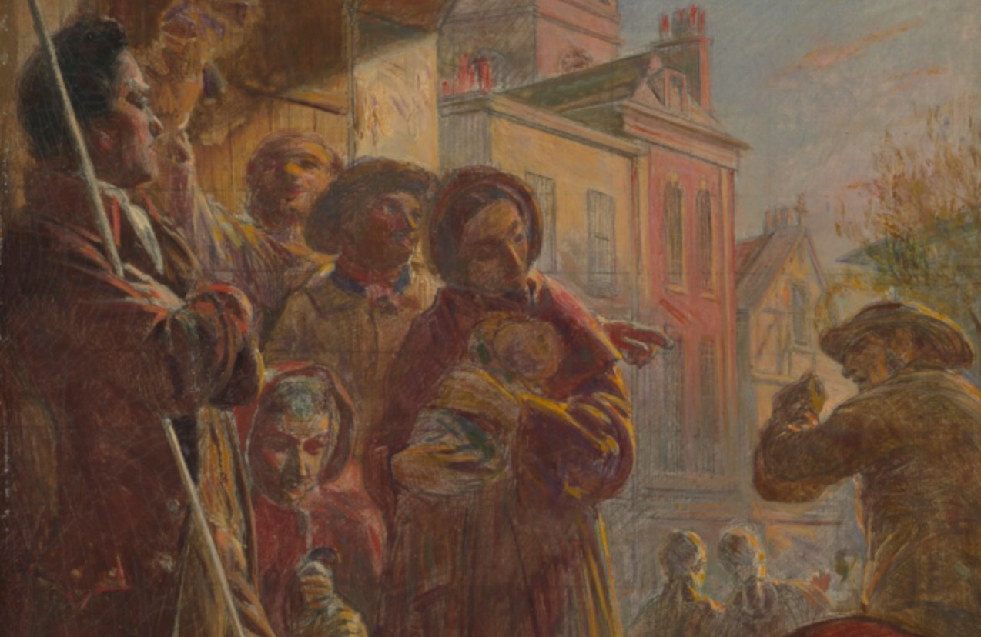

Slide 11
Not Guilty
by Abraham Solomon
1859

Slide 12
Three questions
What is going on in this picture?
What do you see that makes you say that?
What more can you find?
B

Slide 13
What is going on in this picture?
Assumes the art has meaning and expects the viewer to read it for this meaning
Inquiry model
Every interpretation rests on the next question
H

Slide 14
What do you see that makes you say that?
Evidence
What can you point to?
Visual clues
B
Notes:
Can change wording to “what can you point to…” or “what evidence do you have for this viewpoint”
Students justify their thinking with evidence
Tremendous value in verbalizing what visual clues led to a particular opinion or hypothesis

Slide 15
What else can you find?
Can always go deeper
Students are used to “You are right, next question” routine rather than a cycle of hypothesis, justification and further exploration.
Right!
Next!
H

Slide 16
CCSS Reading
Anchor Standard #1
Read closely to determine what the text says explicitly and make logical inferences from it.
Cite specific evidence to support conclusions.
H

Slide 17
Read, write and speak grounded in evidence
Construct viable arguments
Engage in argument from evidence
H

Slide 18
Learning to read
Learning to cite evidence
Images are the original communication method and are critical when learning new skills
B

Slide 20
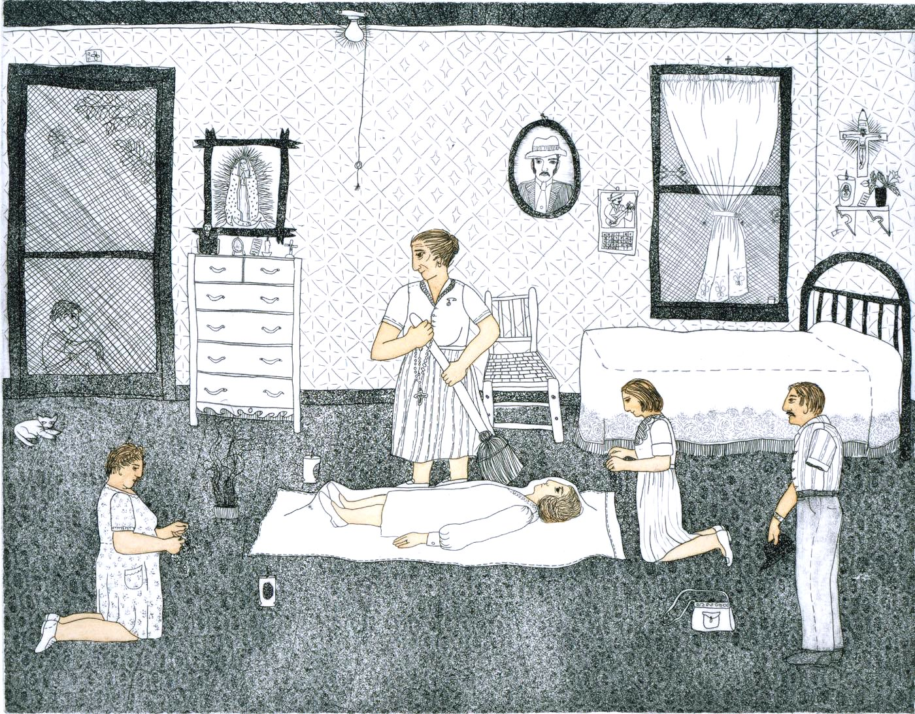

Slide 21
Dawna Boehmer
H

Slide 22
NY Times has “What’s going on in this picture” weekly

