Slide 1
See, Wonder, Think
B

Slide 2
Carmen Lomas Garza

Slide 3
B

Slide 4
Fermin Pena attempts to repair
a broken pipe in Caracas, Venezuela
AP Photographer: Rodrigo Abd
2012
B

Slide 5
See, Wonder, Think
See: observation and description (evidence first)
Wonder: process the image sufficiently to come up with a question
Think: construct an answer to your question
Some teachers separate these into separate sections (3 things you see, then 3 things you wonder, etc)
Can combine See, Wonder, Think into one sentence
1, 2, 3
1, 2, 3
?
B

Slide 6
Read, write and speak grounded in evidence
Construct viable arguments
Engage in argument from evidence
H

Slide 7
http://www.101qs.com/2859

Slide 8
H

Slide 9
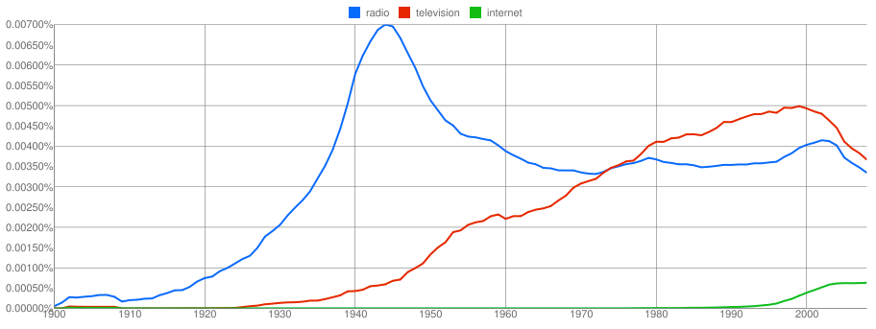
The use of the words “radio”, “television” and “internet” in books 1900-2000
TPS
H

Slide 10
B

Slide 11
B

Slide 12
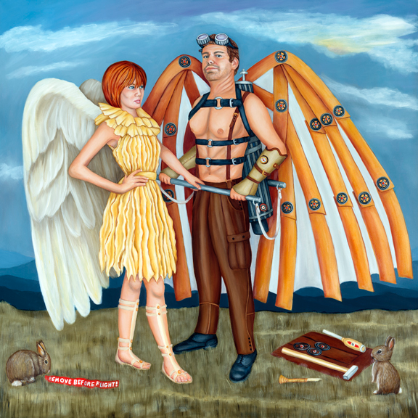
What’s going on in this picture? | See, Wonder, Think
Inference followed by evidence | Evidence then inference
“I think the man thinks he can fly because he is standing tall with a confident expression ” | “I see a man wearing wings. I wonder if he thinks he can fly. I think he can’t because his wings are man made and not real.”

Slide 13
See, Wonder, Think
What’s Going On in
this Picture?

