Slide 1
Linking Arts Education with School Initiatives Like Common Core
March 18, 2016
We will start at 12:00

Slide 2
Heather Gaiera &
Bill Funkhouser

Slide 3
You will explore teaching strategies and learning goals by
Curating a show
Reflecting on the critique process and Studio Habits of Mind
Using structured student talk
resulting in strengthened teaching practice and arts education advocacy linked to initiatives like CCSS.
H

Slide 4
Curate a Show
Curators select and arrange artworks to inform and inspire people.
Many exhibitions are organized around a theme.
Most shows have a curator’s statement explaining the thinking behind their selection.
BH

Slide 5
Possible Exhibition Themes
Elements of Visual Art
Principles of Design
Relationships
Mood, Tone, or Emotion
Place
Time
B/H
Notes:
Line, shape, form, value, color, texture, space
Balance, emphasis, proportion, pattern, repetition, rhythm, movement, variety, unity

Slide 6
“_______demonstrates
___(because/ with/ by) ___”
Lyn Risling
Ernie Barnes
BH
Notes:
Element: color green
Principle: rhythm or movement
Relationships: resources of land/ people and interdependence of women locked in a spirit of celebration and dance

Slide 7
Collaborate to sort and select
2 or more images for an exhibition based on a theme of your choice.
H

Slide 8
After deciding, write
then take turns sharing & discussing within your group

Slide 9
“CCSS emphasize close reading of high-quality, rigorous informational and literary texts, but they also support the “reading” of other forms of text. Works of art can, indeed should, be “read” in a very similar way to a poem by Shakespeare or a speech by Winston Churchill.”
-Lynne Munson,
President and Executive Director of CCSS
TEXT
B

Slide 10
Curate a Show
and CCSS Anchor Standards
H

Slide 11
R1: Read closely to determine what text says explicitly and to make logical inferences from it…
H

Slide 12
R2: Determine central ideas or themes of a text…summarize the key supporting details and ideas.
B

Slide 13
R4: Interpret [elements] as they are used in a text, including determining technical, connotative, and figurative meanings, and analyze how specific choices shape meaning or tone.
B

Slide 14
R5: Analyze the structure of text, including how specific [parts], and larger portions … relate to each other and the whole.
H

Slide 15
R7: Integrate and evaluate content presented in diverse media and formats, including visually and quantitatively, as well as in words.
B

Slide 16
W1: Write arguments to support claims in an analysis of text using valid reasoning and relevant and sufficient evidence.
H

Slide 17
SL1: Prepare for and participate effectively in a range of conversations and collaborations with diverse partners, building on others' ideas and expressing their own clearly and persuasively.
B

Slide 18
21st Century Skills
H/B

Slide 19
Options
B

Slide 20
Art teachers strengthen the CCSS with existing practices
H

Slide 21
The Critique Process
and CCSS
1) Description
2) Analysis
3) Interpretation
4) Evaluation
B

Slide 22
Critique steps | CCSS ELA Anchor Standards
1)Description | R1: Read closely to determine what the text says explicitly…
2) Analysis | R5: Analyze the structure of text, including how specific [parts]… relate to each other and the whole.
3) Interpretation | R4: Interpret [elements] as they are used in a text, including… figurative meanings, and analyze how specific … choices shape meaning or tone.
4) Evaluation | R7: Integrate and evaluate content presented in diverse media and formats…
B/H

Slide 23
Studio Habits of Mind
and CCSS
B

Slide 24
B

Slide 25
Studio Habits | CCSS Math Practice Standards
Develop Craft | Use appropriate tools
Engage and Persist | Persevere in solving problems
Envision | Model with mathematics
Express | Construct viable arguments
Observe | Look for and make use of structure
Reflect | Critique the reasoning of others
Stretch and Explore | Reason abstractly
HB

Slide 26
Studio Habits | CCSS ELA
Develop Craft | Build strong content knowledge (+Anchor standards)
Engage and Persist | Demonstrate independence Write over extended time frames
Envision | Respond to demands of audience, task, purpose & discipline
Express | Writing anchor standards 1-5
Observe | Value evidence
Reflect | Comprehend as well as critique
Stretch and Explore | Students can… comprehend a range of increasingly complex texts
Understand Art World | Understand other perspectives and cultures
B

Slide 27
Studio Habits | Science/ Engineering Practices
Develop Craft | Use math, information and computer technology
Engage and Persist | Plan and carry out investigations
Envision | Ask questions and define problems
Express | Argue from evidence
Observe | Develop and use models
Reflect | Obtain, evaluate and communicate information
Stretch and Explore | Construct explanations/ design solutions
H

Slide 28
H
Notes:
Educational shift from product to process

Slide 29
Using Stems
“Talk about your work”
(without stems)
“Talk about your work”
(with stems)
B

Slide 30
Structured Student Talk
and CCSS
H

Slide 31
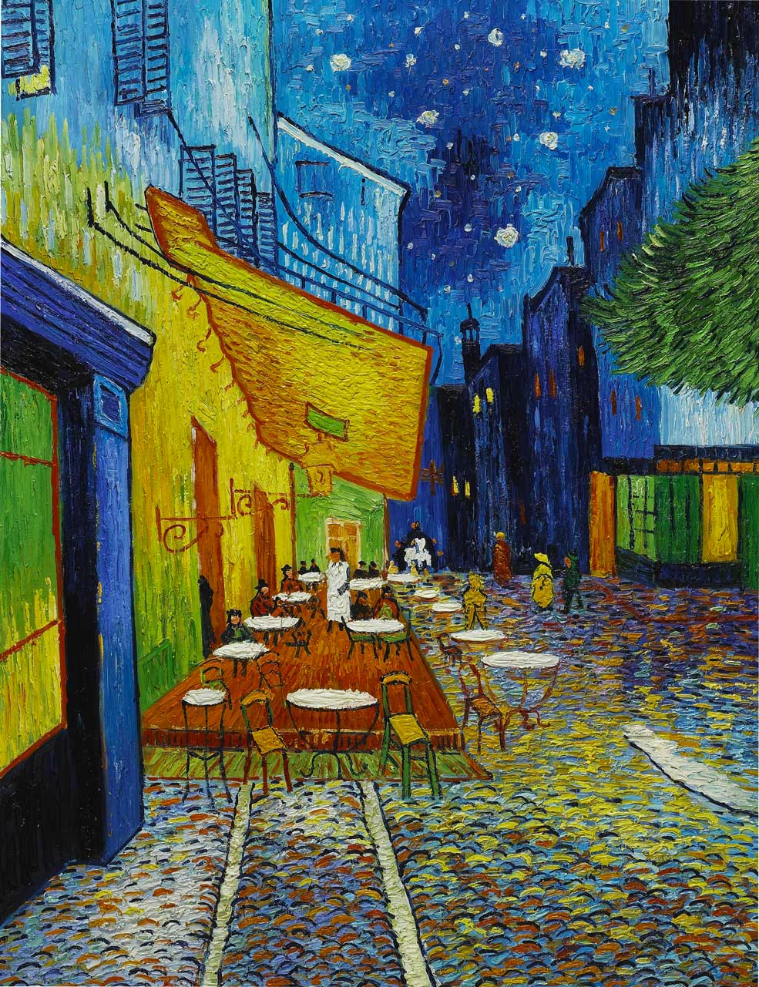
Frames to Analyze Artwork
“_____ (artist) used ___________ to convey __________”
While I focused on ________,
my partner
focused on ________.
Van Gogh
H

Slide 32
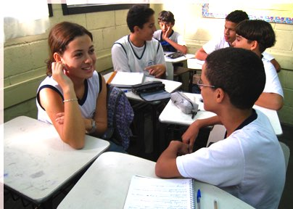
Structured Student Talk
NOT One teacher
One student
All students
in dialogue
H

Slide 33
“When students articulate thoughts, they ___”
H
Notes:
Whole class discussion vs. structured student talk

Slide 34
Benefits of SST
Higher order thinking, processing, listening skills, engagement, relevancy
Speaking is a foundation for literacy.
B

Slide 35
You explored teaching strategies and learning goals by
Curating a show
Reflecting on the critique process and Studio Habits of Mind
Using structured student talk
resulting in strengthened teaching practice and arts education advocacy linked to initiatives like CCSS.
B

Slide 36
Leadership involves:
1) Vision
2) Knowledge
3) Sharing
H

Slide 37
Leadership involves establishing a clear vision.
Arts are important in their own right, and help students learn CCSS skills in new ways.
B

Slide 38
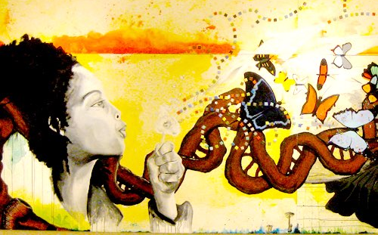
Jeff Musser,
Tony Berger,
Nadja Fitchhorn, & Rachel Hartsough
Davis Art Center mural
Leadership involves sharing knowledge with others.
This presentation and others at artsintegration.net

Slide 39
One action I will take as a result of this session is ____________________

Slide 40
I will
… ‘Curate a Show’ when we study____.
…use structured student talk even though it makes me nervous.
…voice the strong connection between arts education and CCSS.
…have students write in art class.
…share this presentation with ___.

Slide 41
artsintegration.net

Slide 42
Time for
one more routine

Slide 43
See, Wonder, Think
I think he is waiting for the bus because that looks like a bus stop
I see a man
standing by the side of the road
I wonder what he is doing there
B

Slide 44
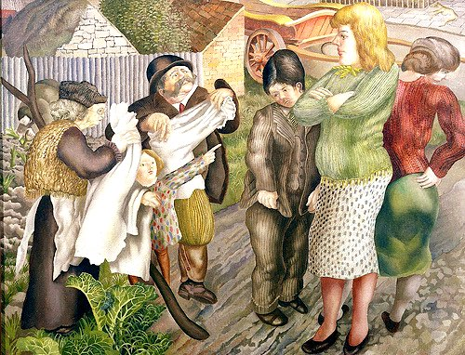
Village Gossips by Stanley Spencer 1940
B

Slide 45
See, Wonder, Think
See: observation and description (evidence first)
Wonder: process the image sufficiently to come up with a question tied to each of the things you saw
Think: construct an answer to each question
B

Slide 46
Using
“See, Wonder, Think”
in other classes
H

Slide 47
http://threeacts.mrmeyer.com/

Slide 48
artsintegration.net

