Slide 1
Welcome back
We will start at 1:20

Slide 2
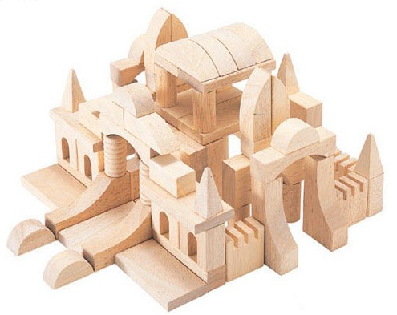
The Elements of Art
The “building blocks” of art.

Slide 3
Artists use one or more elements of art to create their artwork.
Flour, sugar, butter can be used to make all kinds of baked goods.
(cookies, pie, pastry, doughnuts, etc)
Those ingredients could be called
the “elements of baking”

Slide 4
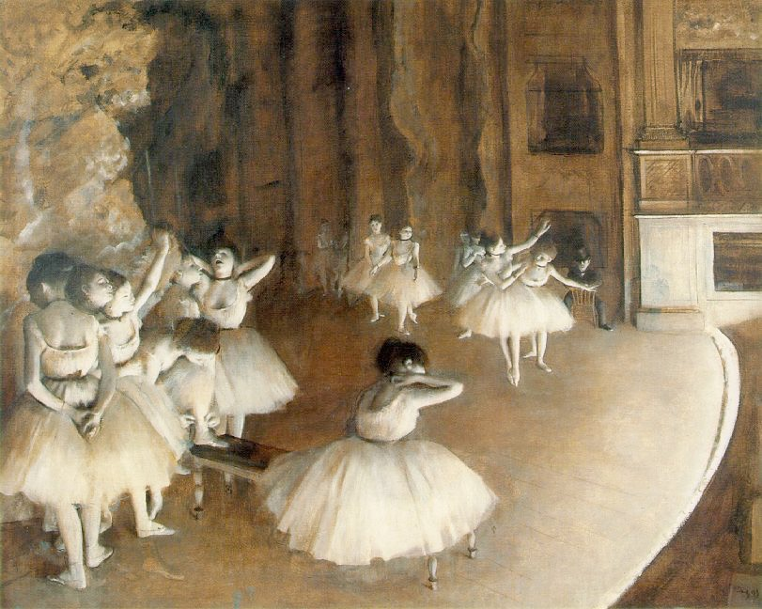
Artists use one or more elements of art to create their artwork.
Line
Shape
Form
Value
Color
Texture
Space
Edgar Degas

Slide 5
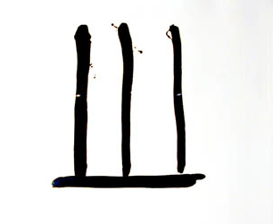
Line
The path of a point through space. (can vary in width, direction, quality, length, and color)
Paul Klee

Slide 6
Lines can be expressive!
Thick and thin
Straight or curving
Different tools= different lines
Line quality can be: nervous, soft, graceful, heavy, erratic…

Slide 7
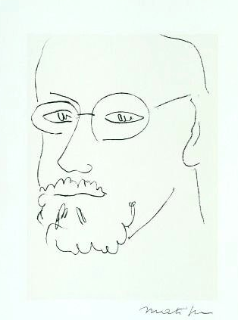
Henri Matisse

Slide 8
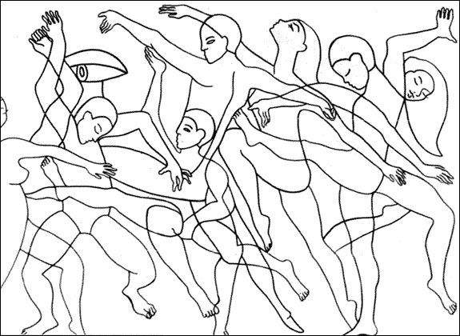
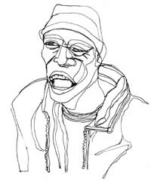

Slide 10
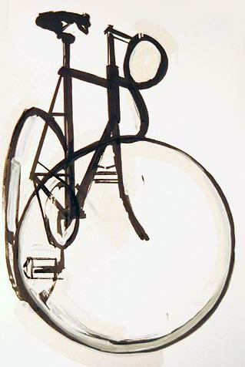

Slide 11
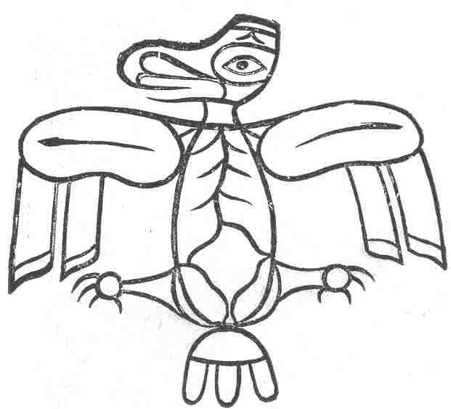

Slide 12
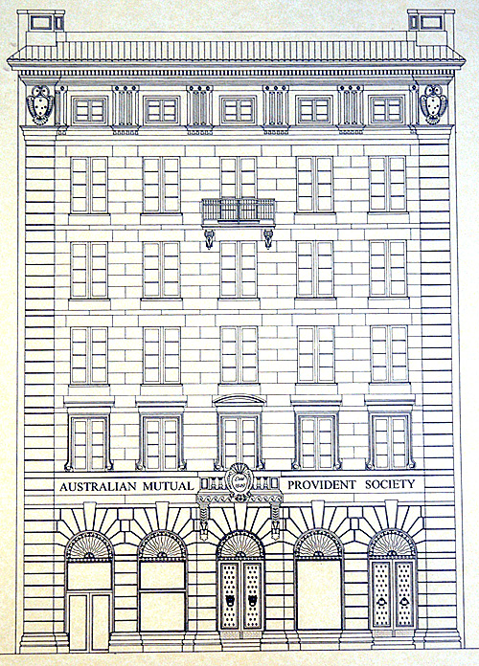

Slide 13
Draw 5+ different lines now.

Slide 14
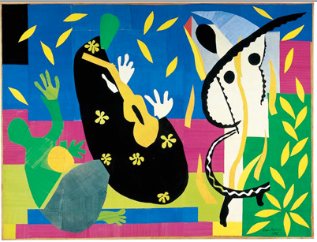
Shape
An area that is contained by a line or by contrast to its surroundings

Slide 15
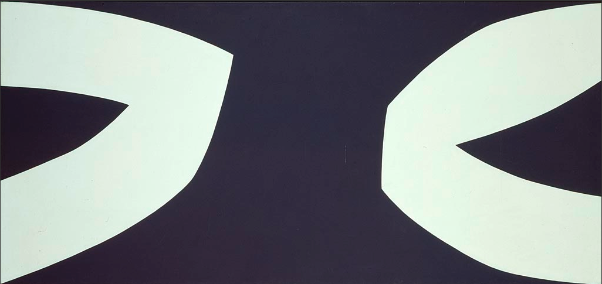
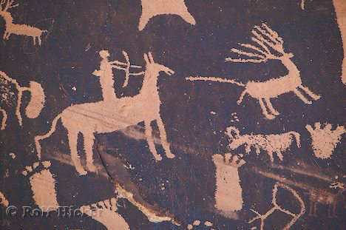
Shape
An area that is contained by a line or by contrast to its surroundings

Slide 16
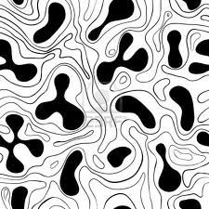
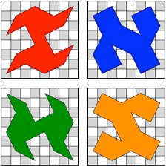
Shape
Shapes can be organic (rounded, natural)
Shapes can be geometric (angular, straight edged)

Slide 17
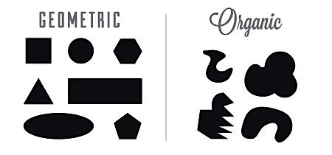
Shape

Slide 18
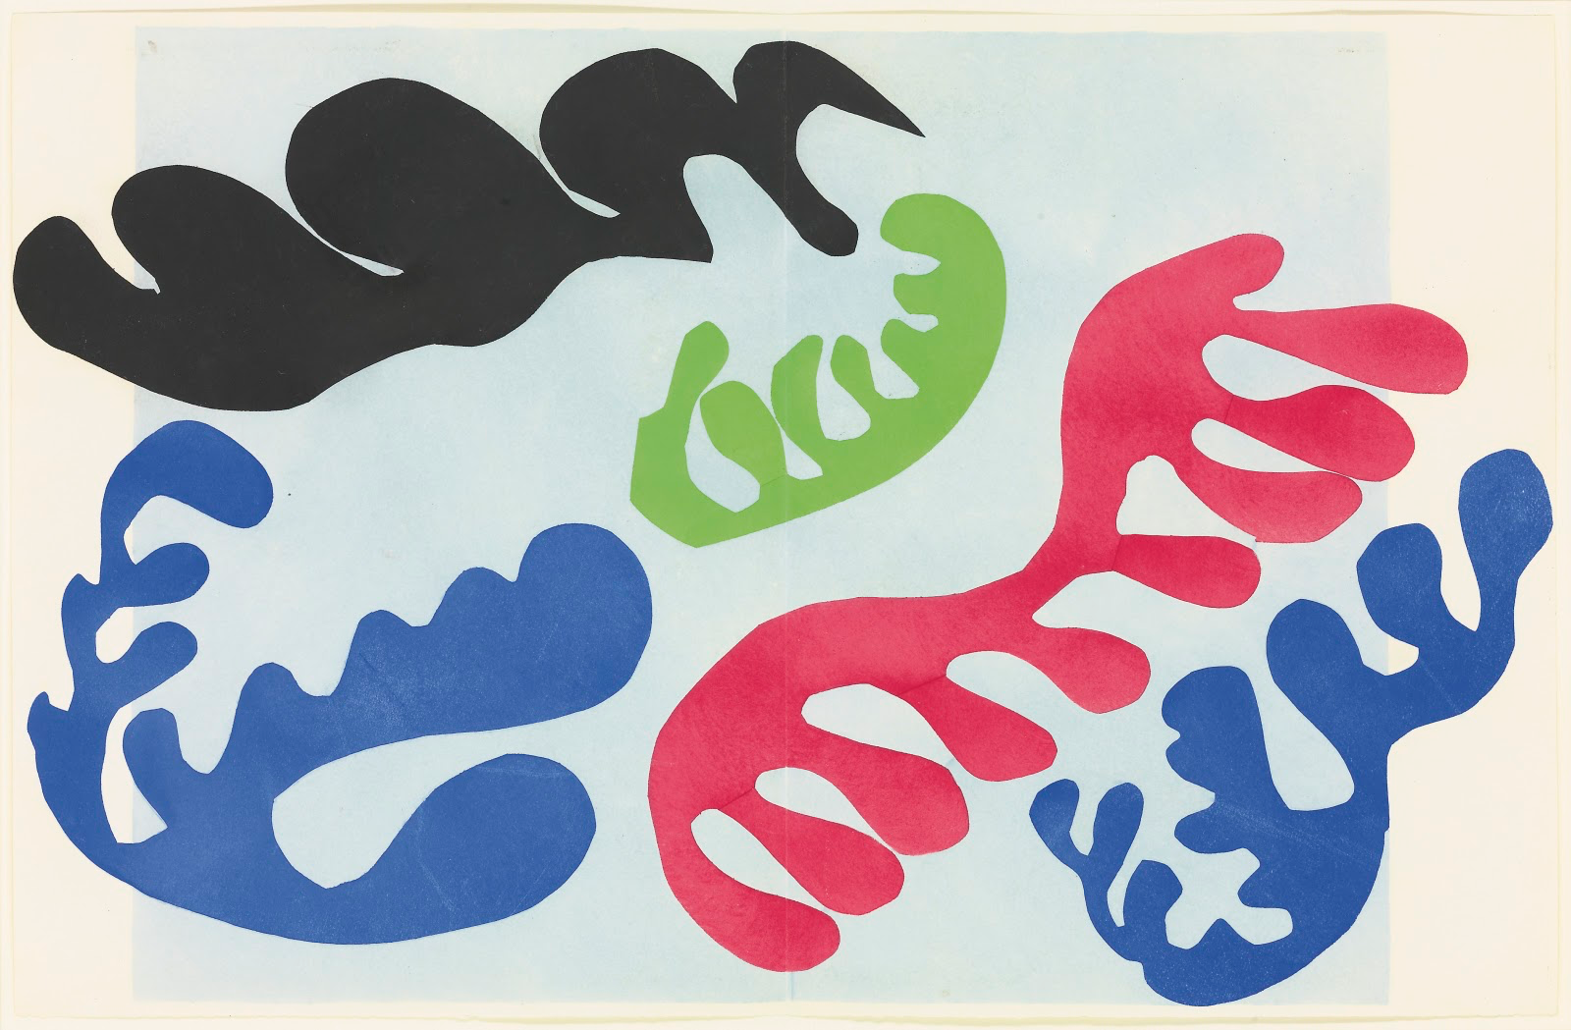

Slide 19
Draw 3 organic and 3 geometric shapes now.

Slide 20
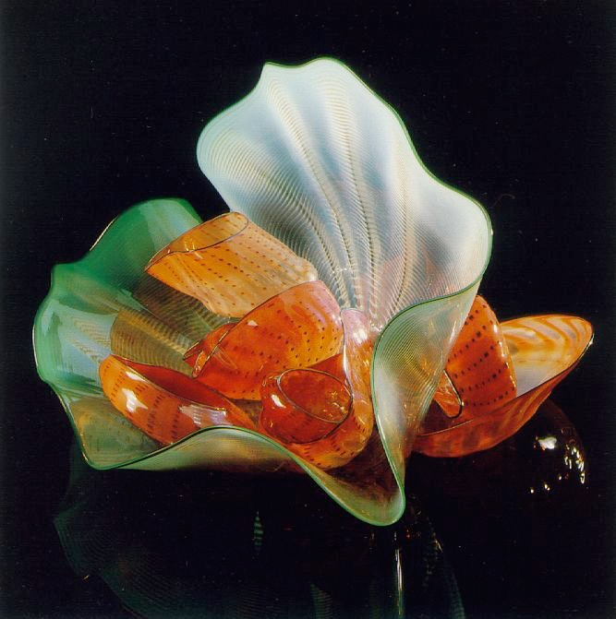
Form
Form describes volume and mass. Objects that are three dimensional have form.
The illusion of 3 dimensions in a two dimensional artwork is also form.
Dale Chihuy

Slide 21
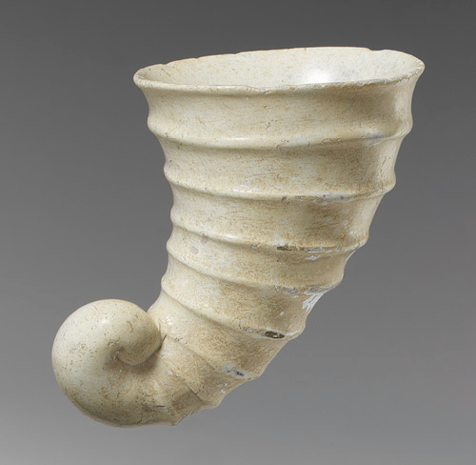

Slide 22
Form
What is something with form?
When drawing, we create the ILLUSION of form.

Slide 23
Space
The experience of distance or emptiness within and around objects.

Slide 24
Space
The experience of distance or emptiness within and around objects.

Slide 25
Space
The experience of distance or emptiness within and around objects.

Slide 26
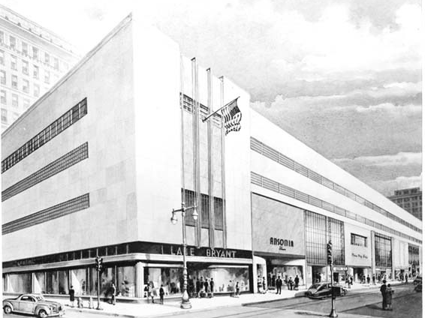
Space

Slide 27
Space

Slide 28
KQED Art School video

Slide 29
Summarize “Space”
in your own way.
Consider illustrating
positive and negative space.

Slide 30
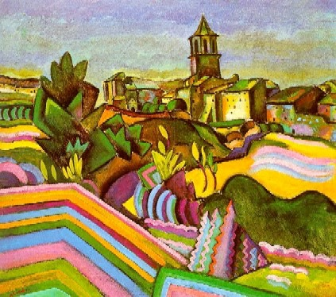
Color
Effect on our optic nerve when seeing light waves of different wave lengths.
Color has 3 qualities:
HUE is the name of the color.
Phillip Martin
Joan Miro

Slide 31
Color Value
VALUE is how light or dark the color is.

Slide 32
Color Intensity
INTENSITY is how pure the color is.

Slide 33
Intensity & Value
Intensity is how pure the color is.
Fire engine red
Brick red
Red #1
Red #2
LIGHT value
HIGH intensity
DARK value
LOW intensity

Slide 34
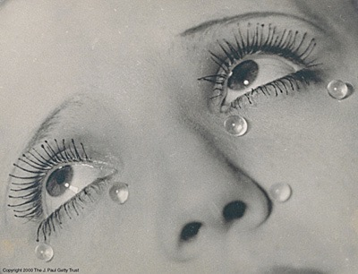
Value
Value refers to dark and light.
Value contrasts let us see and understand two- dimensional
works of art.
Man Ray

Slide 35
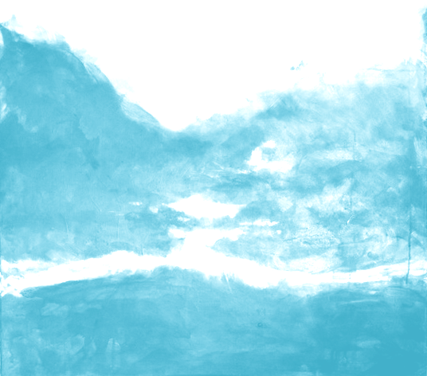
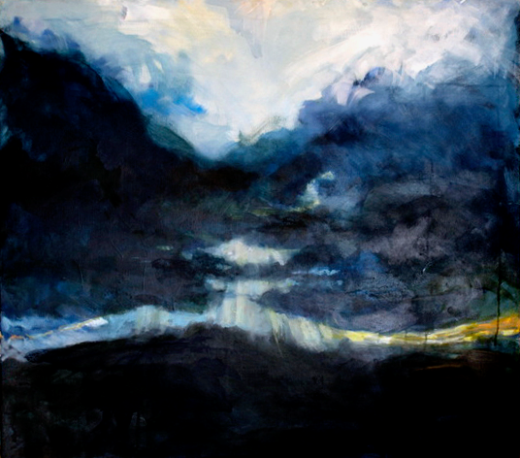
Value
Mood: light value vs. dark value
Painting #1
Painting #2

Slide 36
Are black and white colors?
Answer 1: Color as light. (black is not, white is)

Slide 37
Are black and white colors?
Answer 2: Color as pigment or molecular coloring agent. (black is, white might be)

Slide 38
Shade with light and dark value
(practice “overhand grip”,
“solid tone” and “gradation”)

Slide 39
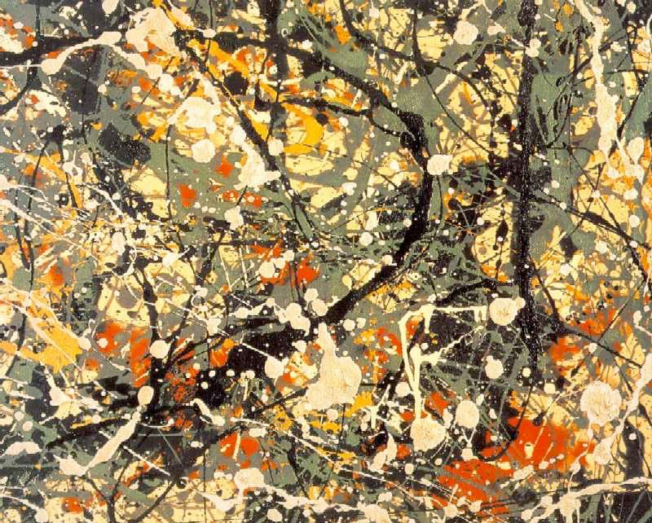
Texture
Texture is the surface quality of artwork.
Visual texture is flat but looks textured.
Jackson Pollack

Slide 40
Texture
Tactile texture- real texture you can feel
Meret Oppenheim

Slide 41
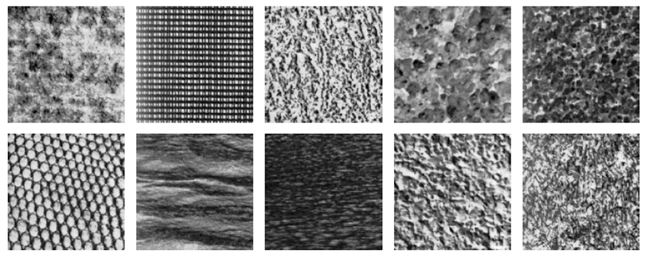
Draw a visual texture.

Slide 42
How many of the 7 elements can you recall from memory without looking in your notes?
Line
Shape
Space
Texture
Form
Color
Value

Slide 43
Bonus elements
Especially with new media works
Time
Motion

Slide 44
End of Elements of Art

Slide 45
Principles of Art
the use or arrangement of the Elements of art.
Principles
Elements

Slide 46
Repeat any elements
such as color, shape, line, texture, etc.

Slide 47
Repetition, Pattern & Rhythm

Slide 48
Repetition, Pattern & Rhythm
Repetition- one object repeated
Pattern- several elements recurring
Rhythm- pattern with variation

Slide 49
Repetition (one object)

Slide 50
Repetition

Slide 51
Repetition-give example

Slide 52
Pattern (several elements)

Slide 53
Pattern (several elements)

Slide 54
Pattern- give example

Slide 55
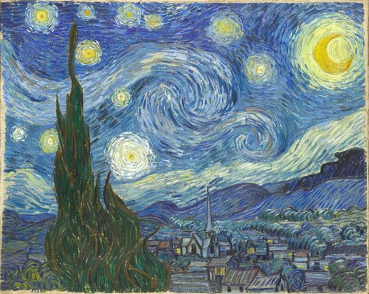
Rhythm (pattern w/variation)

Slide 56
Rhythm

Slide 57
Rhythm

Slide 58
Rhythm

Slide 59
Draw any elements in a way that draws one item to the center of your attention

Slide 60
Emphasis/ subordination
How the elements are arranged to bring your eye to a center of interest or focus

Slide 61
Emphasis

Slide 62
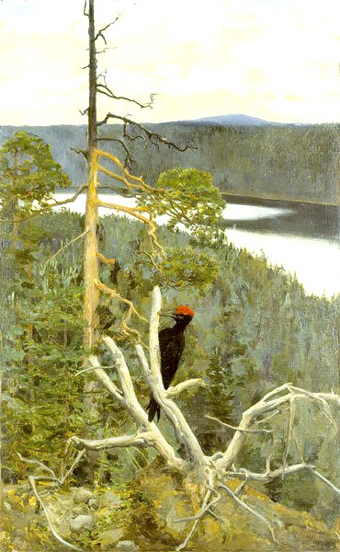
Emphasis

Slide 63
Emphasis

Slide 64
Draw any elements in a way that they work well together/ create a unified image

Slide 65
Unity
Using the elements so they work together

Slide 66
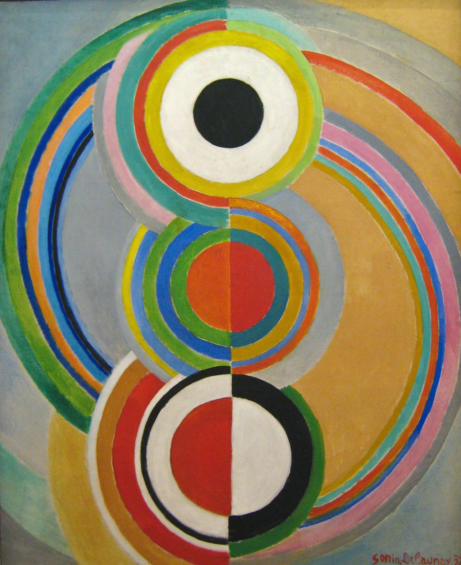
Unity

Slide 67
Unity

Slide 68
Draw many different elements such as different colors, shapes, lines, etc.

Slide 69
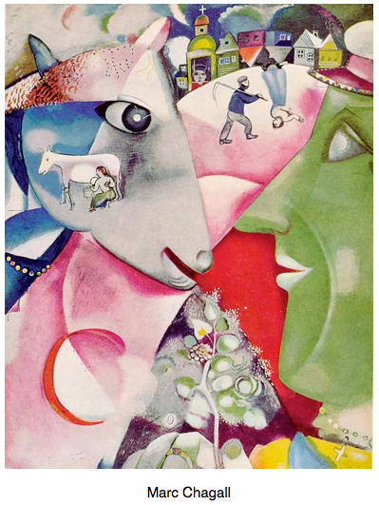
Variety
Using different elements in art (adds interest)

Slide 70
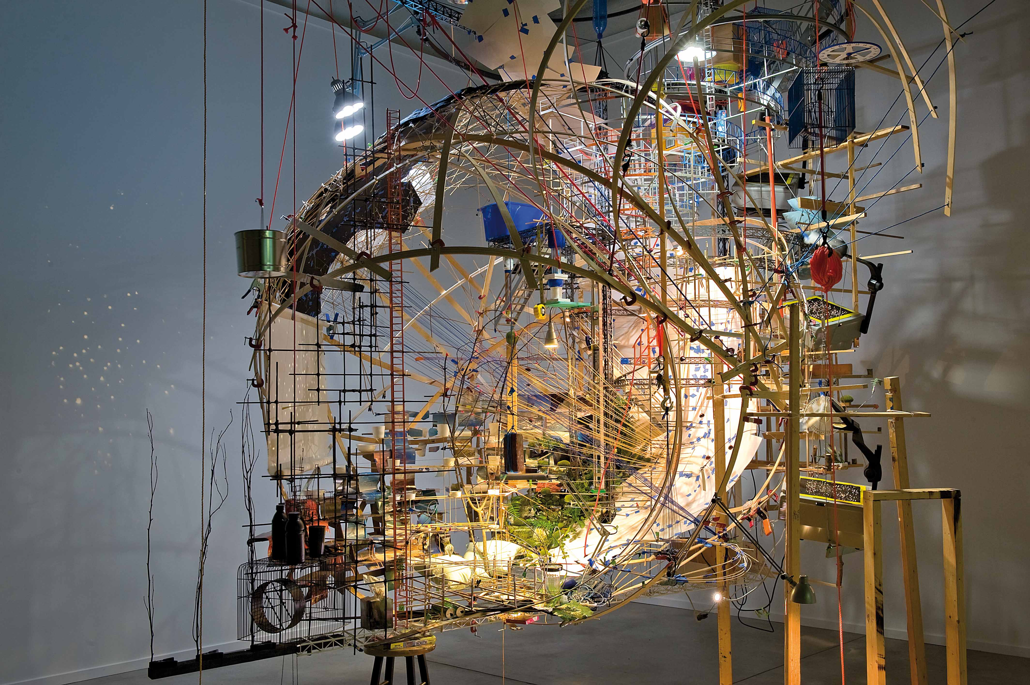
Variety

Slide 71
Variety

Slide 72
Draw some elements in a way that your image is balanced.

Slide 73
Balance
Balance is the placement of visual weight either equal or unequal

Slide 74
Balance
Can be symmetrical, asymmetrical or radial

Slide 75
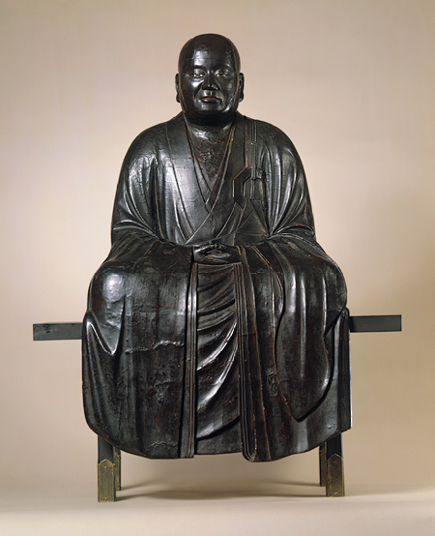
Balance

Slide 76
Balance

Slide 77
Balance

Slide 78
Balance

Slide 79
Draw some elements in a way that movement, action or motion is created visually.

Slide 80
Movement
The arrangement of elements to create motion through the artwork

Slide 81
Movement

Slide 82
Movement

Slide 83
Movement

Slide 84
Draw one or more elements in a way that the relative sizes of the lines, shapes, textures or forms are explored.

Slide 85
Proportion/ scale
Proportion: relationship of sizes within an object
Scale: size of one object in relation to another

Slide 86
Scale: size of one object in relation to another

Slide 87
Scale: size of one object in relation to another

Slide 88
Scale: size of one object in relation to another

Slide 89
Proportion: relationship of sizes within an object

Slide 90
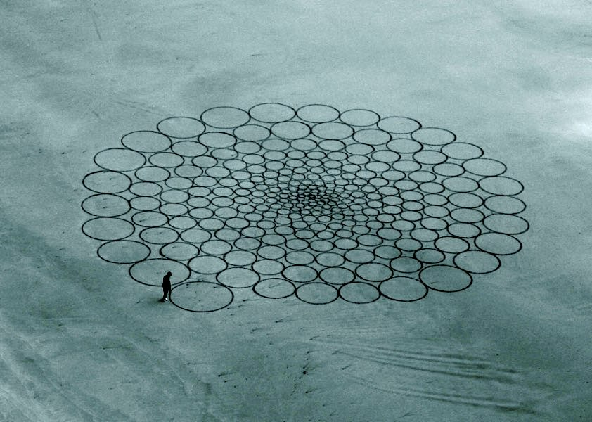
Scale & Proportion

