Slide 1
Curate a show
Curators select and arrange artworks to inform and inspire people.
Many exhibitions are organized around a theme.
Most shows have a curator’s statement explaining the thinking behind their selection.
H

Slide 2
Collaborate to sort and select images for a small exhibition based on a theme of your choice.

Slide 3
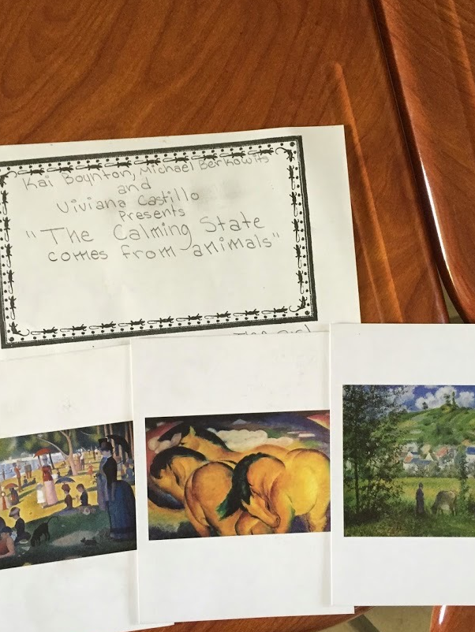
Curate a Show:
Hand out images
Students select theme and choose images that support the theme
Write statement & present exhibit
“The calming state comes from animals.”
H

Slide 4
Exhibition big themes
Elements or Principles
Objects and what they say about us
Relationships
Identity: what does the art tell you about the artist or yourself?
Place: What does our surroundings communicate?
Content specific theme: cells, federalism, word problems
Explore and extend: would you change your theme now?

Slide 5
Theme vs. Topic
Theme is the central idea, meaning or message that the writer wants to convey.
The subject or topic is a more general category.

Slide 6
Examples
For example, the subject might be “war” and the theme is “war is a curse for humanity”
The subject is “crime” and theme might be “evil is always punished” or “crimes can not be hidden”
Through themes, a writer tries to give his readers an insight into how the world works or how he or she views the subjects of human life.

Slide 7
Speaking and Listening Anchor Standards #1, 2, 4
Participate in a range of conversations with diverse partners
Integrate and evaluate information presented visually and orally
Present information so that listeners can follow the line of reasoning and organization
H

