Slide 1
Visual journaling
Sketch-noting
B

Slide 2
B

Slide 3
B

Slide 4
B

Slide 5
Full list of road closures from marathon organizers below:
Highway CA 255 (Samoa Bridge)
• The southbound lane from Arcata to Eureka will be closed starting by 8 AM. Detour north on CA 255 and use US 101 south to Eureka. Reopening will start before 2:30 PM
Eureka
The following closures will begin by 6 AM and will be reopened by 9 AM:
• F Street between 6th Street and Hodgson. Please use E Street or H & I Streets. Cross at 4th Street or 5th Street
• Hodgson between F Street and W Street. Cross traffic allowed at H Street and W Street
• Chester Street between W Street and Harrison. Cross traffic allowed at W Street
• Harrison between Wilson and Chester. Detour via W Street.
• Wilson between Harrison and Walford
• Walford between Wilson and Harris
• Harris and Hall between Hubbard and Myrtle Avenue will be closed to through traffic. Detour via Hubbard
• Old Arcata Road and Myrtle Avenue between Buttermilk Ln in Sunny Brae and Hall Ave in Eureka
• The southbound lane continuing west into Eureka will be closed before 7 AM and will be reopened no later than
• 11 AM. Southern sections will be reopened first as the last runner passes. The northbound lane will remain
• open. The detour is to go north and use US 101 South to Eureka. Cross traffic will be allowed at Indianola
• Cutoff and Bayside Cutoff.
Old Town Eureka
The following roads will be closed between 8 AM and 2:30 PM
• 3rd Street between Q and R Streets
• Q Street between 2nd and 3rd Streets
• 2nd Street north of P and Q Streets
• 2nd Street between M and F Streets F Street from 2nd Street north to the Eureka Boardwalk
• Traffic will be allowed to cross 2nd Street at L Street
Sunny Brae and Arcata
The following closures will begin before 8 AM and will be reopened by 11:30
• Bayside Road between Union and Buttermilk: Southbound lane will be closed. 7th Street between G and Union: Eastbound lane will be closed. Cross traffic allowed at Union and F St.
• 10th Street between G and Q will be closed. Please use 11th Street. Cross traffic allowed at H St. and K St.
• Q Street between 10th and 17th will be closed. Cross traffic allowed at 11th St.
Arcata Bottoms
• Foster, Seidel and Jackson Ranch Road will be closed between 8 AM and 1 PM
B

Slide 6
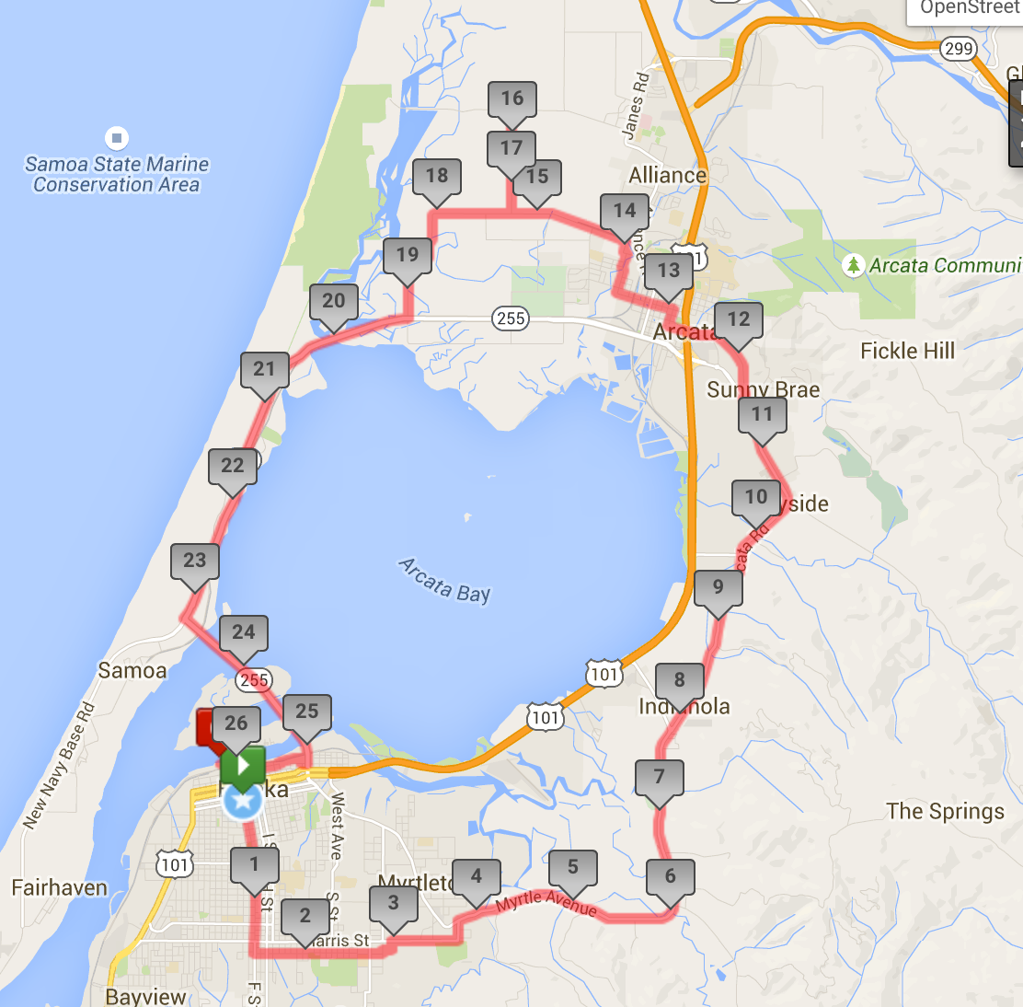
B

Slide 7
B

Slide 8
B

Slide 9
B

Slide 11
Please practice visual note taking this week

