Slide 1
B

Slide 2
Telephone
“Receiver” sketches
“Caller” describes
Math words: isosceles, rhombus, intersecting, tangent
Art words: solid tone, overlap, shape, opaque, translucent
B

Slide 3
Ready?

Slide 4
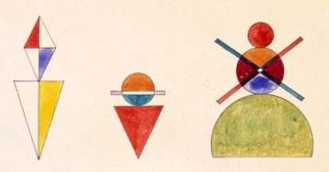
isosceles
rhombus
intersecting
tangent
solid tone, overlap
shape, opaque
translucent

Slide 5
B

Slide 6
quadrants (I, II, III, IV)
origin, quarter
radius, congruent
parallel
solid tone, overlap
shape, opaque
translucent

Slide 7
Tommie Olafsson
“Wherever you go I will follow”
2006
B

Slide 8
quadrants (I, II, III, IV)
origin, quarter
radius, congruent
parallel
solid tone, overlap
shape, opaque
translucent

Slide 9
B

Slide 10
Wassily Kandinsky
B

Slide 11
Speaking and Listening Anchor Standards #1, 2, 4
Participate in a range of conversations with diverse partners
Integrate and evaluate information presented visually and orally
Present information so that listeners can follow the line of reasoning and organization
H

Slide 12
Telephone
Excellent strategy for ELL (prepositions, etc)
Extension/assessment piece/ performance task produce creative work from a given description with differentiation (handout)
H

