Slide 1
Studio Habits of Mind

Slide 2
Art education
What exactly, do the arts teach?
8 different habits or “dispositions”
Created by research team at Project Zero, Harvard Graduate School for Education

Slide 4
Reflect
To question and explain: to think and talk with others about an aspect of one’s work or process.
Evaluate: Learning to judge one’s own work and process with a goal of moving the art to a higher place.
Is this something you need your students to do?

Slide 5
What teachers can do
Teach students how to use words to describe art
Personal, informal and formal critiques
Encourage students to reflect through journals, blogs and diaries

Slide 6
Studio Habits of Mind | English Language Arts Common Core | Math Common Core
Reflect | Respond to texts with self-awareness and awareness of context. | Compare and reason with stated assumptions, definitions and constructed arguments to analyze and critique the reasoning of others effectively.

Slide 7
Envision
Learning to picture mentally what can not be directly observed
Imagine possible next steps in making a piece
Envision end product and ask, what do I need to do to get there?
Is this something you need your students to do?

Slide 8
What teachers can do
Ask questions rather than defining set outcomes
Prompt students to think about things in multiple ways before deciding on a solution
Multiple sketches/ iterations rather than ‘one and done’
Look for envisioning in core topics.

Slide 9
Studio Habits of Mind | English Language Arts Common Core | Math Common Core
Envision | Interpret/Analyze Integrate/Synthesize | CCSS problem solving process

Slide 10
Reflection Day 1
Reflect on your teaching practice. What do you think you do well and what would you like to improve?
Envision how your classroom might look after you are trained in arts integration.

Slide 12
Stretch and Explore
To reach beyond one’s capacities
To playfully explore without a preconceived plan
To create something new from where you’ve been
Iterations, not failures
WD40, Formula 409, etc

Slide 13
What teachers can do
Encourage students to try new things, play around, take risks, plan multiple versions
Look for opportunities to change direction
Mid-point critique/ reflection instead of too-late-to change-course
Is this something you need students to do?

Slide 14
Studio Habits of Mind | English Language Arts Common Core | Math Common Core
Stretch & Explore | Activate prior knowledge to make hypotheses and generate “what if”? questions. Writing process | Consider and try new skills to create a coherent representation or understanding of the problem at hand. Prolem solving process

Slide 15
Develop Craft
Learn to use tools (pencil, brush, potters wheel, etc)
Make informed decisions about when to use specific tools & materials
Learn to care for tools, materials and space
Learn artistic conventions/ techniques

Slide 16
What teachers can do
Focus on craft in relation to what the work conveys
“Identity” instead of “Making paper masks”
Avoid teaching craft in isolation
Craft is how artists convey meaning
Highlight when learning craft in core subjects too.

Slide 17
Studio Habits of Mind | English Language Arts Common Core | Math Common Core
Develop Craft | Demonstrate grade-appropriate command of conventions of reading and writing. | Use appropriate tools strategically. Reason through math processes in concrete and abstract ways.

Slide 18
Understand Art World
Domain: Learn art history from origins of art to contemporary art
To use art history for ideas: “All of art history belongs to me.”
Communities: To interact with other artists & broader society
We work in artistic communities of creators, consumers, critics and colleagues.

Slide 19
What teachers can do
Immerse students in the work of other artists both historical and contemporary
Encourage collaboration and social interaction in the extended community

Slide 20
Studio Habits of Mind | English Language Arts Common Core | Math Common Core
Understand Art World | Understand the history and field of literary arts and literature, including popular culture. | Understand the history of math and real-life applications of math.

Slide 21
Reflection Day 2
S/E: I tried something I’d never done before when I....
S/E: I was outside my comfort zone today when… yet I learned…
Craft: I learned some skills such as ___ today.
Art World: I was inspired by the work of __________ this week because…

Slide 22
Studio Habits of Mind

Slide 23
Alternate with partner to see how many you recall

Slide 24
5 so far
Reflect
Envision
Stretch & Explore
Develop Craft
Understand (Art) World

Slide 25
Engage and Persist
Engage- making the art relevant and of personal importance.
Remain focused and on task
Optimal ambiguity involves balance between guided structure and open ended opportunity
Stick to a task for sustained period of time

Slide 26
What teachers can do
Give students choice to build engagement.
Remind and encourage students to make goals and strive to achieve them.
Highlight when ‘engaging and persisting’ in core subjects.

Slide 27
Studio Habits of Mind | English Language Arts Common Core | Math Common Core
Engage & Persist | Read and write routinely. Learn to revise. | Make sense of problems and persevere in solving them.

Slide 28
Express
Learning to create works that convey an idea, feeling or personal meaning
Isadora Duncan: “If I could say it, I wouldn’t have to dance it.”

Slide 29
What teachers can do
Keep meaning & emotion at the center of the art making process
Use themes for units (“Identity” vs. “Paper Masks”)
Emotion is human
Remember that craft is how we develop meaning. Make the meaning the focus and craft how we communicate.

Slide 30
Mythbusting: “theme”
Theme is the central idea, meaning or message that the writer wants to convey.
The subject or topic is a more general category.
For example, the subject might be “war” and the theme is “war is a curse for humanity”
The subject is “crime” and theme might be “evil is always punished” or “crimes can not be hidden”
Through themes, a writer tries to give his readers an insight into how the world works or how he or she views human life.

Slide 31
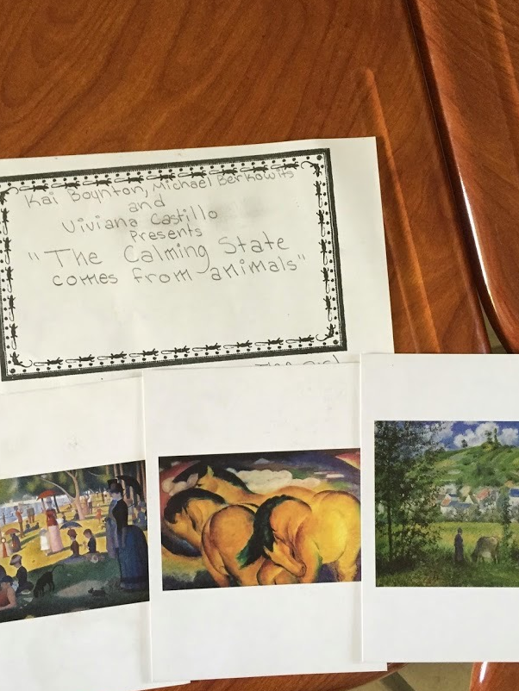
Curate a Show:
Hand out images
Students select theme and choose images that support the theme
Write statement & present exhibit
“The calming state comes from animals.”
H

Slide 32
Observe
Learning to attend to visual contexts more closely than ordinary “looking” requires.
Seeing things that might not otherwise be seen
As you become more sophisticated in your artistic mind, you develop the capacity to really see, interpret, question, and understand.

Slide 33
What teachers can do
Visual thinking strategies
Train students how to look with goal of seeing
Sketchbooks, journals
Seek observation in all core subjects. (Look for structure, cite evidence, etc)

Slide 34
Studio Habits of Mind | English Language Arts Common Core | Math Common Core
Observe | Listen and comprehend narrative structure. Read written texts closely. | Look closely for a pattern, structure, general method and shortcuts. Observe and maintain oversight of process in order to attend to details and precision.

Slide 36
How to amplify your efforts

Slide 37
Studio Habits of Mind
Expands the scope of art beyond skills and technique
Provide multiple opportunities for learning and assessment (How did the student show ability to ‘Stretch and Explore’? How did they demonstrate their “Understanding of the Art World”? etc.)
Offer a common language across all classrooms

Slide 38
Tips for teaching
Studio Habits of Mind
Do not try to teach all eight in each assignment
Look for opportunities to spotlight the habits as they arise
They never occur in isolation
They are neither linear nor circular

Slide 40
Studio Habits | CCSS Math Practices
Develop Craft | Use appropriate tools
Engage and Persist | Persevere in solving problems
Envision | Model with mathematics
Express | Construct viable arguments
Observe | Look for and make use of structure
Reflect | Critique the reasoning of others
Stretch and Explore | Reason abstractly

Slide 41
Studio Habits | CCSS ELA Practices
Develop Craft | Build strong content knowledge (+Anchor standards)
Engage and Persist | Demonstrate independence Write over extended time frames
Envision | Respond to demands of audience, task, purpose & discipline
Express | Writing anchor standards 1-5
Observe | Value evidence
Reflect | Comprehend as well as critique
Stretch and Explore | Students can… comprehend a range of increasingly complex texts
Understand Art World | Understand other perspectives and cultures

Slide 42
Studio Habits | Science/ Engineering Practices
Develop Craft | Use math, information and computer technology
Engage and Persist | Plan and carry out investigations
Envision | Ask questions and define problems
Express | Develop and use models
Observe | Argue from evidence
Reflect | Obtain, evaluate and communicate information
Stretch and Explore | Construct explanations/ design solutions

Slide 44
Reflection Day 3
Express: Did you explore emotion or feeling in your creations this week? If so, how? If not, how might you explore emotion or feeling personally or with students?
Observe: I practiced my ability to look closely this week when I...
Engage/Persist: I was personally connected to the work I did this week on ….
Engage/ Persist: Describe a time you had difficulty or struggled this week. How did you persevere?

