Slide 1
Artful Thinking Routine:
Perceive, Know, Care About

Slide 2
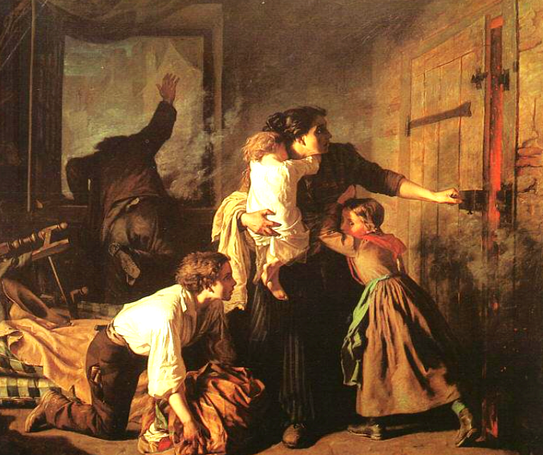
Perceive
Know
Care
About
H
Notes:
30 second art viewing
1-think time, whole group, what can she perceive? know? care about?
2- partners
3- group

Slide 3
1
3
Perceive
6
5
Know
2
Care
About
4
The Fire- Alexandre Antigna 1850
H
Notes:
30 second art viewing
1-think time, whole group, what can she perceive? know? care about?
2- partners
3- group

Slide 4
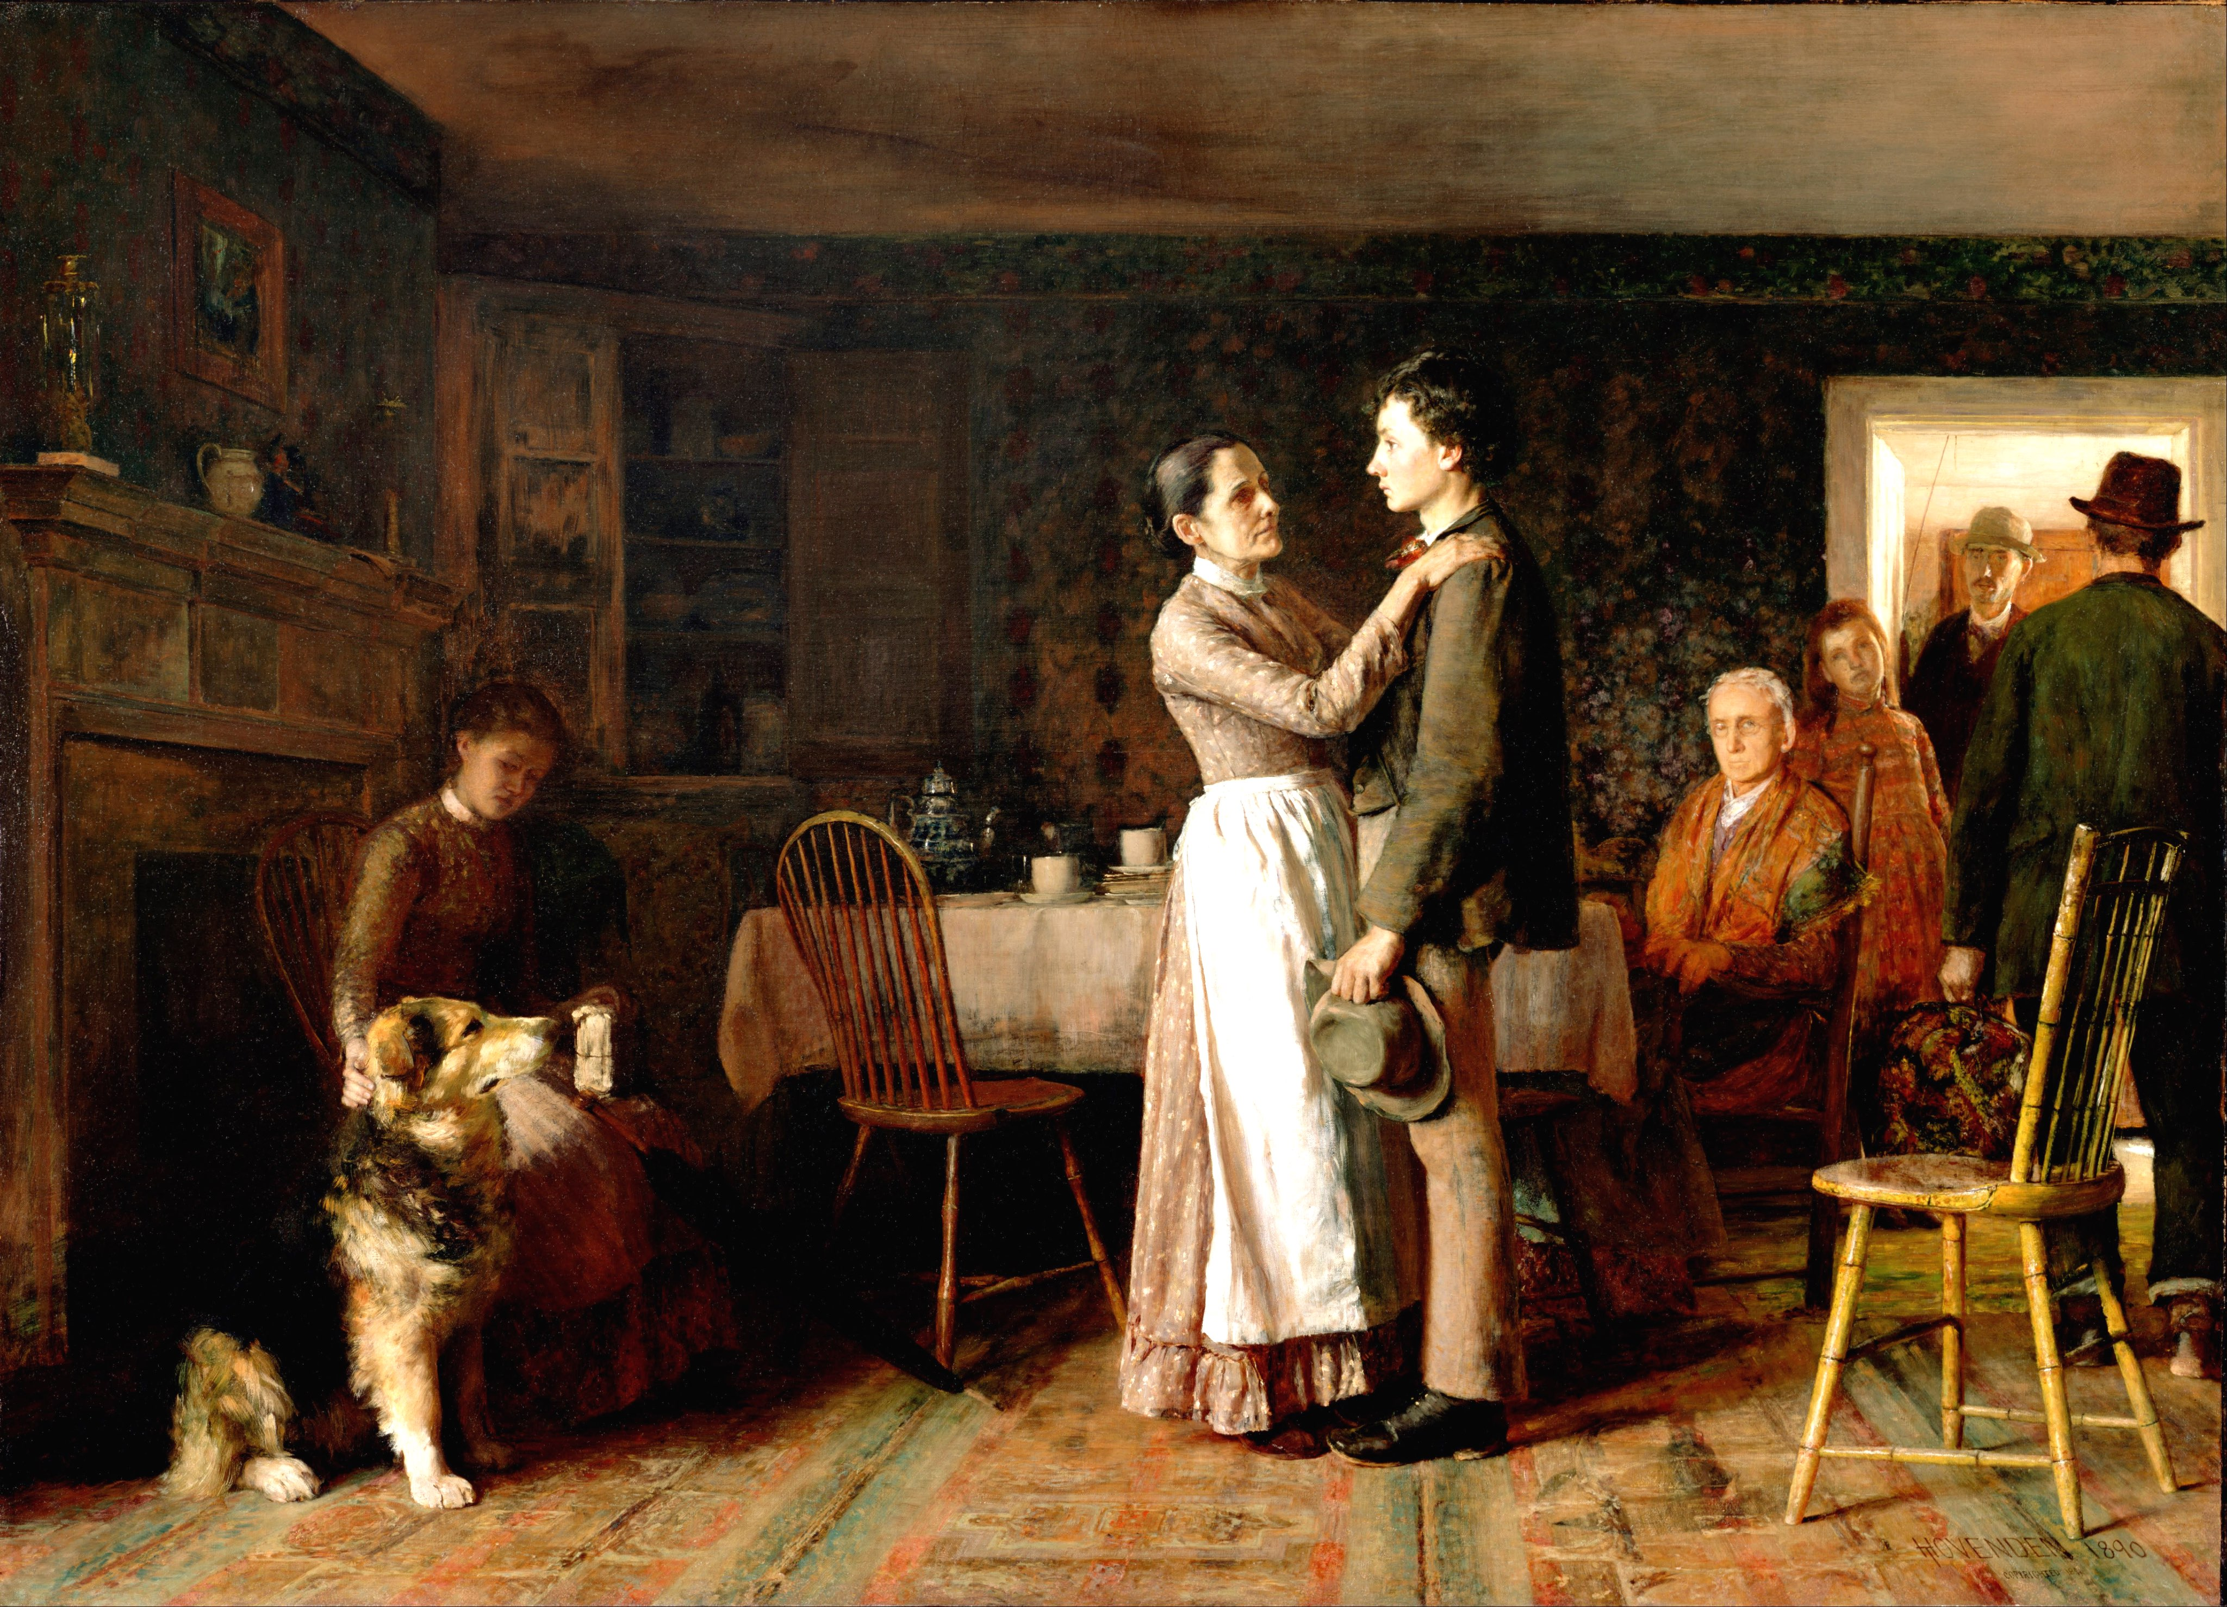
B
Notes:
View time

Slide 5
2
1
5
3
4
Breaking Home Ties- Norman Rockwell 1954
B
Notes:
View time
Chin answers
“I see my grandson is leaving, I know he’s hoping to find work, and I’m proud of him.” Who am I?
“All these people are worried about me. I have a job waiting for me in the west. I hope things work out.”
“Why isn’t he throwing the ball for me?”

Slide 6
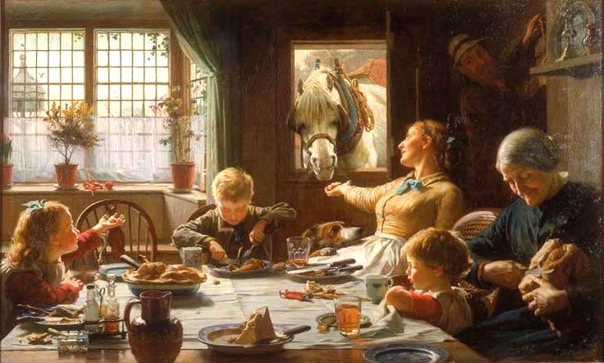

Slide 7
One of the Family
Frederick Cotman

Slide 8
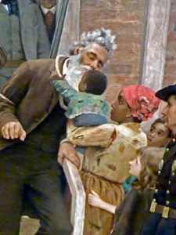
Perceive, Know, Care About
Explore perspectives
Can be inanimate objects (child’s stuffed animal, for example)
Can have students speak as the people and have everyone guess who they are.
Write from within the viewpoint
H

Slide 9
Anchor standards
W3: Write narratives to develop real or imagined experiences or events using effective technique, well-chosen details and well-structured event sequences.
R3: Analyze how and why individuals, events, or ideas develop and interact..
S&L: Demonstrate understanding of multiple perspectives…
H

