Slide 1
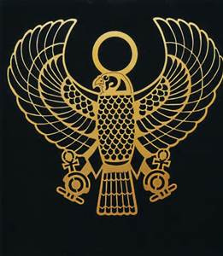
Patterns and SYMBOLS

Slide 2
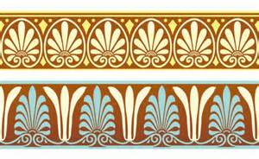
VOCABULARY
PATTERN:
Pattern is the repetition of visual elements such as line, shape and color.

Slide 3
VOCABULARY
SYMBOL:
A symbol is a person or a concept that represents, stands for or suggests another idea, visual image, belief, action or material entity. Symbols take the form of words, sounds, gestures, ideas or visual images and are used to convey other ideas and beliefs. For example:
A red octagon may be a symbol for "STOP".
On a map, a blue line might represent a river.
Numerals are symbols for numbers.
Alphabetic letters may be symbols for sounds.
Personal names are symbols representing individuals.
A red rose may symbolize love and compassion.

Slide 4
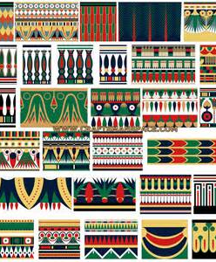
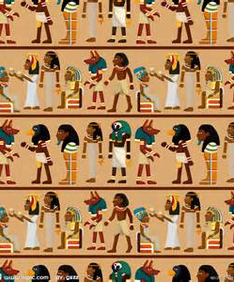
EGYPT

Slide 5
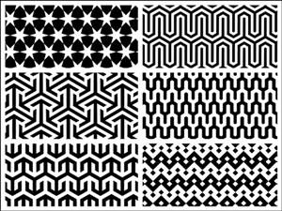
EGYPTIAN PATTERNS

Slide 6
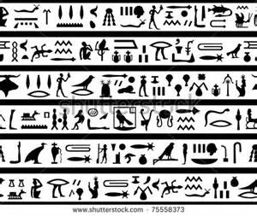
EGYPTIAN SYMBOLS

Slide 7
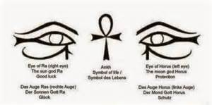
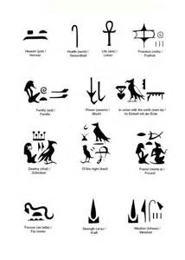
EGYPTIAN SYMBOLS

Slide 8
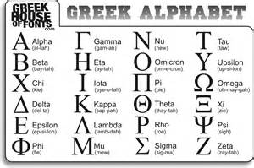
GREECE

Slide 9
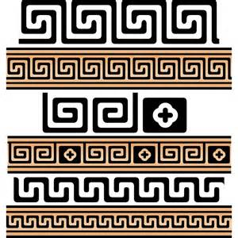
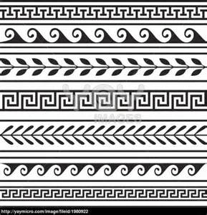
GREEK PATTERNS

Slide 10
ROME

Slide 11
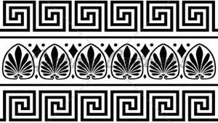
ROMAN PATTERNS

Slide 12
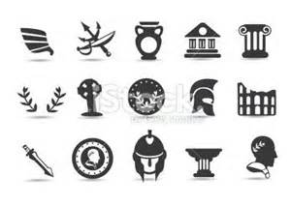
ROMAN SYMBOLS

Slide 13
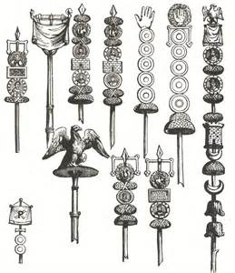
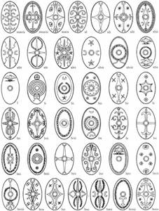
ROMAN SYMBOLS

Slide 14
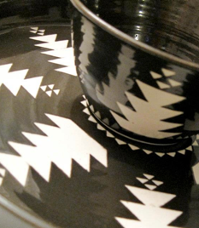
HUPA, KARUK, YUROK

Slide 15
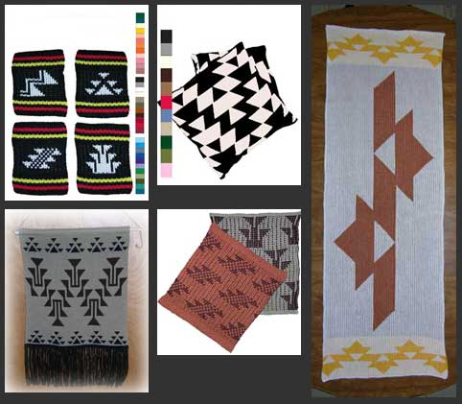
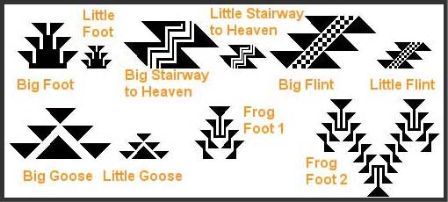
patterns

Slide 16
baskets

Slide 17
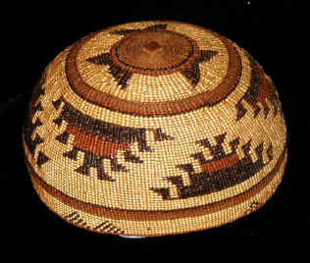
CAP

Slide 18
caps

Slide 19
Comparing Symbols across cultures
Egypt, Greece, Rome
Hupa, Karuk, Yurok
1. Animals
2. Plants
3. People
4. Shape (geometric, organic)
5. Line
6. Color
7. Pattern
1. Animals (abstract)
2. Plants
3. Shape (geometric, organic)
4. Line
5. Color
6. Pattern

