Slide 1
North Coast Arts Integration Project
A four year collaboration between HSU, Eureka City Schools and
Klamath Trinity Joint Unified School District

Slide 2
Objective: You will be able to describe the NCAIP and decide on your participation level in this dynamic, innovative, collaborative opportunity.

Slide 3
Question: Think of a favorite teacher you had.
What did they do? How did you feel in their class?
Were you engaged? Did you feel creative?

Slide 4
Elbow partners: share your memory of this teacher.
Keep them in mind during this presentation.

Slide 5
What is arts integration?
Arts
Curriculum
Arts
Integration
Core
Curriculum

Slide 6
Why arts integration?
CCSS require deep understanding of concepts best achieved by integrating various content areas
Provides advanced skills demanded by the complexity of modern life that are ignored by teaching only “The Basics”
Provides access points to engage a diverse student population and connects their world to the classroom
Develops 21st century skills in communication, collaboration, creativity, critical thinking, perseverance and innovation

Slide 7
https://www.youtube.com/watch?v=cPbKUF2zbyw

Slide 8
What is the grant?
$2.2 million budget federally funded through U.S. Department of Education's Arts in Education Model Development and Dissemination program
Grant targets eight schools
Provides technology, training and coaching to better teach CCSS through the integration of music, drama, dance and visual arts

Slide 9
Goals of the project & what can be expected
Improve student mastery of Common Core Performance Standards in Reading, Writing and Math.
Improve academic performance in STEM subjects.
Improve student engagement.
Double the amount of time students study the arts.
Develop a sustainable and replicable arts integration model.

Slide 10
Who is involved
Phase one involves Zane, Winship, Hoopa Valley and Trinity Valley 6-8 students.
Tish Nilsen - project director
Jack Bareilles - project evaluator
Heather Gaiera and Bill Funkhouser - project coordinators
Jennifer Lane - Klamath/ Trinity coordinator
Beth Foster - instructional coach
Lyn Scott & Mimi Dojka - HSU leads
You!

Slide 11
Two participation levels for 6th-8th teachers this year
Site Leaders
Teacher Participants

Slide 12
Site Leader | Teacher Participant
Design and implement arts integrated lessons into your curriculum
Collaborate and co-teach with teaching artists
Regular meetings to discuss progress
Be contact person at your school | _
40 hours professional development in Spring | _
4 Day Summer Institute | 3 day Summer Institute
3 year commitment | 1 year renewable commitment
$1000 per year | $500 per year

Slide 13
Site leader professional development
The 40 hours are flexible.
Attend what you can from over 60 planned hours to meet 40 hour requirement.
Online courses, HCOE forum, readings
Instruction will include integration strategies, technology training, curriculum alignment and mapping, collaboration with teaching artists

Slide 14
What we provide
Field trip opportunities to attend arts events
20 tablet computers for your school
Lesson plans and modules for arts & technology integration
Professional artist collaboration opportunities
Ample training to ensure your students’ success
Extended education credits available through HSU

Slide 15
Should you get involved?
Do you want your students to be creative problem solvers who work with others to persevere through the rigorous demands of weaving multiple ideas into a final project that demonstrates understanding of core standards?
Do you want to take your teaching and the learning of your students to ground breaking new levels?
Do you enjoy collaboration, research, and intentional alignment of your curriculum in ways that challenge and engage students?

Slide 16
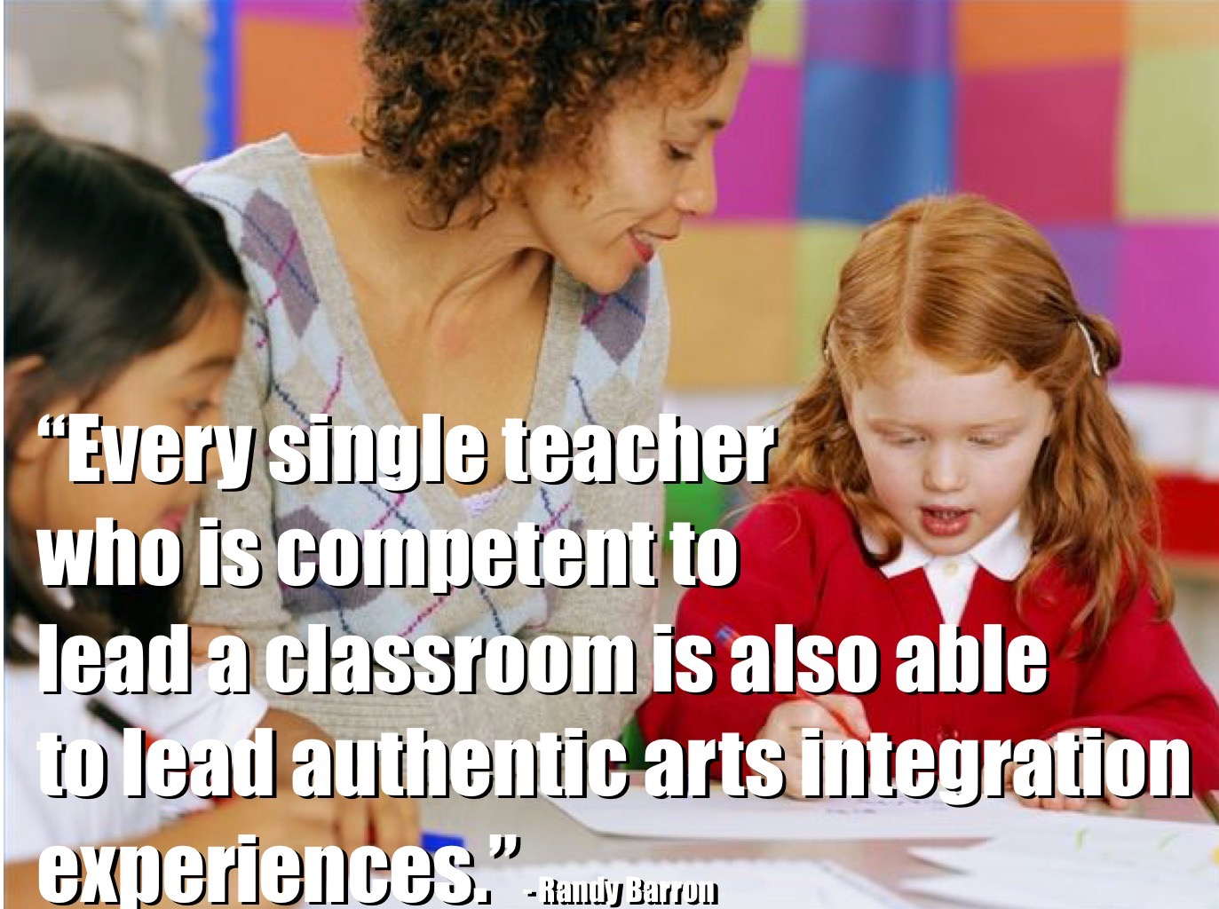

Slide 17
What are some positive things about this project that excite you?

Slide 18
Please fill out the paper form to indicate your participation level.
Site leader or
Teacher participant or
Not interested at this time

