Slide 1
Welcome ECS & KT
Site Leaders
Humboldt State University
May 27, 2015

Slide 2
B

Slide 3
Three More
Artful Thinking Routines
Handouts for your binder

Slide 4
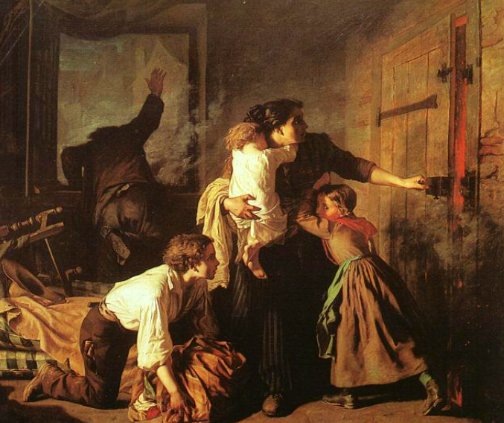
1
Perceive
3
Know
Care
About
2
H
Notes:
30 second art viewing
1-think time, whole group, what can she perceive? know? care about?
2- partners
3- whole group

Slide 5
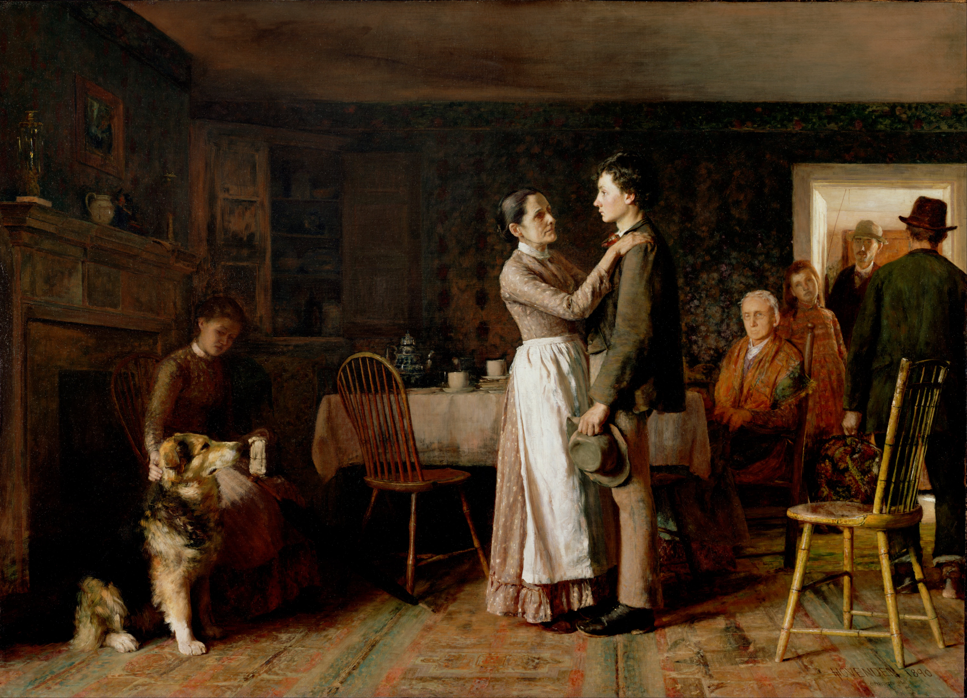
2
1
5
3
4
B
Notes:
View time
Chin answers
“I see my grandson is leaving, I know he’s hoping to find work, and I’m proud of him.” Who am I?
“All these people are worried about me. I have a job waiting for me in the west. I hope things work out.”
“Why isn’t he throwing the ball for me?”

Slide 6
Southern
soldiers
Northern
soldiers
Grant accepting
Lee’s surrender
Lee
surrendering
B

Slide 7
Perceive
2
x
Know
+
= 5
3
Care
About
B

Slide 8
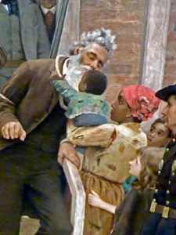
Perceive, Know, Care About
Explore perspectives
Can be inanimate objects (child’s stuffed animal, for example)
Can have students speak as the people and have everyone guess who they are.
Write from within the viewpoint
H

Slide 9
Anchor standards
W3: Write narratives to develop real or imagined experiences or events using effective technique, well-chosen details and well-structured event sequences.
R3: Analyze how and why individuals, events, or ideas develop and interact..
S&L: Demonstrate understanding of multiple perspectives…
H

Slide 10
Creative Comparisons
Metaphor
Simile
H
Notes:
A metaphor is a figure of speech that identifies something as being the same as some unrelated thing to highlight the similarities between the two.
Simile applies distancing words such as "like" or “as".

Slide 11
Creative Comparisons
Closed choice method:
Identify how aspects of the artwork are similar to something else.
How are they different?
B

Slide 12
Cells
Membrane: controls what goes in and out of cell
Vacuoles: stores water, waste, food, etc
DNA: biological information storage
Nucleus: directs cell actions
Mitochondria: produces energy
Endoplasmic reticulum: carries substances to parts of the cell
Cell wall: protects and supports cell
H

Slide 13
Membrane: controls what goes in and out of cell
DNA: biological information storage
Vacuoles: stores water, waste, food, etc
Notes:
15 second view

Slide 14
Try it with your curriculum
Open choice method
Think of a topic you teach.
Choose one of the four images.
Create comparisons/ similes for how the image relates to the topic.
B

Slide 19
1
2
3
4

Slide 20
CCS Standards
G5 RL: Determine the meaning of words and phrases as they are used in a text, including figurative language such as metaphors and similes.
CCSS design structure is cross disciplinary

Slide 21
Elaboration game
H

Slide 22
ELA Literacy
S&L 6.1 Follow rules for collegial discussion
Pose and respond to questions with elaboration and detail by making comments that contribute to the topic, text, or issue under discussion
Review key ideas expressed and demonstrate understanding of multiple perspectives
H

Slide 23
Person 4: describe a new part of the artwork. (repeat)
Person 1: describe part of this artwork.
Person 2: Elaborate on what person 1 saw
Person 3: Add yet more
B
Notes:
Count off, hold up number, describe the role to each person

Slide 24
Reflection
Perceive, know, care about
Creative Comparisons
Elaboration Game
Think/ Ink: on back of any paper, write which one you could see yourself using next week & how you would use it.
Pair: discuss your choice with elbow partner
H
Notes:
The goal of professional development is to get these techniques fully learned, in use in classrooms, changing the culture of schools and affecting student learning.

Slide 25
Review of Previous
Artful Thinking Strategies

Slide 26
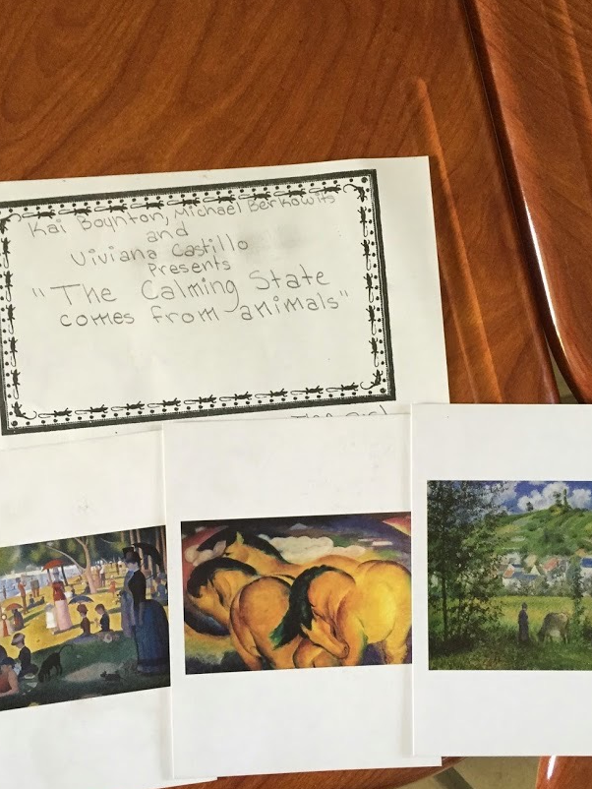
Curate a Show:
Hand out images
Students select theme and choose images that support the theme
Write statement & present exhibit
“The calming state comes from animals.”
H

Slide 27
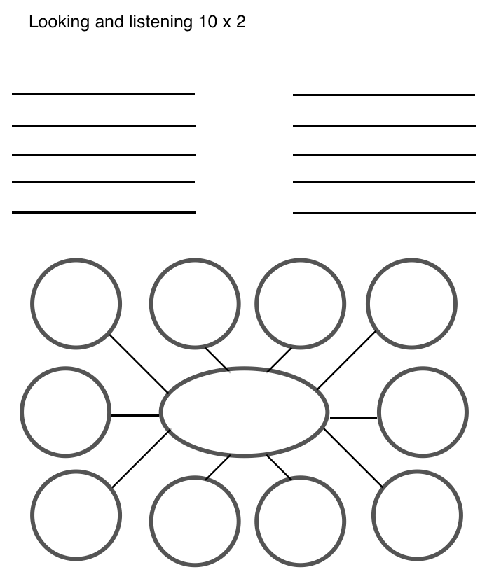
10 x 2
List 10 words or phrases about image
Share
Pick one word or phrase and write 10 more words/ phrases to further elaborate
B

Slide 28
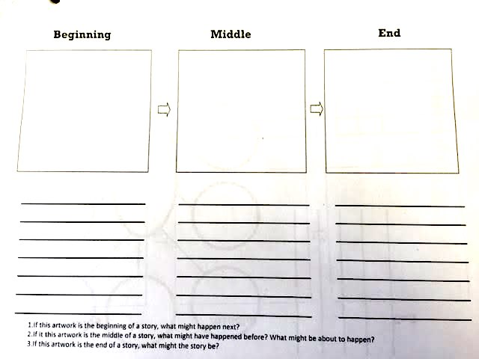
Beginning, Middle or End
Decide if the image is from beginning, middle or end of story
Write and illustrate the other two parts.
H

Slide 29
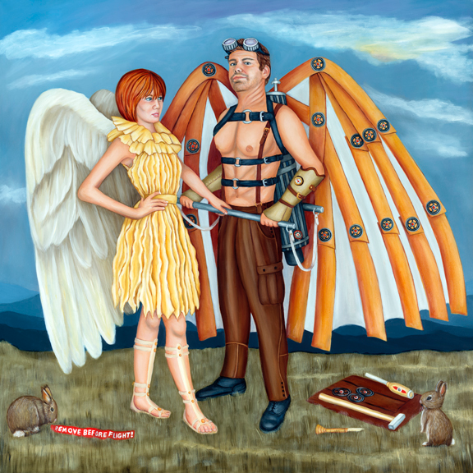
What’s going on in this picture?
“What’s going on?”
“What do you see that makes you say that?”
Paraphrase
“What else can you find?”
Notice: inference then evidence
B

Slide 30
See, Wonder, Think
List three things you see
Write what you wonder about those things
Answer your own questions
Notice: evidence then inference
H

Slide 31
Telephone
Position so one person sees image and other does not
Have conversation to describe image and draw it.
Extensions possible
B

Slide 32
Artful thinking routines
Routine/ “Back pocket activities”
Many can be used without much preparation
Summer institute presentation?
H

Slide 33
Making Learning Visible
H

Slide 34
Mimi Dojka
Art scholar &
artist collaboration coordinator
B

