Slide 1
North Coast Arts Integration Project
Update to KTJUSD leaders
March 9, 2015

Slide 2
What is arts integration?
Arts
Curriculum
Arts
Integration
Core
Curriculum
B

Slide 3
Spring training update
H

Slide 4
Spring training
KTJUSD: March 9 training
ECS Training: April 7 full day training
KTJUSD & ECS: May 27 full day training
You will have 5 or more remaining hours of training to complete which can include discussion with us, preparation for the summer, and independent reading/ research. Weekend?
H

Slide 5
Summer update
B

Slide 6
Summer training
 | Day 1 (Aug 11) | Day 2 (Aug 12) | Day 3 (Aug 13) | Day 4 (Aug 14)
Morning 9AM-12PM | SL: prepare for the week | 9-10 subject level meetings/ SL present AI unit to PT |  | Begin individual collaboration meetings with artists/ teachers Site meetings Planning units for next year. Fresno consulting all day long
 | PT: foundational information | 10-11 SL & coordinators present to all 11-12 Fresno COE presents to all
12PM-1PM | LUNCH
Afternoon 1PM-4PM | SL: run through presentations | Fresno COE presents to all
 | PT: AI unit experience
B

Slide 7
Commitment update
H

Slide 8
Site Leader | Teacher Participant
Design and implement arts integrated lessons
Collaborate and co-teach with teaching artists
Regular meetings to discuss progress
4 Day Summer Institute August 11-14
Present at Summer Institute
Be contact/ organizing person at your school | _
30 hours professional development in Spring | _
3 year commitment | 1 year renewable
$1000 per 12 month year (1/2 in June then 1/2 in Dec) | $500 per year (paid in June)

Slide 9
Next year update
B

Slide 10
Opportunities next year
Teachers apply artful thinking strategies to increase engagement, creativity, and critical thinking. (daily routines)
Teachers teach art skills and concepts while teaching the core curriculum. (regular practice)
Teachers implement arts integration units where students construct and demonstrate understanding of core content through an art form. (occasional)
B

Slide 11
Opportunities next year
Visiting Artists come to your school to teach skills and concepts and teachers have the opportunity to make connections to other content areas.
Collaborating Artists plan longer units with you so students can engage in a creative process which connects an art form to another subject area and meet objectives in both.
Students experience visual art, theatre, music or dance through a field trip and/or site-based performance. Teachers have the opportunity to enhance the learning and make connections to other content areas in the classroom.
H

Slide 12
Current visiting/ collaborating artist opportunities
as of February 2015
DANCE: Creative Movement, Folk, Modern, Choreography
LITERARY ART: Poetry, Storytelling
MUSIC: Composition, Folk, Percussion, Rhythm and rhyme, Singing, Kodaly Method
THEATRE: Creative Drama, Melodrama, Clown, Improvisation, Mask making, Puppetry, Reader’s Theatre, Script Development, Voice
TRADITIONAL ART: Carving, Weaving, Sewing
VISUAL ART: Art History, Assemblage, Book making, Cartoons, political cartoons Ceramics, Color and Design, Computer Art/Graphic Design, Drawing, Graffiti (legal surface), Jewelry, Marbling, Mixed Media, Murals, Painting, Photography, Printmaking, Scratchboard, Sequential art (comics, graphic novels), Sculpture, Stenciling, Watercolor
B

Slide 13
Binders
H

Slide 14
Today’s agenda
Introducing the Triple P lesson objective
H

Slide 15
P___________ (Big picture, the why) | We will explore arts integration and develop our teaching practice by
P___________ (The activities, the how) | visualizing roles and possibilities in arts integration practicing artful thinking strategies and planning for implementation developing foundational concepts and vocabulary (afternoon-if you can)
P___________ (The results or outcomes, the what) | resulting in the field test of at least two artful thinking lessons in your class, the collection of student work samples and preparation for reflection with our team on May 27.
oint
ath
roduct
H

Slide 16
Summer presentations
Artful thinking strategies: BME, Telephone, What’s going on in this picture?, See, Wonder, Think, Elaboration Game, Creative Questions, etc.
Elements & Principles of Visual Art, Music, Theater…
Making Learning Visible, Studio Habits of Mind,
Writing lesson plans in the NCAIP format
Why Arts Integration?

Slide 17
Why arts integration
Low income children involved with arts integration are 4 times more likely to have high academic achievement than those who don’t.
Without
Arts
With
Arts
B

Slide 18
Why arts integration
Low income children involved with arts integration are 3 times more likely to have high attendance than those who don’t.
Without
Arts
With
Arts
B

Slide 19
Why arts integration
79% of teachers say arts integration “totally changed their teaching”.
79%
Journal for Learning Through the Arts 2014
H

Slide 20
Why arts integration
94% of teachers gained “additional ways of teaching critical thinking skills” through arts integration
94%
Journal for Learning Through the Arts 2014
H

Slide 21
Why arts integration
Arts integration techniques that use multiple senses are correlated with more information stored in long term memory.
Journal for Learning Through the Arts 2014
H

Slide 22
What does it look like?
Teachers trained in arts integration embed the arts in their classroom lessons in all subjects to introduce, support, reinforce and assess learning.
Classrooms are safe learning environments where students are encouraged to explore, experience and discover.
Data, assessment and accountability inform instruction.
Lessons often shift from teacher directed to student directed.
H

Slide 23
What does it look like?
Students connect to prior knowledge and patterns of play.
Classroom creates opportunities for multi-modal learning that engages a broad range of learning styles.
Students engage in critical thinking, creativity, cooperation, communication and problem solving.
Classrooms have high level of rigor teaching core standards.
Parent and community involvement is more frequent.
B

Slide 24
Artful Thinking Strategies
From Project Zero, an educational research group at the Harvard Graduate School of Education
Could you present one of these during the summer?
B

Slide 25
What we will do today
Provide foundational thinking strategies for any classroom on any day
Guarantee minimal preparation and no clean up
Increase engagement, creativity and critical thinking in your classroom
Use these techniques in your class tomorrow
B

Slide 26
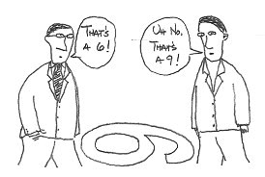
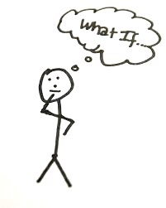
Artful Thinking Purposes
Reasoning- cite evidence
Perspective taking- understand point of view
Questioning and investigating- What if, how, why?
B

Slide 27
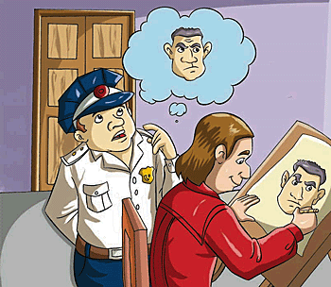
Artful Thinking Purposes
Observing and describing- elaborating
Connecting new ideas to prior knowledge- extend
Finding complexity- uncover multiple dimensions
B

Slide 28
Think outside the boundaries of these examples.
B

Slide 29
Goal 1: use 2+ of these in your classroom and collect student work samples before May 27
B

Slide 30
Goal 2: consider presenting one of these strategies as part of your summer leadership responsibilities
B

Slide 31
Beginning,
Middle or End?
Observing & describing
Connecting new ideas to prior knowledge
Perspective taking
Purpose:
Bloom’s Taxonomy
B

Slide 32
Beginning, Middle, End
If this is the beginning of a story, what happens next?
If this is the middle of the story, what happened on either side of this moment?
If this is the end of the story, what was the story about?
H

Slide 33
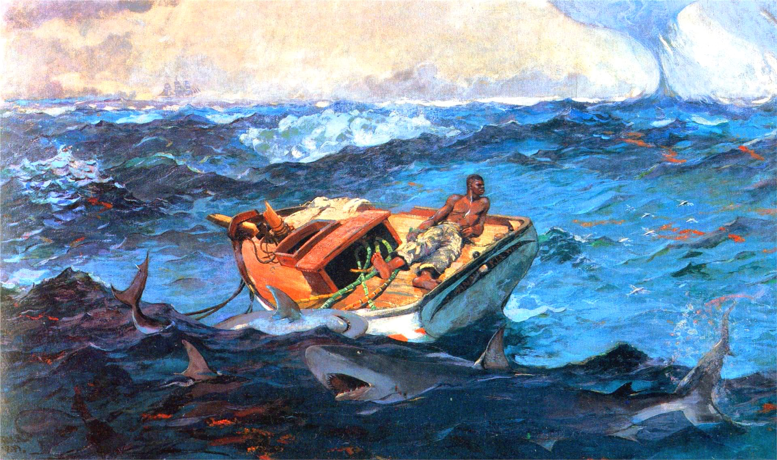
What was presented January 26 at HCOE
H

Slide 34
Focus considerations
Setting
Plot
Character
Point of view
Dialogue
Conflict
Theme

Slide 35
Look closely to write a beginning, middle or end story that uses details you can point to in this image
H

Slide 36
Gregory Crewdson
“Untitled”
1998-2002
B

Slide 37
“I was always influenced by a particularly American tradition of art making that searches to find an intersection between ordinary life and theatricality. The painting of Edward Hopper and Norman Rockwell…The photographs of Walker Evans, Diane Arbus, William Eggleston…
The short stories of Raymond Carver and John Cheever. The movie Blue Velvet fits squarely within this tradition. The tension between ordinary life and something mysterious and unknown.”

Slide 38
Edward Hopper
1952
Diane Arbus
1962
David Lynch
1986

Slide 39
B

Slide 41
H

Slide 42
Writing Anchor Standard #3
Write narratives to develop real or imagined experiences of events using effective technique, well-chosen details and well-structured event sequences.
H

Slide 43
Telephone*
Observing & describing
Perspective taking
B

Slide 44
B

Slide 45
Telephone
“Receiver” has back to screen and sketches the image
The “caller” describes the image using as many of the vocabulary words as possible but can not see what is being drawn.
They can have a conversation.
B

Slide 46
Telephone
Math words: quadrants (I, II, III, IV) , origin, quarter, radius, congruent, parallel
Art words: solid tone, overlap, shape, opaque, translucent
origin
B

Slide 47
Ready?

Slide 48
quadrants (I, II, III, IV)
origin, quarter
radius, congruent
parallel
solid tone, overlap
shape, opaque
translucent

Slide 49
Tommie Olafson
“Wherever you go I will follow”
2006
B

Slide 50
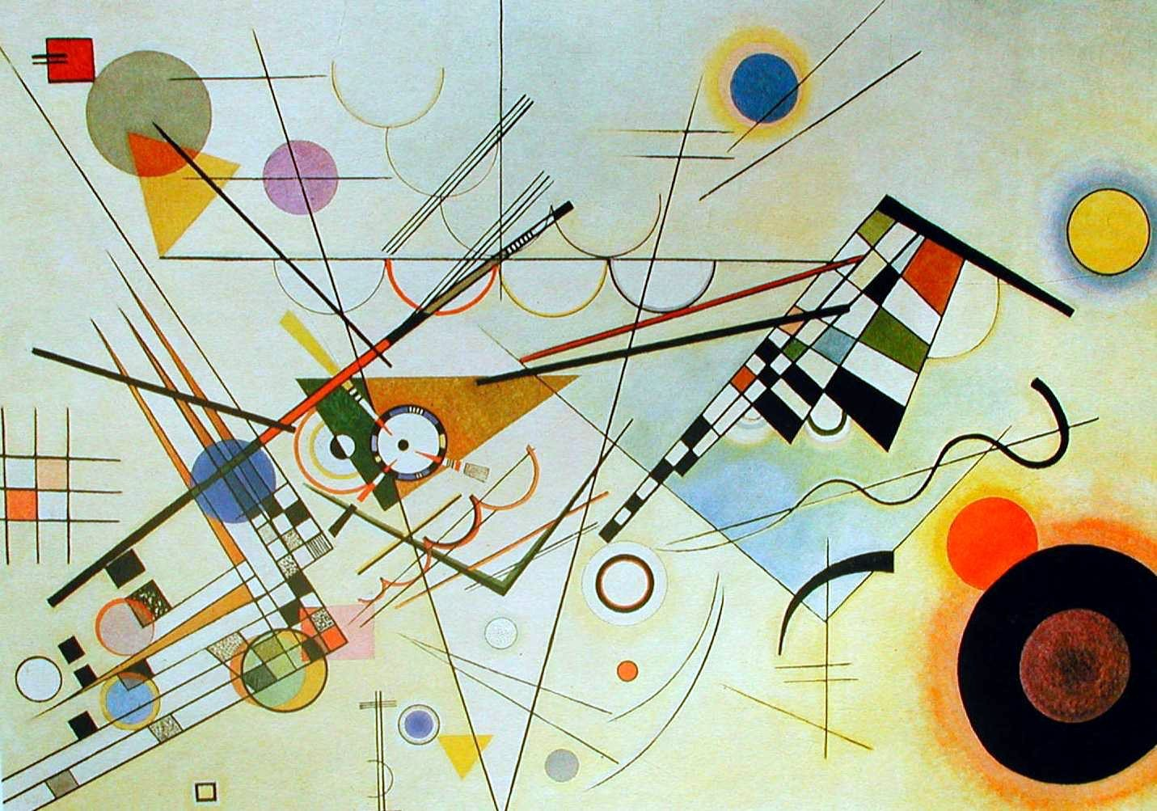
Wassily Kandinsky
B

Slide 51
B

Slide 52
Speaking and Listening Anchor Standards #1, 2, 4
Participate in a range of conversations with diverse partners
Integrate and evaluate information presented visually and orally
Present information so that listeners can follow the line of reasoning and organization
H

Slide 53
Telephone
Excellent strategy for ELL (prepositions, etc)
Extension/assessment piece/ performance task produce creative work from a given description with differentiation (handout)
H

Slide 54
What’s Going On In This Picture?
Observing & describing
Reasoning
Questioning
H

Slide 55
What’s going on in this picture?
Start with observation period
Explain what is going on in this picture
You will be asked to support your inference with evidence
H

Slide 56
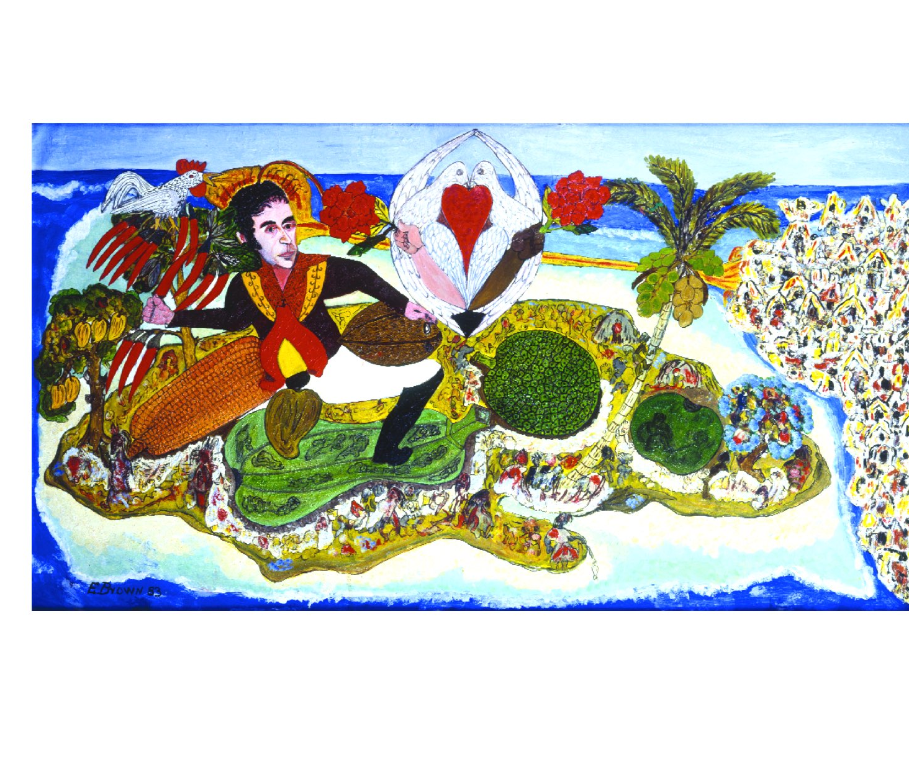
H

Slide 57
Look carefully at this artwork for 60 seconds.
What do you see that makes you say that?
What do you think is going on here?

Slide 58
Thomas Hart Benton
“Cut the line” 1944
Mr. Benton is considered by many art critics to be the quintessential American artist of the 20th Century, and during World War II was commissioned by Abbott Laboratories to produce artworks about the Navy. This 1944 artwork “Cut the Line” shows the launch of a Tank Landing Ship (LST). The audience leans forward with breathless expectation as the foreman of the crew holds his hat high. Seconds later, the hat came down, the crowd roared and a new ship joined the US landing craft armada. These ships, built along the banks of the Ohio River were launched sideways instead of stern first.

Slide 60
Three questions
What is going on in this picture?
What do you see that makes you say that?
What more can you find?
B

Slide 61
What is going on in this picture?
Assumes the art has meaning and expects the viewer to read it for this meaning
Inquiry model
Open ended responses
No right or wrong answers
Every interpretation rests on the next question
H

Slide 62
What do you see that makes you say that?
Can change wording to “what can you point to…” or “what evidence do you have for this viewpoint”
Students justify their thinking with evidence
Tremendous value in verbalizing what visual clues led to a particular opinion or hypothesis
B

Slide 63
What else can you find?
Can always go deeper
Thoughtful conversation can be had about the artist, the meaning of the work, artist intention, the audience, etc.
Students are used to “You are right, next question” routine rather than a cycle of hypothesis, justification and further exploration.
Right!
Next!
H

Slide 64
EVIDENCE
H

Slide 65
Read, write and speak grounded in evidence
Construct viable arguments
Engage in argument from evidence
H

Slide 66
Learning to read
Learning to cite evidence
Images are the original communication method and are critical when learning new skills
B

Slide 67
See, Wonder, Think
Observing & describing
Reasoning
B

Slide 68
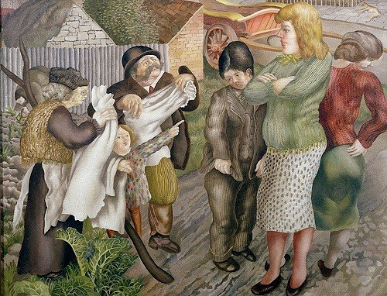
B

Slide 69
Write 3 things you see objectively without inference.
Look carefully at this photograph for 60 seconds.
Write 3 things you think/ hypothesize.
Write 3 things you wonder about.
B

Slide 70
“It appears in this picture that a man is trying not to drown in some kind of sewer, and he seems quite in danger because of the frightened look on his face. However, maybe it’s some sort of public punishment because the police are looking at him while driving by and random people to the left don’t seem to care either. It also looks like the area he is in has been barred off, so maybe nobody is allowed to help him. The place seems to not be the richest place on earth. This area is worn down, and it seems Latin because of the writing on the police’s shirt. It is also possible that he is seeking refuge from the police, but he has failed as they have found him.”
B

Slide 71
Fermin Pena attempts to repair
a broken pipe in Caracas, Venezuela
AP Photographer: Rodrigo Abd
2012
B

Slide 72
See, Wonder, Think
See: observation and description (evidence first)
Wonder: process the image sufficiently to come up with a question
Think: construct a hypothesis
Some teachers separate these into separate sections (3 things you see, then 3 things you wonder, etc)
Can combine See, Wonder, Think into one sentence
Some sources use “See, think, wonder”
1, 2, 3
1, 2, 3
?
B

Slide 73
CCSS Reading
Anchor Standard #1
Read closely to determine what the text says explicitly and make logical inferences from it.
Cite specific evidence to support conclusions.
H

Slide 74
What’s going on in this picture? | See, Wonder, Think
Inference followed by evidence | Evidence then inference
“I think the tall woman is angry because her arms are crossed.” | “I see a tall woman with arms crossed. I wonder how she is feeling. I think she is angry.”

Slide 75
See, Wonder, Think
What’s Going On in
this Picture?

Slide 76
H

Slide 77
See, Wonder, Think w/ David Cooper
https://www.teachingchannel.org/videos/interpreting-ancient-art-getty
B

Slide 78
Where can you get images?
Online search
_____________(concept) + “painting” or “sculpture”
Calisphere.com for California history documents/ photos
nytimes.com has weekly “What’s going on in this picture?” series
getty.edu & google art project display art at amazing resolution
H

Slide 79
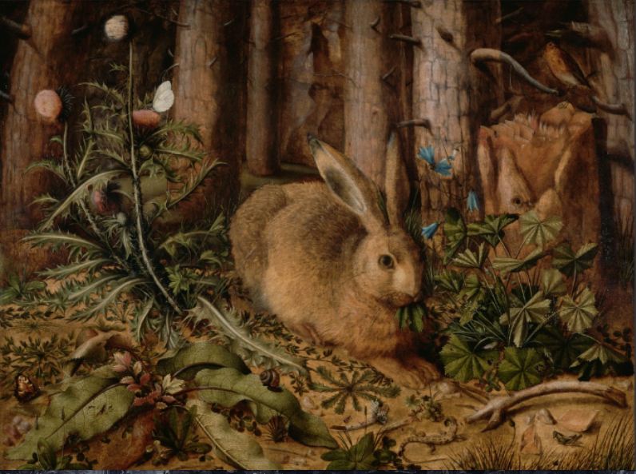

Slide 80
Artwork in text is more than decoration
H

Slide 81
Goal 1: use 2+ of these in your classroom and collect student work samples before May 27
B

Slide 82
Goal 2: consider presenting one of these strategies as part of your summer leadership responsibilities
B

Slide 83
Summer presentations
Artful thinking strategies: BME, Telephone, What’s going on in this picture?, See, Wonder, Think, Elaboration Game, Creative Questions, etc.
Why Arts Integration?
Elements & Principles of Visual Art, Music, Theater…
Making Learning Visible, Studio Habits of Mind

Slide 84
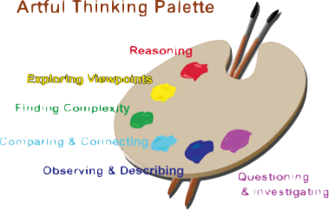
Field Test Planning
Choose 2+ Artful Thinking Strategies to use in your classroom
Choose core topic for each
Choose image for each
Discuss & plan with us

Slide 85
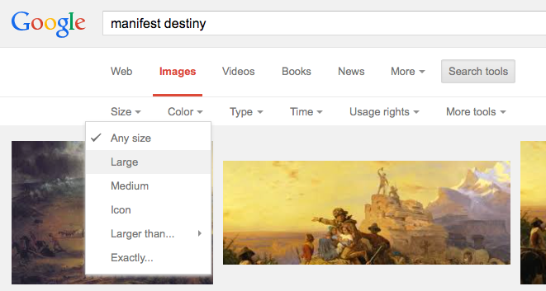
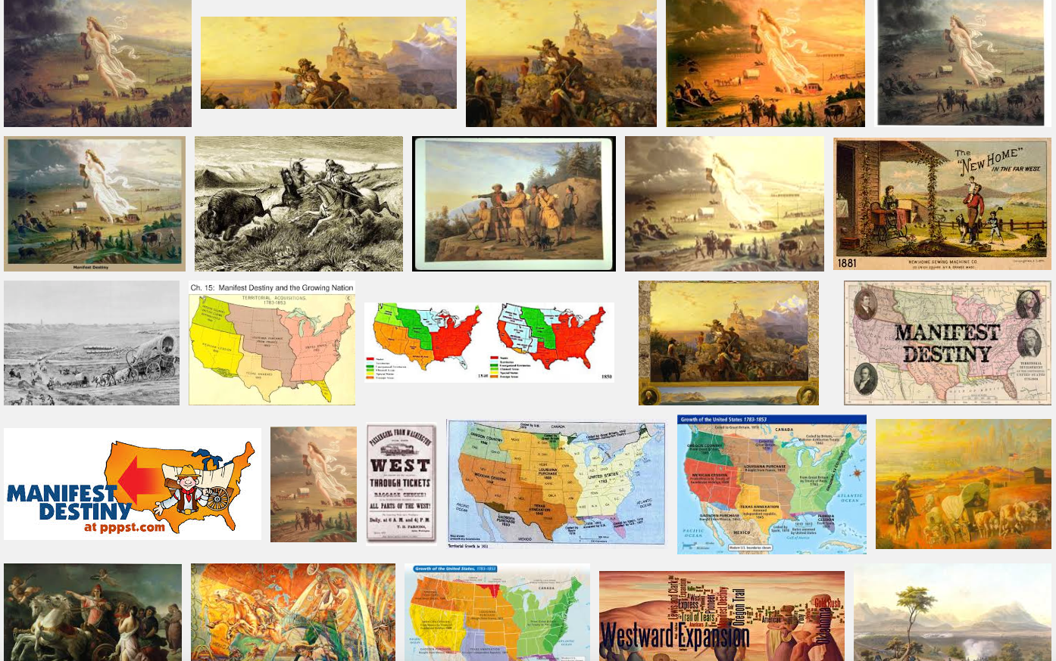

Slide 86
Consider several images

Slide 87
Select one image
BME
Telephone
What’s going on
See, Wonder…
I will use this image with the “See, Wonder, Think” strategy

