Slide 1
North Coast Arts Integration Project
KTJUSD April 28, 2015

Slide 2
Curate a show
Curators select and arrange artworks to inform and inspire people.
Many exhibitions are organized around a theme.
Most shows have a curator’s statement explaining the thinking behind their selection.
H

Slide 3
Collaborate to sort and select images for a small exhibition based on a theme of your choice.

Slide 4
Exhibition themes
Elements of art such as color, line, shape, texture, value
Objects and what they say about us
Relationships, types of love, emotion
Identity: what does the art tell you about the artist or yourself?
Place: What do our surroundings communicate?
Content specific theme: cells, federalism, greek gods
Explore and extend: would you change your theme now?
B

Slide 5
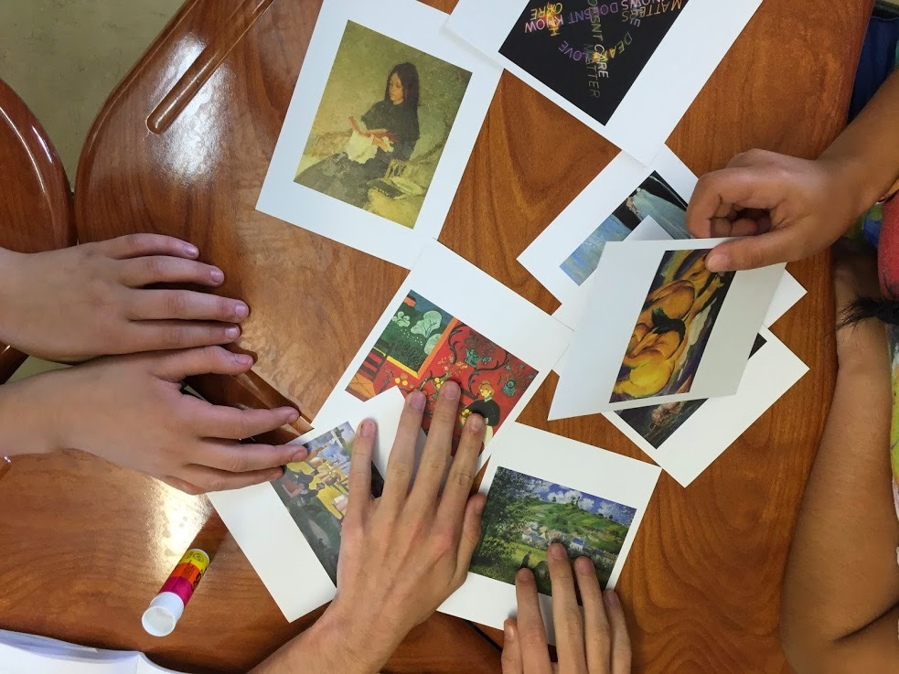

Slide 6
Share your show

Slide 7
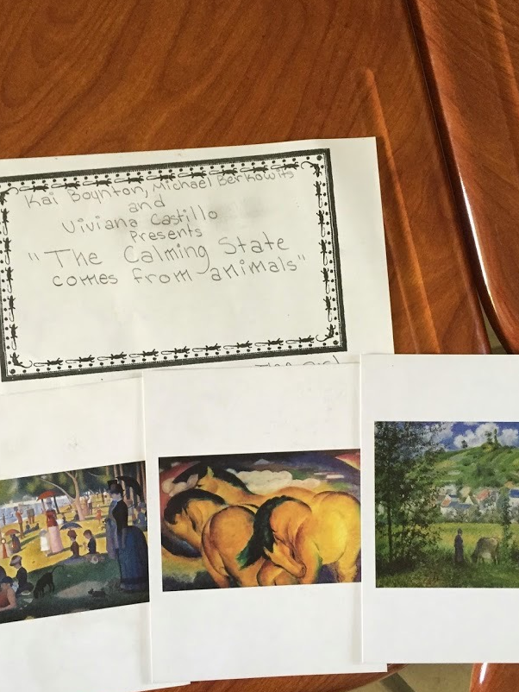
Zane Middle School
student group
“The calming state comes from animals.”
H

Slide 8
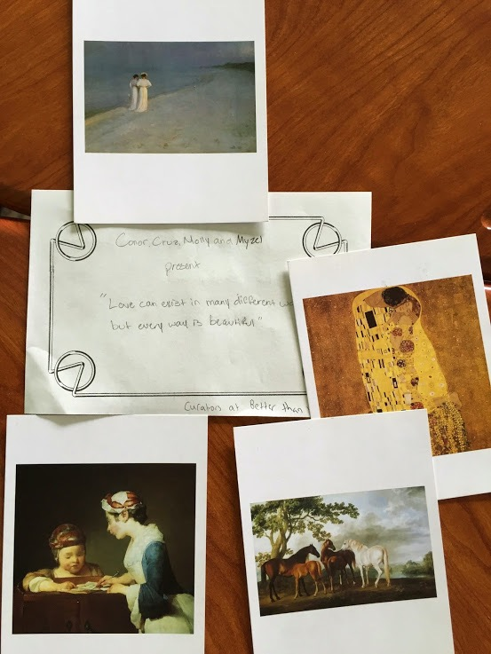
Zane Middle School
student group
“Love can exist in many different ways, but every way is beautiful.”
H

Slide 9
Speaking and Listening Anchor Standards #1, 2, 4
Participate in a range of conversations with diverse partners
Integrate and evaluate information presented visually and orally
Present information so that listeners can follow the line of reasoning and organization
H

Slide 10
Binders
H

Slide 11
Today’s agenda
Introducing the Triple P lesson objective
H

Slide 12
P___________ (Big picture, the why) | We will explore arts integration and develop our teaching practice by
P___________ (The activities, the how) | practicing 2 new artful thinking strategies and seeing what arts integration looks like reflecting on our instructional practice so far requesting artist collaboration pilot for this year planning for summer training
P___________ (The results or outcomes, the what) | resulting in the field test of at least two artful thinking lessons in your class, the collection of student work samples and preparation for reflection with our team on May 27.
oint
ath
roduct
H

Slide 13
B

Slide 14
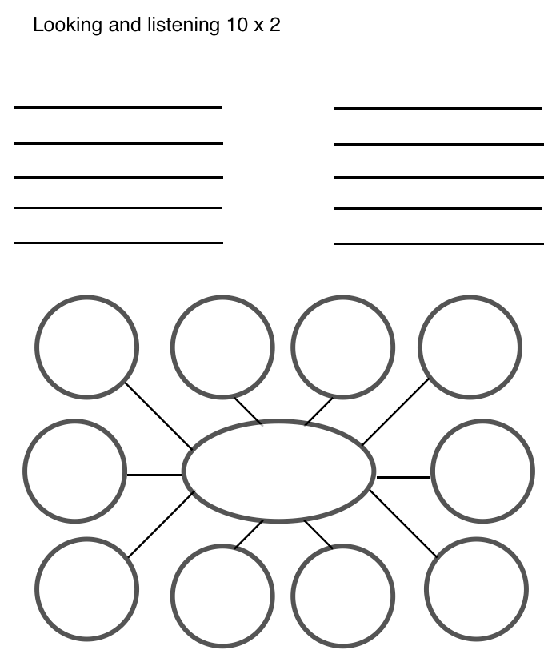
10 x 2
Make a list of 10 words or phrases to describe things you see.
Look carefully at the artwork for 30 seconds.
Share your words.
B

Slide 15
Carmen Lomas Garza

Slide 16
Carmen Lomas Garza The Fair at Reynosa 1987

Slide 17
Evert Collier, Körül
1699

Slide 18
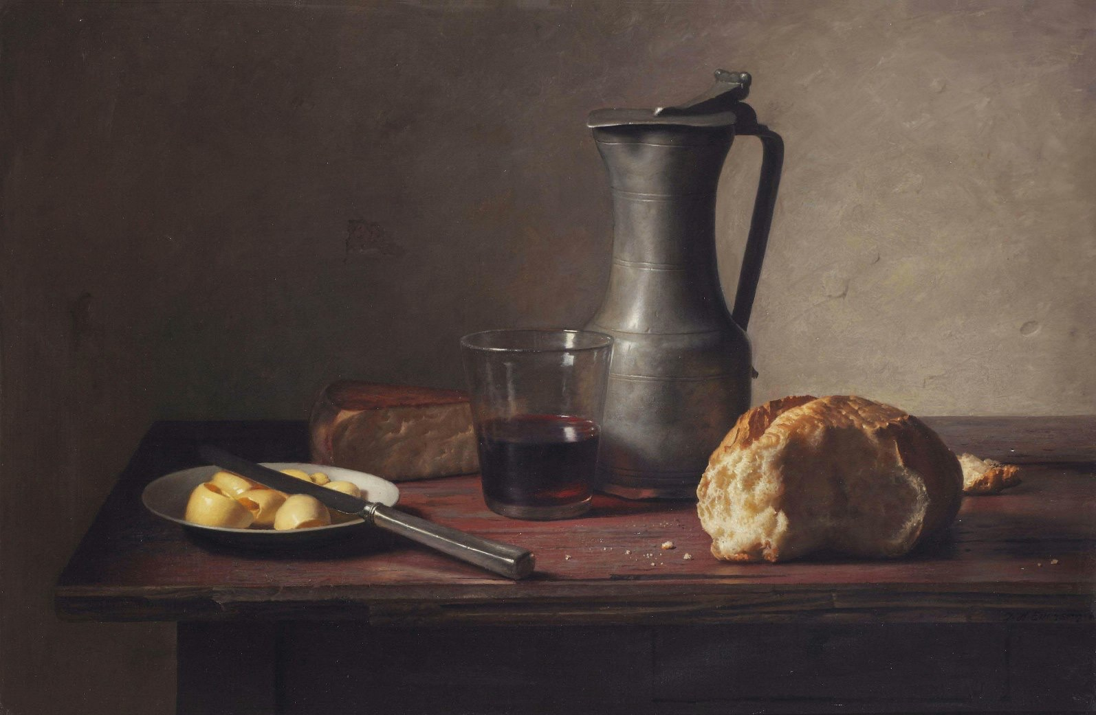
'A still life with cheese, bread, butter and wine'
Jan Eversen (Dutch painter, 1963)

Slide 19
H

Slide 20
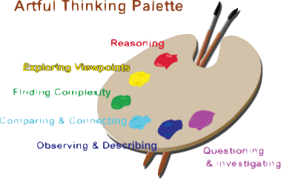
Field Test
Choose 2+ Artful Thinking Strategies to use in your classroom
Choose core topic for each
Choose image for each
H

Slide 21
Think, Ink, Pair, Share
What have you tried?
What was great about it?
What would you do differently next time?
Where can you see it going?
H

Slide 22
What does
arts integration look like in schools?
B

Slide 23
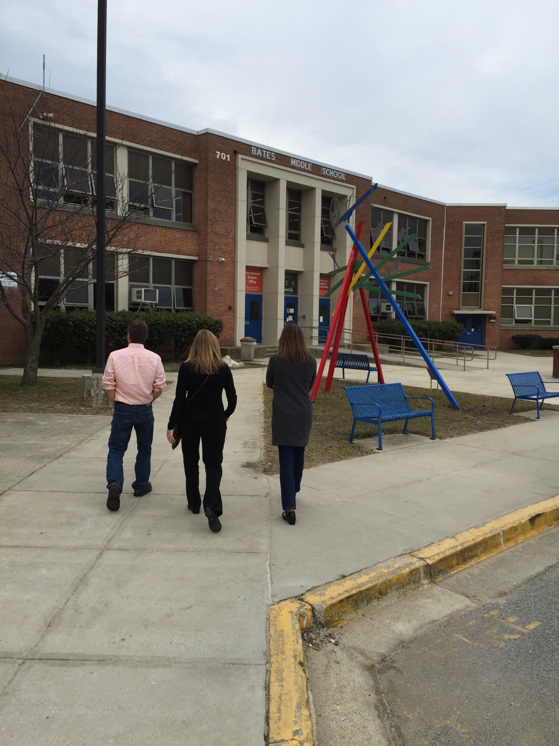
B

Slide 24
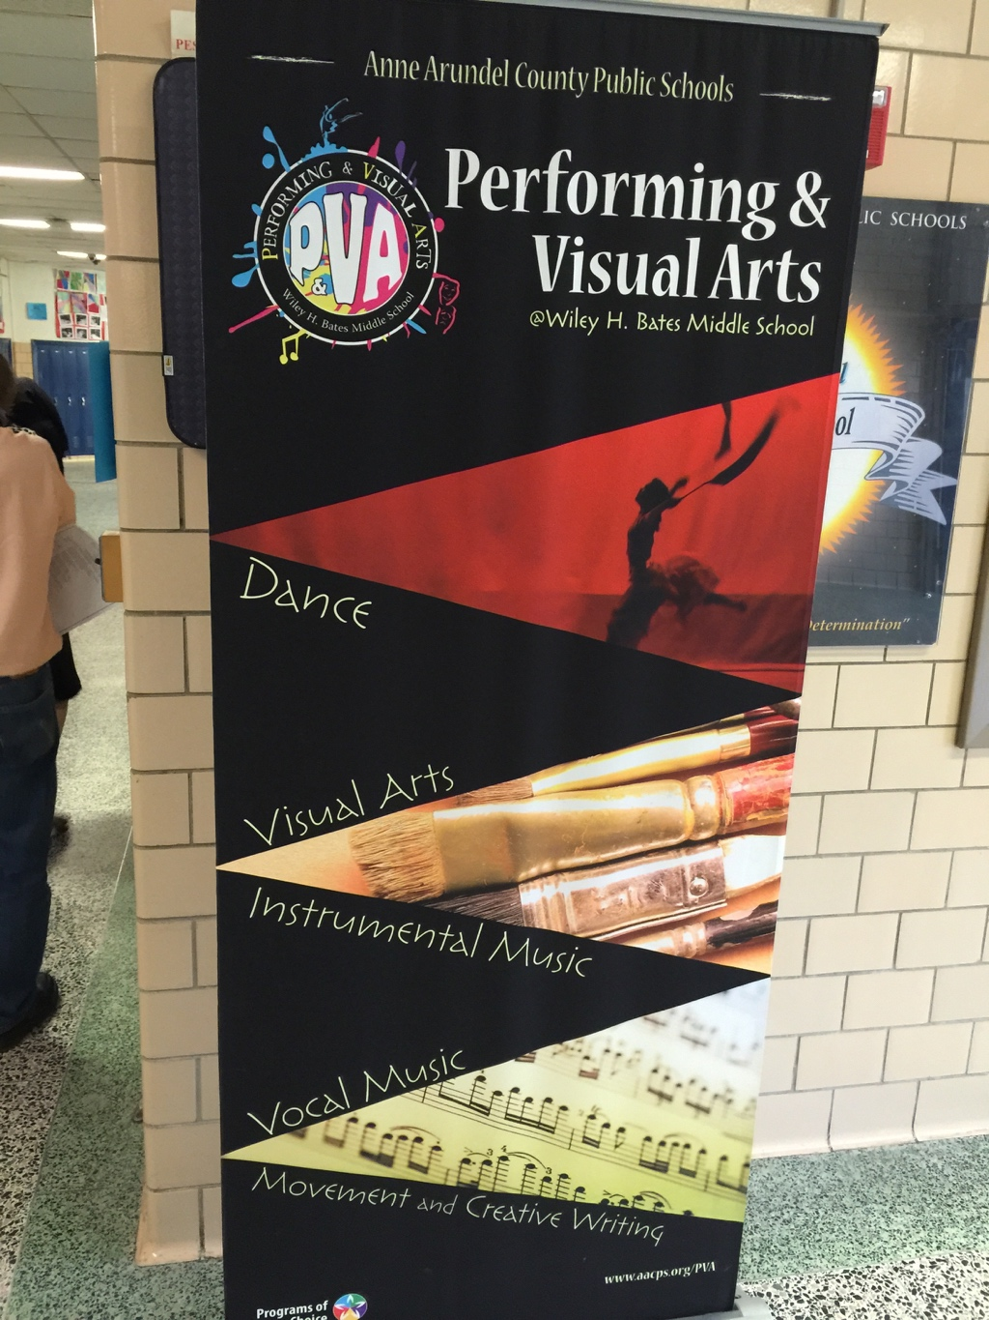
B

Slide 25
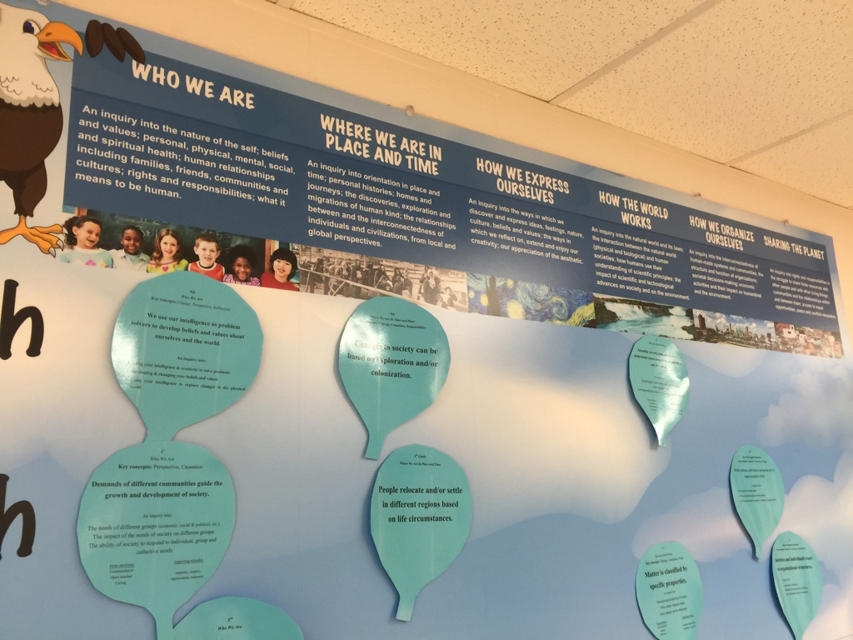
B

Slide 26
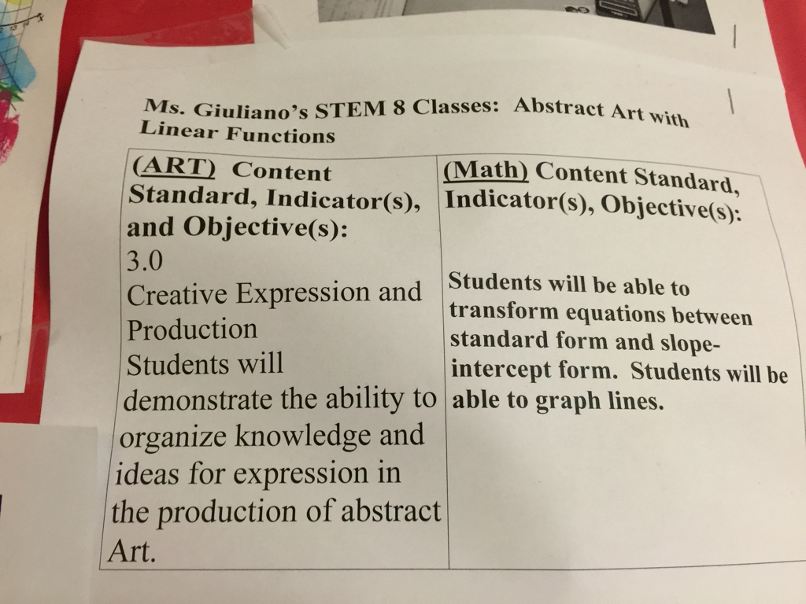
B

Slide 27
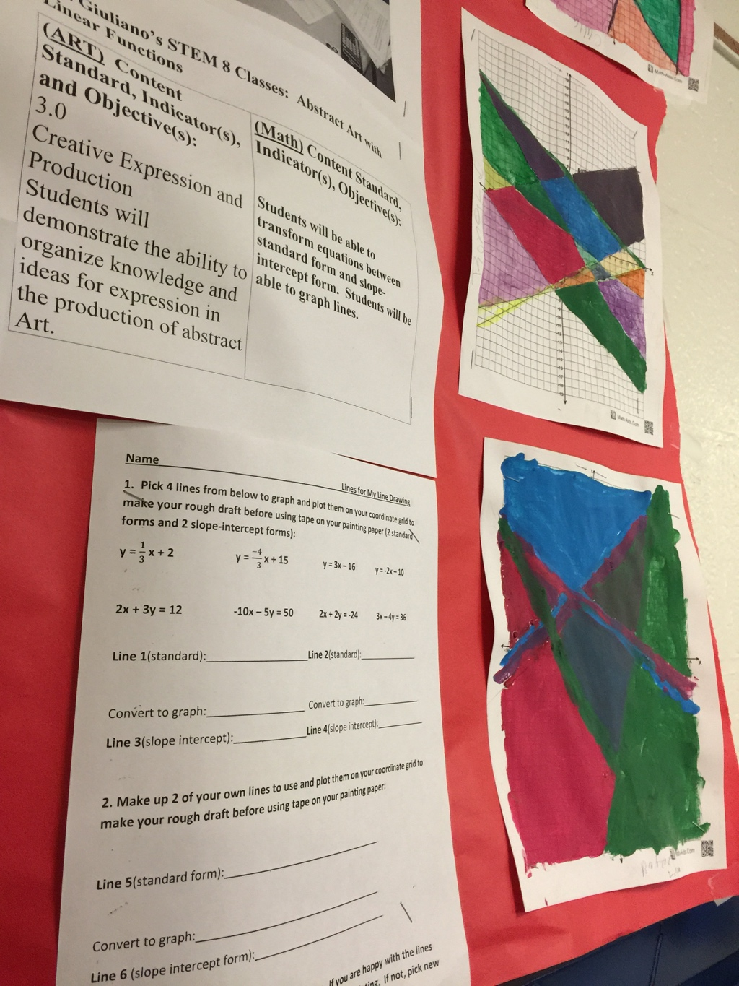
B

Slide 28
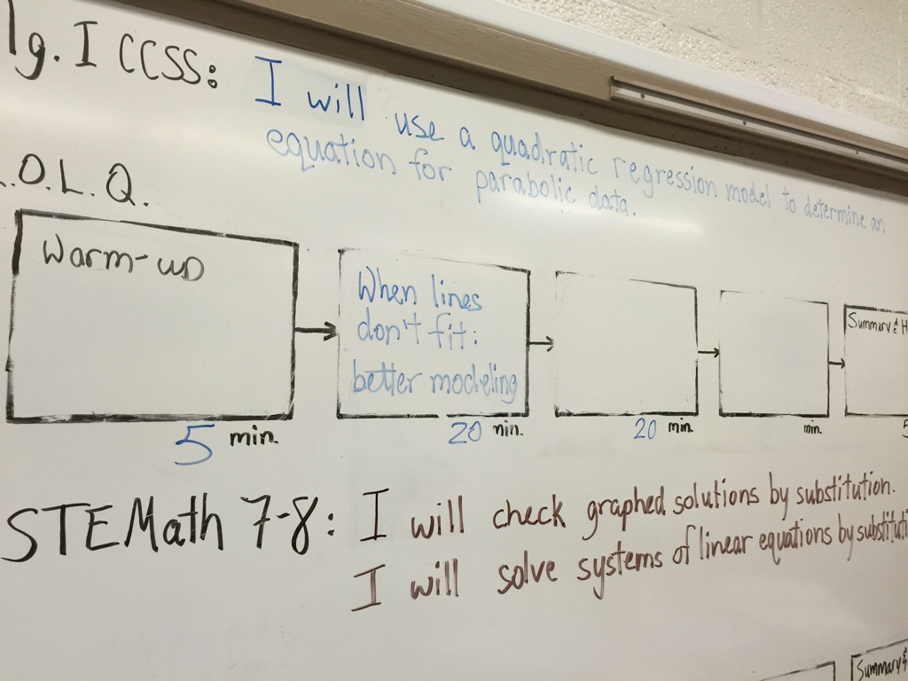
B

Slide 29
B

Slide 30
B

Slide 31
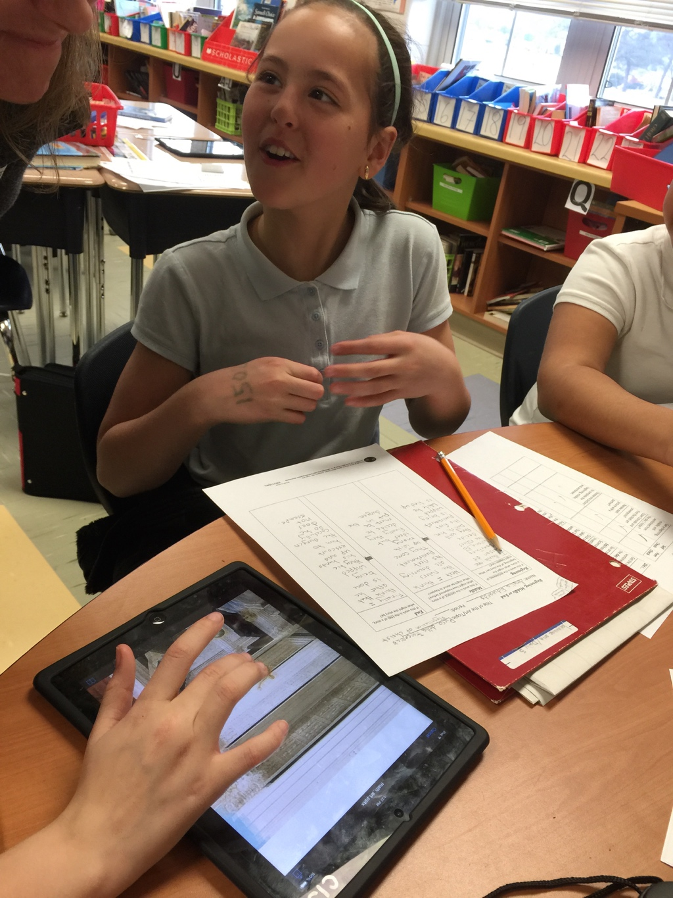
B

Slide 32
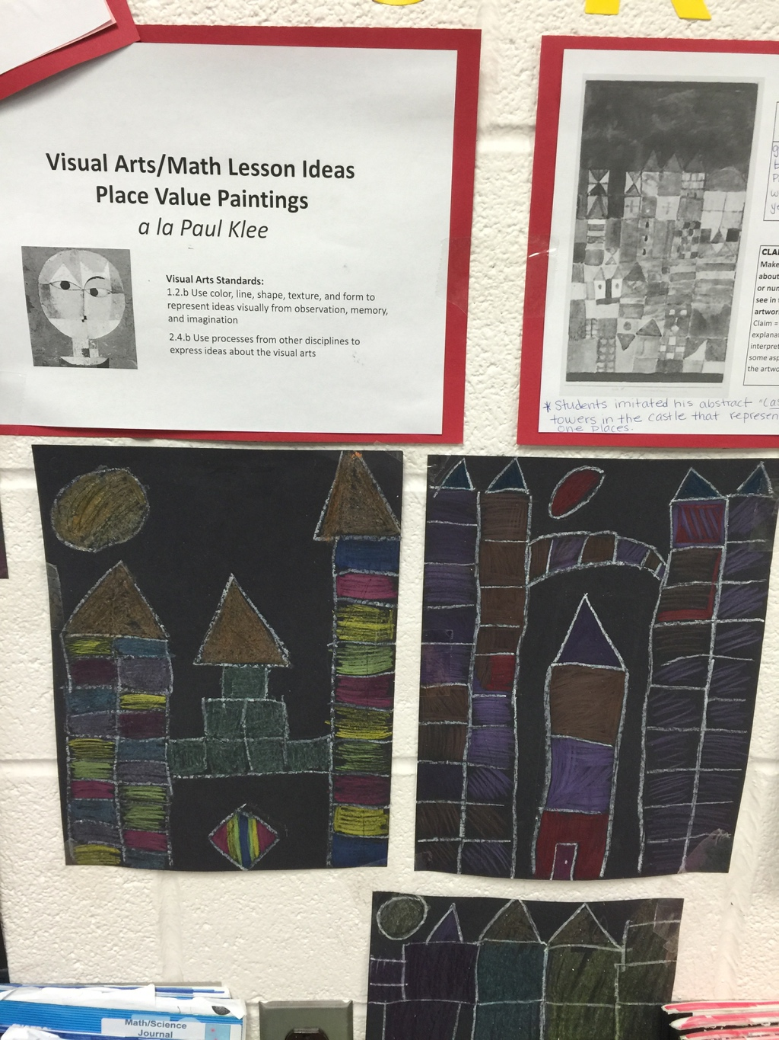
B

Slide 33
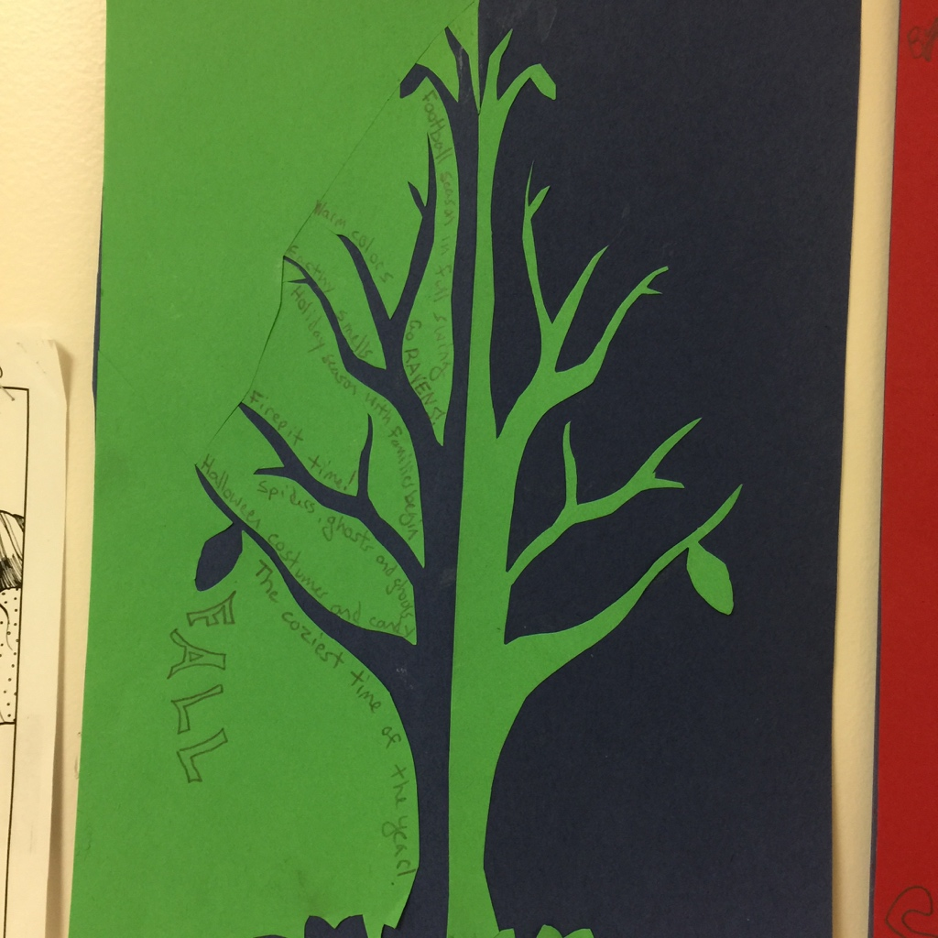
B

Slide 34
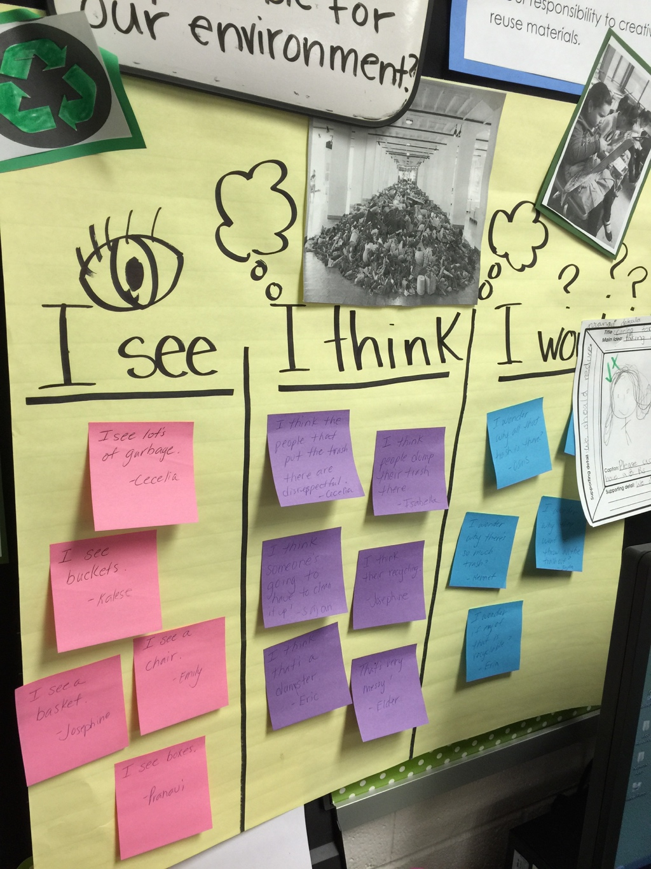
B

Slide 35
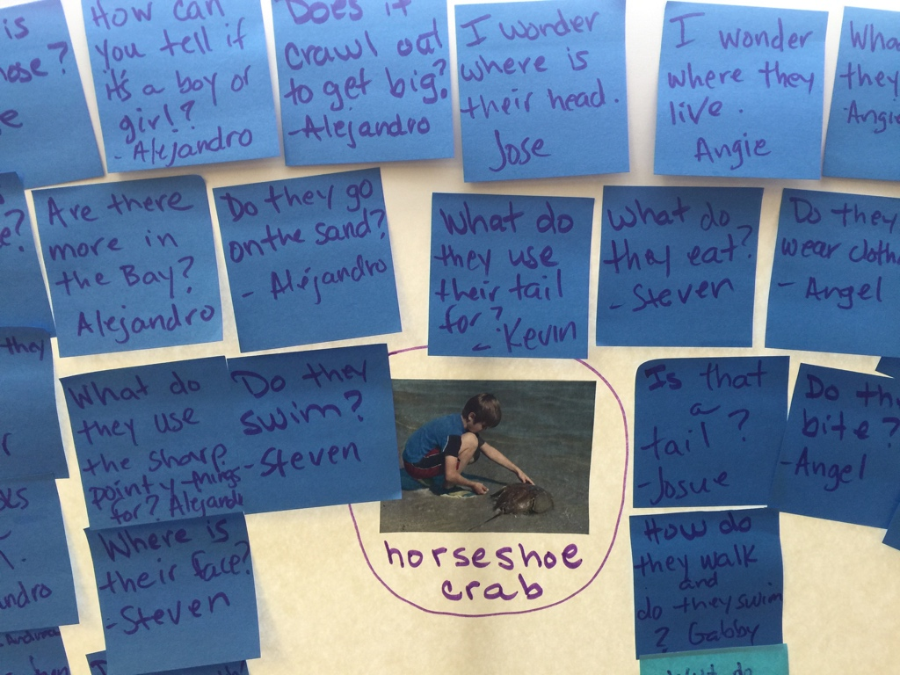
B

Slide 36
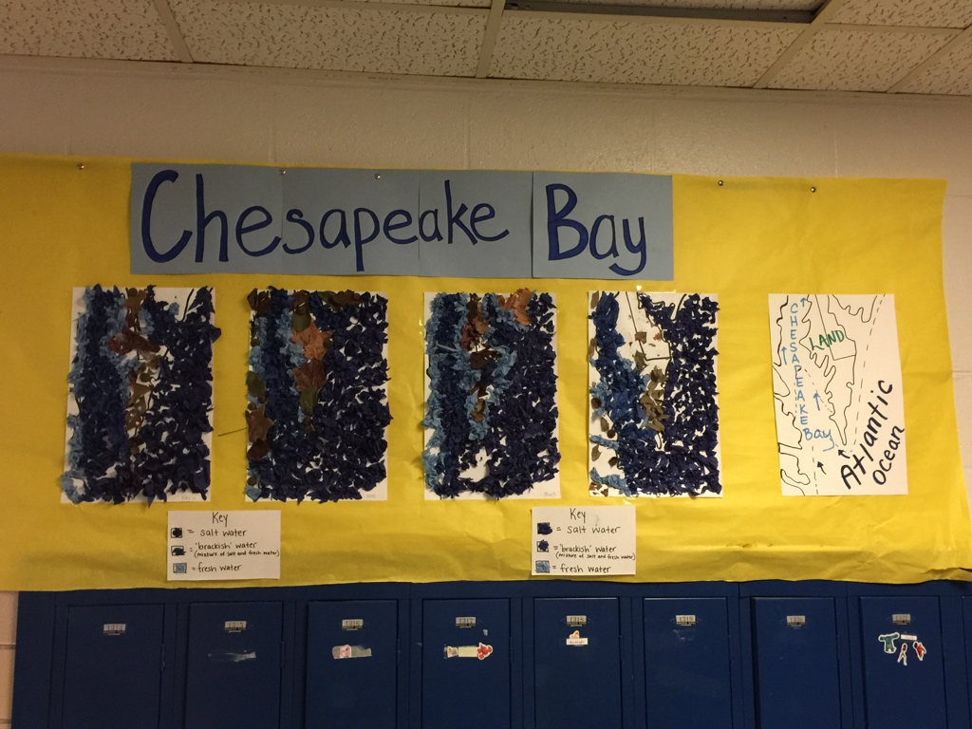
B

Slide 37
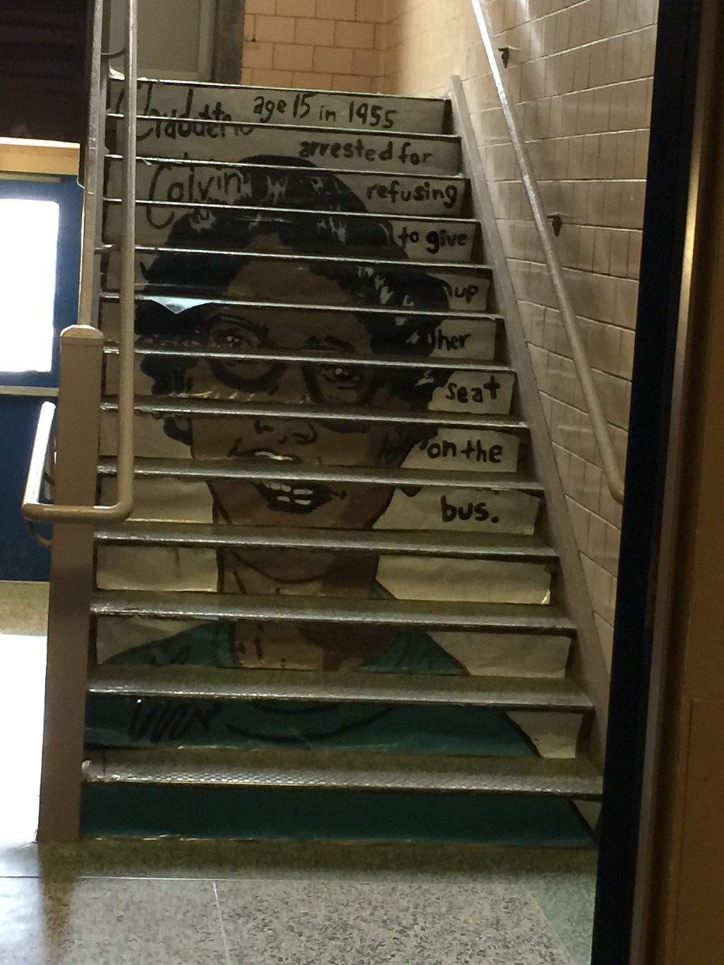
B

Slide 38
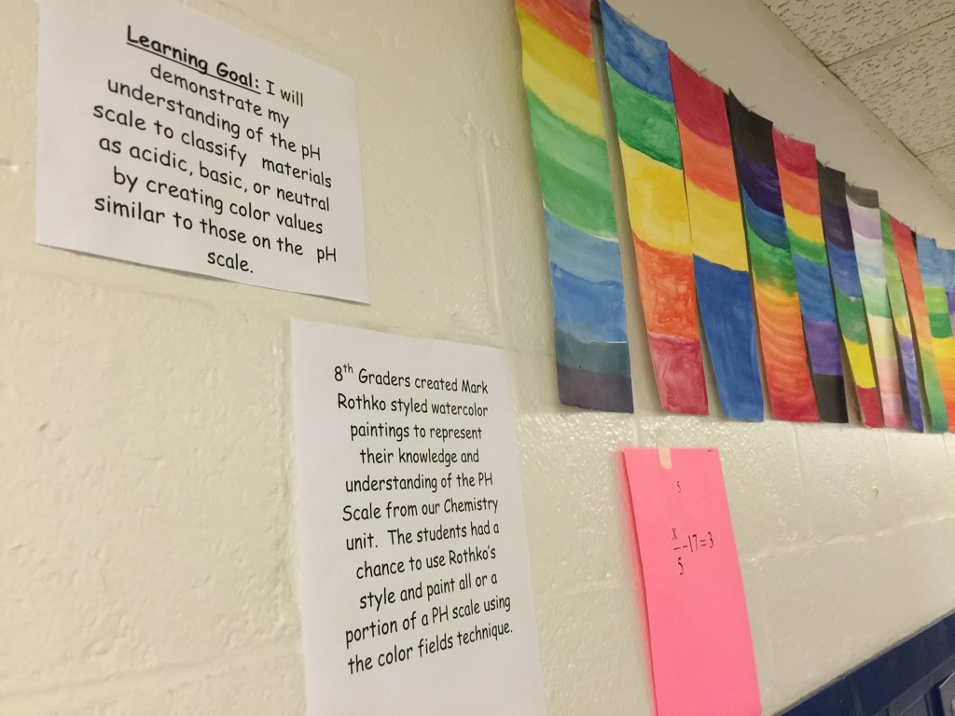
B

Slide 39
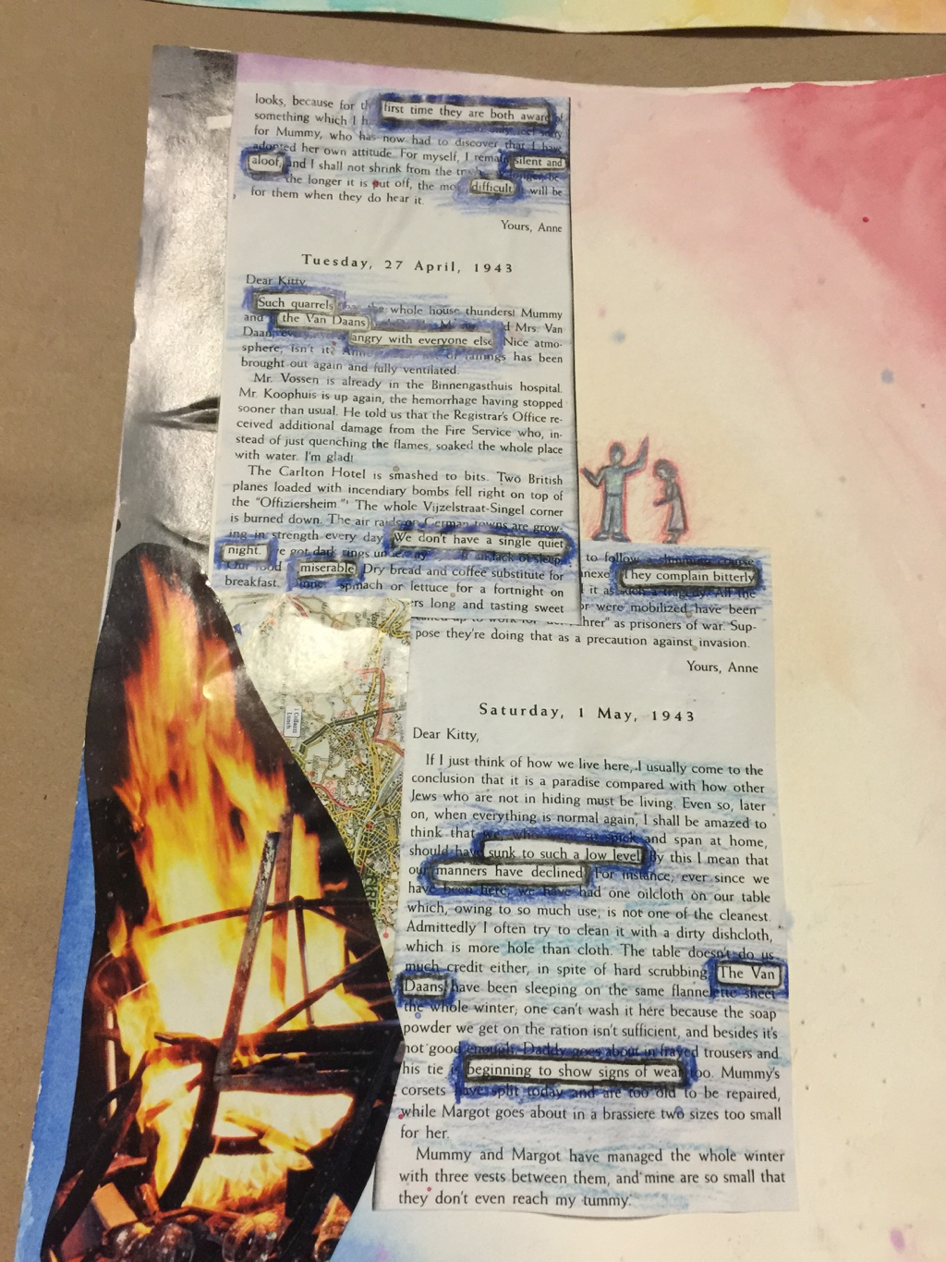
B

Slide 40
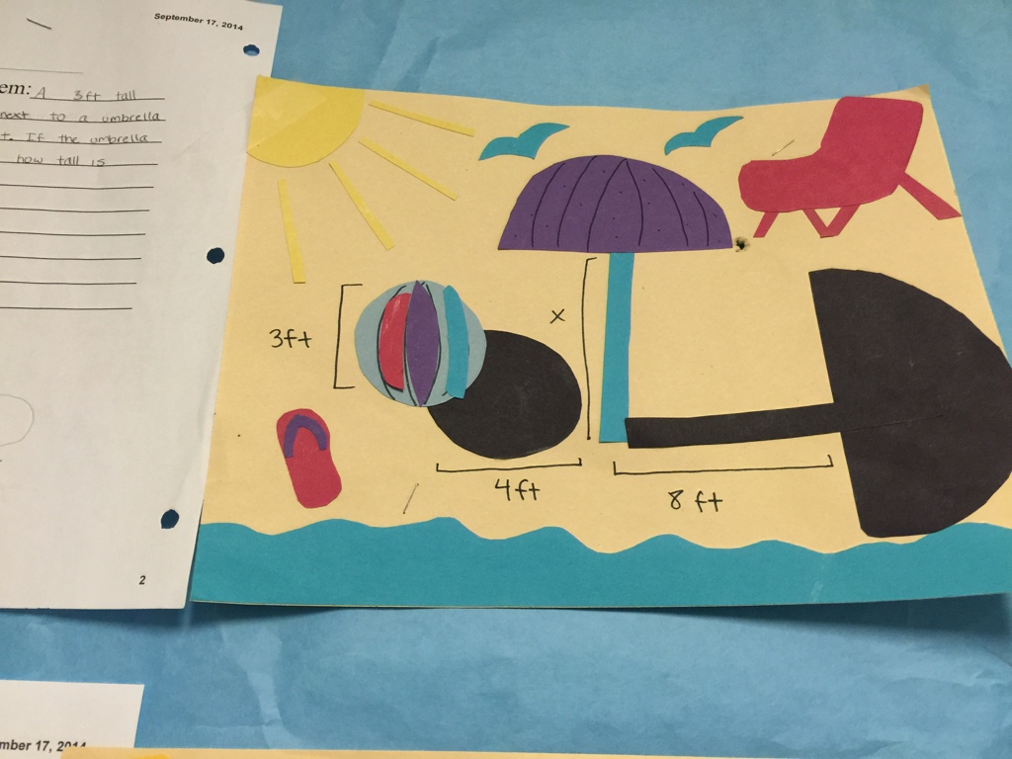
B

Slide 41
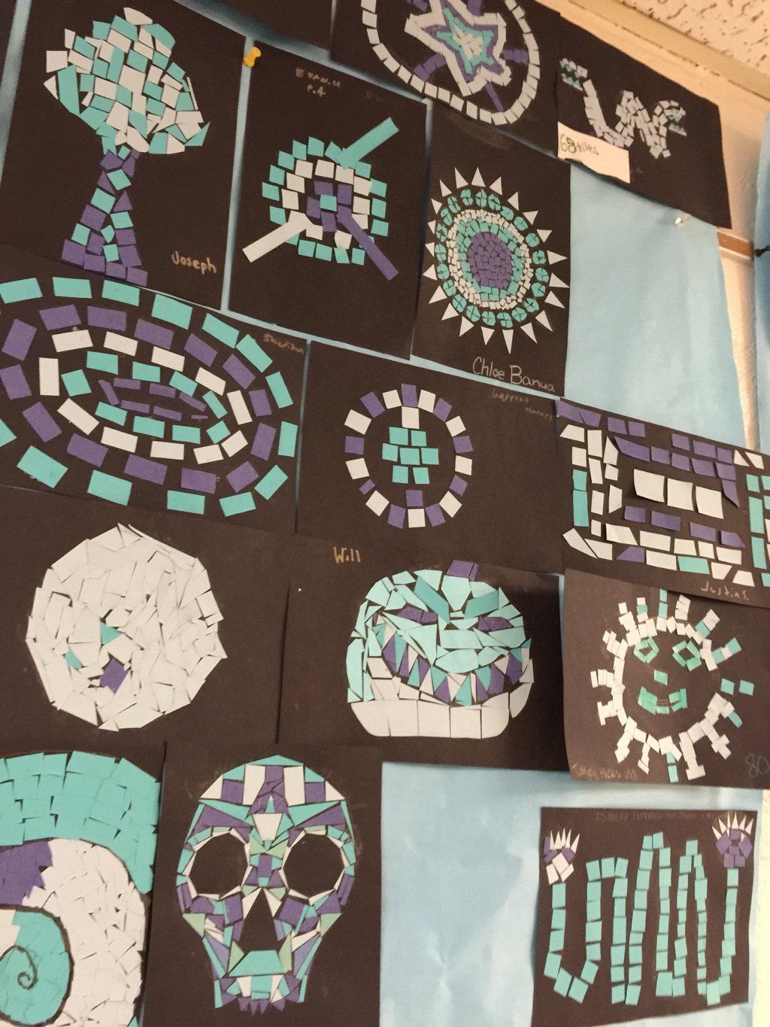
B

Slide 42
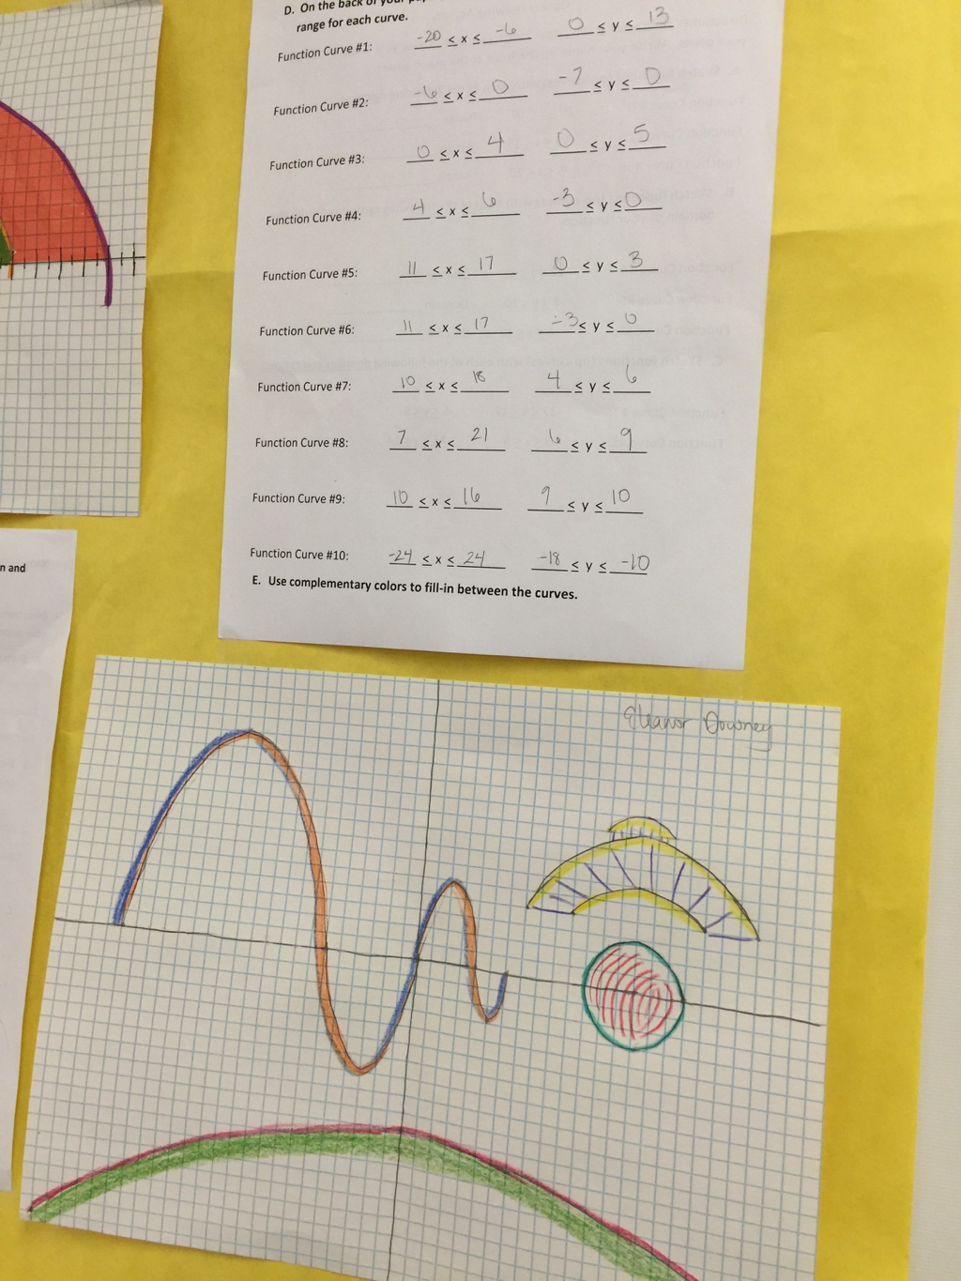
B

Slide 43
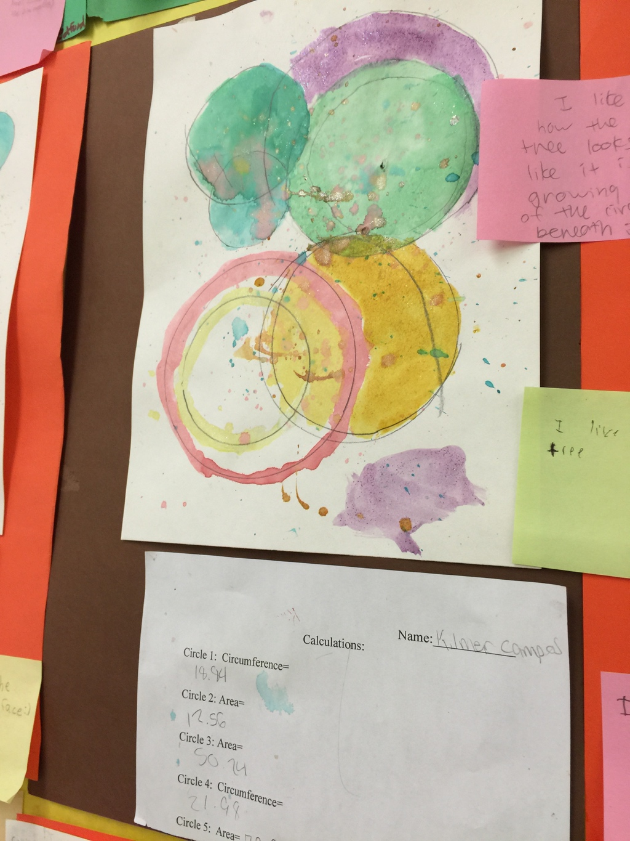
B

Slide 44
Next year update
H

Slide 45
Opportunities next year
Teachers apply artful thinking strategies. (daily routines)
Teachers teach art skills and concepts. (regular practice)
Teachers implement arts integration units where students construct and demonstrate understanding of core content through an art form. (occasional)
H

Slide 46
Opportunities next year
Visiting Artists come to your school to teach skills and concepts.
Collaborating Artists plan longer units with you so students can engage in a creative process which connects an art form to another subject area.
Students experience visual art, theatre, music or dance through a field trip and/or site-based performance. Teachers have the opportunity to enhance the learning and make connections to other content areas in the classroom.
H

Slide 47
Current visiting/ collaborating artist opportunities
as of February 2015
DANCE: Creative Movement, Folk, Modern, Choreography
LITERARY ART: Poetry, Storytelling
MUSIC: Composition, Folk, Percussion, Rhythm and rhyme, Singing, Kodaly Method
THEATRE: Creative Drama, Melodrama, Clown, Improvisation, Mask making, Puppetry, Reader’s Theatre, Script Development, Voice
TRADITIONAL ART: Carving, Weaving, Sewing
VISUAL ART: Art History, Assemblage, Book making, Cartoons, political cartoons Ceramics, Color and Design, Computer Art/Graphic Design, Drawing, Graffiti (legal surface), Jewelry, Marbling, Mixed Media, Murals, Painting, Photography, Printmaking, Scratchboard, Sequential art (comics, graphic novels), Sculpture, Stenciling, Watercolor
B

Slide 48
Some artist collaborations happening in ECS
Printmaking in science
Wool dying/ weaving in 6th grade social studies
Visual art & mathematics
Latin dance & social studies
Music and language arts or social studies
Spoken word poetry in 6th grade LA
B

Slide 49
What would you like to pilot this year?
H

Slide 50
Commitment update
H

Slide 51
Site Leader | Teacher Participant
Design and implement arts integrated lessons
Collaborate and co-teach with teaching artists
Regular meetings to discuss progress
4 Day Summer Institute August 11-14
Present at Summer Institute | _
Be contact/ organizing person at your school | _
30 hours professional development in Spring | _
The Art of Coaching training Aug 17-18 | _
3 year commitment | 1 year renewable
$1000 per 12 month year (1/2 in June then 1/2 in Dec) | $500 per year (paid in June)
H

Slide 52
Site Leader Names (co-presenters) | Topic | Time needed
 | Unit share: | 20
 | Unit share: | 20
 | VTS: “Beginning, Middle, End” and how it worked in our classrooms | 20
 | VTS: “Telephone” and how it worked in our classrooms | 20
 | Why use Arts Integration? | 20
 | Studio Habits of Mind | 20
 | Making Learning Visible | 20
 | VTS: “See, Wonder, Think” and how it worked in our classrooms | 20
 | VTS: “What is going on in this picture” and how it worked in our classrooms | 20
 | VTS: “See, Know, Care About” and how it worked in our classrooms | 20
 | VTS: “Creative Questions” and how it worked in our classrooms | 20
 | Other: _______________ | 20
Summer Presentations

