Slide 1
North Coast Arts Integration Project
A guide for art teachers
HCOE April 2, 2015

Slide 2
Curate a show
Curators select and arrange artworks to inform and inspire people.
Many exhibitions are organized around a theme.
Most shows have a curator’s statement explaining the thinking behind their selection.
H

Slide 3
Collaborate to sort and select images for a small exhibition based on a theme of your choice.

Slide 4
Exhibition big themes
Elements or Principles
Objects and what they say about us
Relationships
Identity: what does the art tell you about the artist or yourself?
Place: What does our surroundings communicate?
Content specific theme: cells, federalism, word problems
Explore and extend: would you change your theme now?

Slide 5
Speaking and Listening Anchor Standards #1, 2, 4
Participate in a range of conversations with diverse partners
Integrate and evaluate information presented visually and orally
Present information so that listeners can follow the line of reasoning and organization
H

Slide 6
H

Slide 7
What is arts integration?
Arts
Curriculum
Arts
Integration
Core
Curriculum
B

Slide 8
Students benefit in three ways
Students benefit from connections between arts and other content areas
Arts
Education
Core
Education
B

Slide 9
Artful Thinking Strategies
From Project Zero, an educational research group at the Harvard Graduate School of Education
B

Slide 10
Goals
Explore foundational thinking strategies for any class on any day.
Strengthen the connections between your art class and core content.
Increase engagement, creativity and critical thinking in your class.
Use these techniques in your class tomorrow.
H

Slide 11
Visual Thinking Strategies
Once visual thinking strategies are learned, artwork is not viewed the same way ever again.
H

Slide 12
Beginning,
Middle or End?
B

Slide 13
Need

Slide 14
Look closely to fill in the
beginning, middle and end of this story
B

Slide 15
Focus considerations
Setting
Plot
Character
Point of view
Dialogue
Conflict
Intent
Theme
Are these considerations for writing, visual art, or both?
B

Slide 16
Gregory Crewdson
“Untitled”
1998-2002
B

Slide 17
“I was always influenced by a particularly American tradition of art making that searches to find an intersection between ordinary life and theatricality. The painting of Edward Hopper and Norman Rockwell…The photographs of Walker Evans, Diane Arbus, William Eggleston…
The short stories of Raymond Carver and John Cheever. The movie Blue Velvet fits squarely within this tradition. The tension between ordinary life and something mysterious and unknown.”
B

Slide 18
Edward Hopper
1952
Diane Arbus
1962
David Lynch
1986

Slide 19
B

Slide 21
H

Slide 22
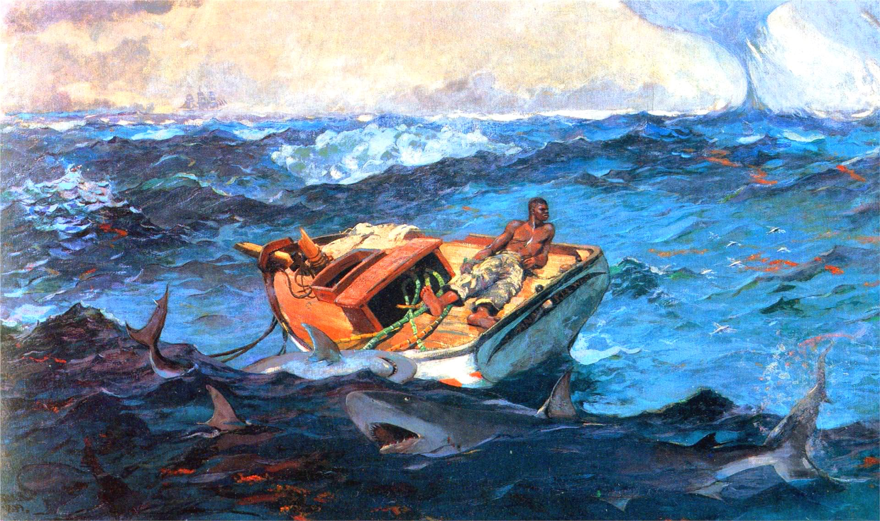
What was presented January 26 at HCOE
H

Slide 23
Writing Anchor Standard #3
Write narratives to develop real or imagined experiences of events using effective technique, well-chosen details and well-structured event sequences.
H

Slide 25
Shawn Tan

Slide 26
H

Slide 27
What’s Going On In This Picture?
H

Slide 28
What’s going on in this picture?
Start with observation period
Explain what is going on in this picture
You will be asked to support your inference with evidence
H

Slide 29
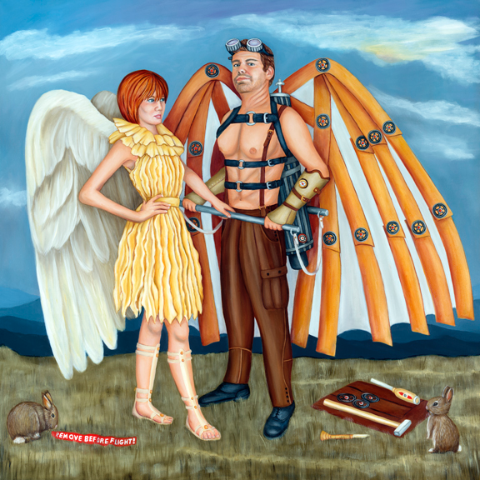
Dawna Boehmer
H

Slide 30
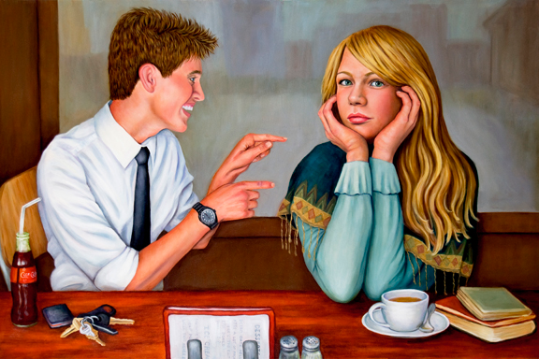
Dawna Boehmer
H

Slide 31
“My paintings capture and preserve glimpses of the humorous yet revealing nature of human social interaction.
Filled with sensual charm, the characters in my pictures unveil their story through body language and compelling facial expressions. I intertwine humor with a touch of “attitude” to create paintings that entice viewers to look a little deeper. My pictures catch pivotal moments when people let down their guard, openly display their thoughts, and make that all-important connection – no matter how brief.”
- Dawna Boehmer
B

Slide 32
Three questions
What is going on in this picture?
What do you see that makes you say that?
What more can you find?
B

Slide 33
CCSS Reading
Anchor Standard #1
Read closely to determine what the text says explicitly and make logical inferences from it.
Cite specific evidence to support conclusions.
H

Slide 34
H

Slide 35
EVIDENCE
H

Slide 36
Read, write and speak grounded in evidence
Construct viable arguments
Engage in argument from evidence
H

Slide 37
Learning to read
Learning to cite evidence
Images are the original communication method and are critical when learning new skills
B

Slide 38
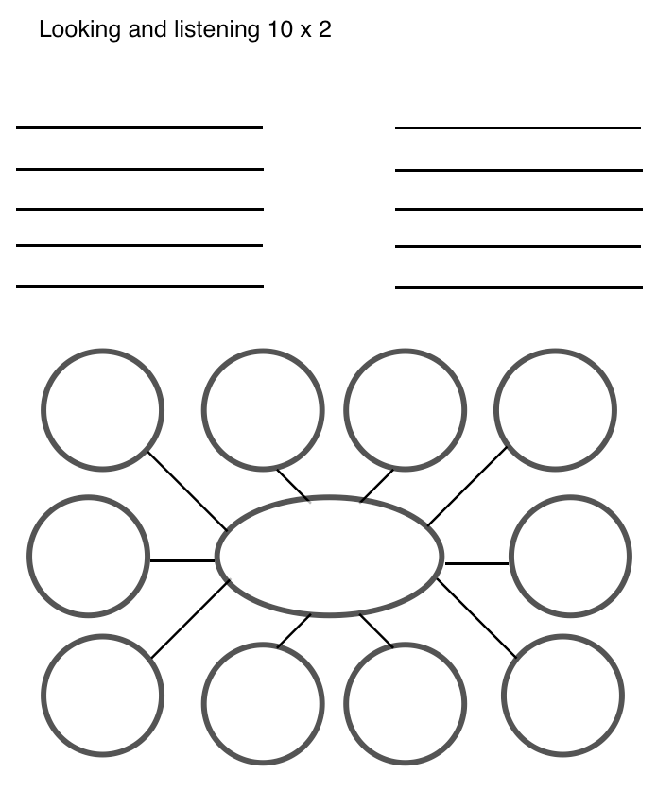
10 x 2
H

Slide 39
Pick one word and write more 10 words that
further describe or elaborate.
Make a list of 10 words or phrases to describe things you see.
Look carefully at this artwork for 30 seconds.
Share your words.

Slide 40
Evert Collier
Körül
Victoria and Albert Museum
1699

Slide 41
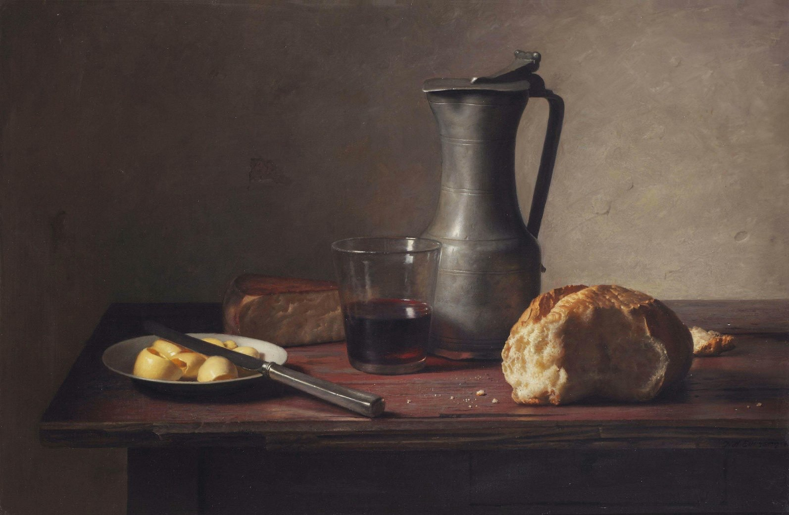

Slide 42
Carmen Lomas Garza The Fair at Reynosa 1987

Slide 43
H

Slide 44
Elements
B

Slide 45
Elements
Color
Shape
Line
canary yellow
crescent moon
B

Slide 46
Describe the elements you see

Slide 47
Paul Klee
Asian Entertainers
1919

Slide 48
Stuart Davis
Hot still-scape for six colors
1940

Slide 50
H

Slide 51
H

Slide 52
See, Wonder, Think
B

Slide 53
B

Slide 54
B

Slide 55
Title
B

Slide 56
See, Wonder, Think
See: observation and description (evidence first)
Wonder: process the image sufficiently to come up with a question
Think: construct an answer to your question
Some teachers separate these into separate sections (3 things you see, then 3 things you wonder, etc)
Can combine See, Wonder, Think into one sentence
1, 2, 3
1, 2, 3
?
B

Slide 57
What’s going on in this picture? | See, Wonder, Think
Inference followed by evidence | Evidence then inference
“I think the man thinks he can fly because he is standing tall with a confident expression ” | “I see a man wearing wings. I wonder if he thinks he can fly. I think he can’t because his wings are man made and not real.”

Slide 58
See, Wonder, Think
What’s Going On in
this Picture?

Slide 59
Where can you get images?
Online search
_____________(concept) + “painting” or “sculpture”
nytimes.com has weekly “What’s going on in this picture?” series
getty.edu & google art project display art at amazing resolution
H

Slide 60
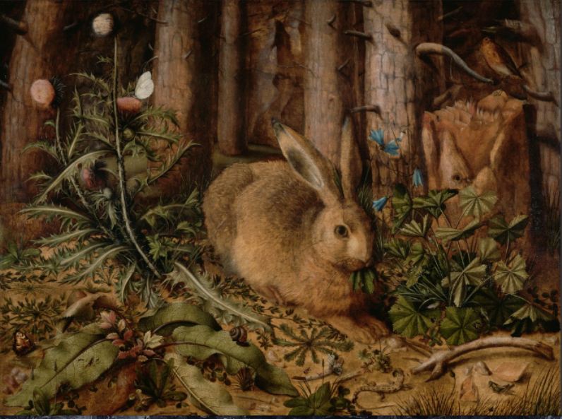
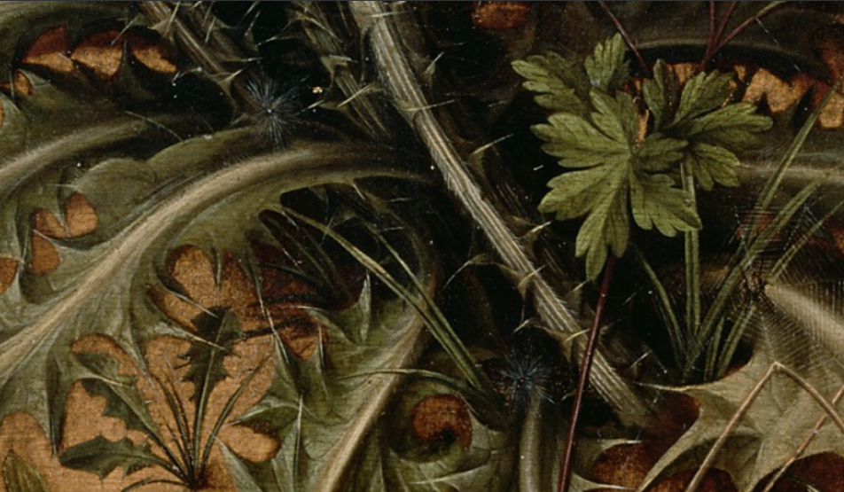

Slide 62
B

