Slide 2
PROCEDURE
1. Write your name on the back of one sheet of mixed media paper.
2. Fold 12” x 18” sheet of mixed media paper into 12 equal sections.
3. Paint two sections each:
Blue
Red
Yellow
Green
Orange
Purple
4. Set aside to dry.

Slide 3
Notes:
Thomas Kincaid
Connecting the element of color, and color theory to students’ life experience.

Slide 4
All the colors of the rainbow
A Brief History of the Color Wheel

Slide 5
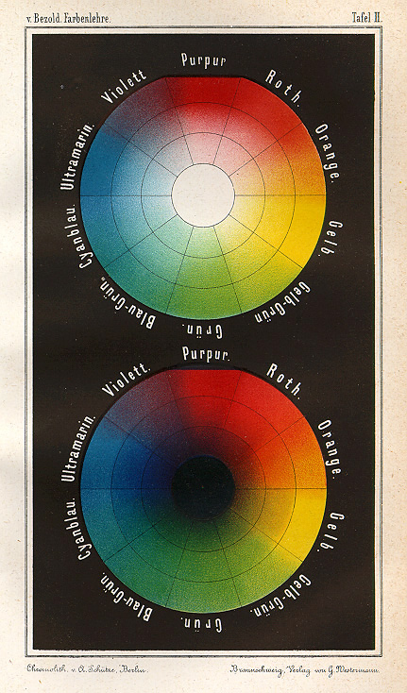
THE COLOR WHEEL
A color wheel is the visual organization of color around a circle.
A color wheel includes primary, secondary and intermediate hues and shows relationships between these colors.
Each side of the wheel seems cool or warm in psychological temperatures.
Cool - blue, green, purple
Warm - orange, red, yellow
Color schemes reflect these relationships and include:
Analogous - hues adjacent to one another on the color wheel.
Complementary – when placed side by side, these colors intensify each other.
The color wheel has an interesting history that begins with light….
Notes:
Wilhelm von Bezold's 1874 Farbentafel

Slide 6
LIGHT
Have you ever seen a small rainbow on a wall in your house or school? This rainbow is formed when visible, or white light is bent.
Light can be bent or refracted through a prism. A prism is a glass object with flat, polished surfaces.
The prism causes the visible light to bend, or refract into colors –all the colors of the rainbow.
This means that all the colors of the rainbow make up visible, or white light.
Who, you might be thinking, made this discovery?

Slide 7
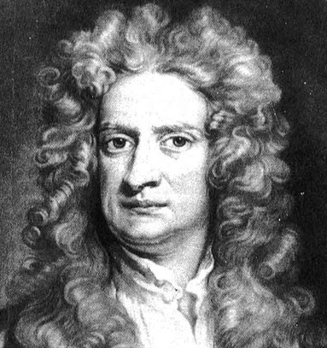
SIR ISAAC NEWTON (that’s who)
Issac Newton is also responsible for developing:
The theory of gravity
His three laws of motion
The reflecting telescope
Calculus
Newton was very busy.

Slide 8
NEWTON’S EXPERIMENT and NGSS (Next Generation Science Standards)
When Issac Newton was reading through the Next Generation Science Standards he discovered the following for Grade: K-2
1-PS4-3 Waves and Their Applications in Technologies for Information Transfer
Plan and conduct investigations to determine the effect of placing objects made with different materials in the path of a beam of light.
So, Newton set up a prism near a window, and when light hit the prism it projected a beautiful color spectrum onto the far wall.
Notes:
1666 - 1672

Slide 9
NEWTON’S DIAGRAM
To prove that the prism wasn't coloring visible light, he then used another prism to refract the light back together again. This caused all the colors to join back together into visible, or white, light.
This image is the diagram drawn from Isaac Newton’s experiment.
A ray of light is divided into the colors of the rainbow by the first prism (left), and the resulting bundle of colored rays is joined back into white light by the second prism.

Slide 10
NEWTON’S COLOR CIRCLE
Artists were fascinated by Newton’s clear demonstration that light alone was responsible for color.
His most useful idea for artists was his arrangement of the refracted colors around the circumference of a circle as seen in this image.
Newton placed the primary colors red, yellow and blue opposite the secondary colors orange, green and violet (purple).
This arrangement served as a way of visually explaining that each pair of opposite colors would enhance or complement the other’s effect through optical contrast.
Notes:
Newton's asymmetric color wheel correlates colors with musical notes and planetary symbols.

Slide 11
THE COLOR WHEEL
Newton’s circular diagram became the model for many color systems.
These seven- and twelve- color circles are probably the first to be based on Newton’s circle.
Scientists and artists have studied and designed numerous variations of this concept.
Notes:
Discovered in a 1708 artists’ manual and attributed to “CB” (often assumed to be Claude Boutet, or the publisher, Christophe Ballard).

Slide 12
THE MODERN COLOR WHEEL
This image shows a typical color wheel that artists use today.

Slide 13
USING THE COLORS OF THE RAINBOW TO CREATE PATTERN
Pattern is the repetitive ordering of design elements such as color.

Slide 14
Procedure
1. Cut your paper into the 12 sections.
2. Working with your collaborative team, create a pattern using you color “tiles”.

Slide 16
The Visual and Performing arts standards
Visual Art - Kindergarten
Dance - Kindergarten
Artistic Perception
Identify the elements of art (line, color, shape/form, texture, value, space) in the environment and in works of art, emphasizing line, color, and shape/form.
Creative Expression
Use lines, shapes/forms, and colors to make patterns
Aesthetic Valuing
Discuss their own works of art, using appropriate vocabulary (e.g., color, shape/form, texture)
Artistic Perception
Understand and respond to a wide range of opposites (e.g., high/low, forward/backward, wiggle/freeze).
Creative Expression
Create movements that reflect a variety of personal experiences (e.g., recall feeling happy, sad, angry, excited).

Slide 17
The Visual and Performing arts standards
Visual Art – Grade One
Dance – Grade One
Artistic Perception
Describe and replicate repeated patterns in nature, in the environment, and in works of art.
Identify the elements of arts in objects in nature, in the environment, and in works of art, emphasizing line, color, shape/form, and texture.
Creative Expression
Mix secondary colors from primary colors and describe the process.
Plan and use variations in line, shape/form, color, and texture to communicate ideas or feelings in works of art.
Draw or paint a still life using secondary colors.
Aesthetic Valuing
Discuss works of art created in the classroom, focusing on selected elements of art (shape/form, texture, line, color).
Connections, Relationships, Applications
Identify and sort pictures into categories according to the elements of art emphasized in the works (e.g., color, line, shape/form, texture).
Creative Expression
Imitate simple movement patterns.
Express basic emotional qualities (e.g., angry, sad, excited, happy) through movement.
Aesthetic Valuing
Describe how they communicate an idea or a mood in a dance (e.g., with exaggerated everyday gesture or emotional energies).

Slide 18
The Visual and Performing arts standards
Visual Art – Grade Two
Dance – Grade Two
Artistic Perception
Perceive and discuss difference in mood created by warm and cool colors.
Identify the elements of art in objects in nature, the environment, and works of art, emphasizing line, color, shape/form, texture, and space.
Creative Expression
Demonstrated beginning skill in the use of arts media, such as oil pastels, watercolors, and tempera.
Create a painting or drawing, using warm or cool colors expressively.
Aesthetic Valuing
Use appropriate vocabulary of art to describe the successful use of an element of art in a work of art.
Connections, Relationships, Applications
Select and use expressive colors to create mood and show personality within a portrait of a hero from long ago or the recent past.
Identify pictures and sort them into categories according to expressive qualities (i.e., theme and mood).
Artistic Perception
Perform short movement problems, emphasizing the element of time (e.g., varied tempos, rhythmic patterns, counting).
Creative Expression
Creative and improvise movement patterns and sequences.
Create, memorize, and perform original expressive movements for peers.

