Slide 1
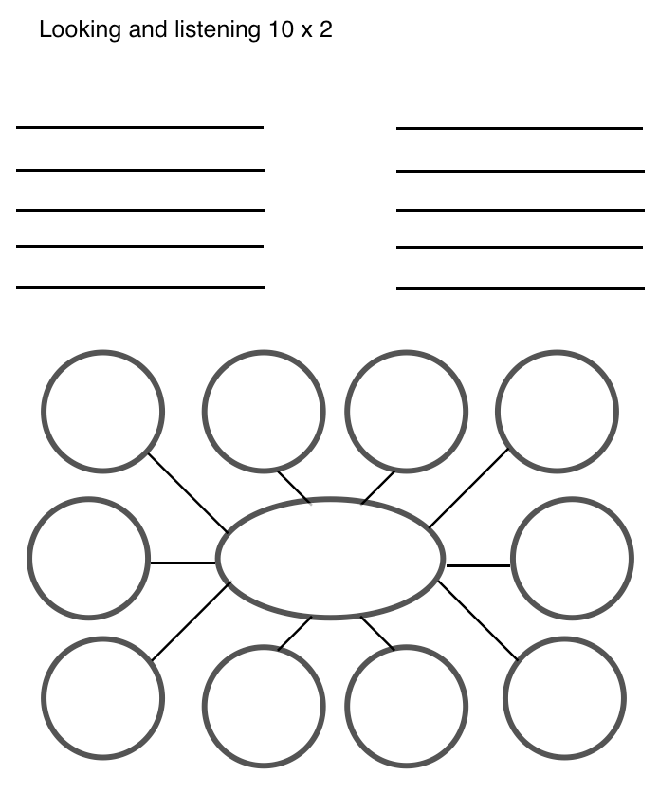
10 x 2
H

Slide 2
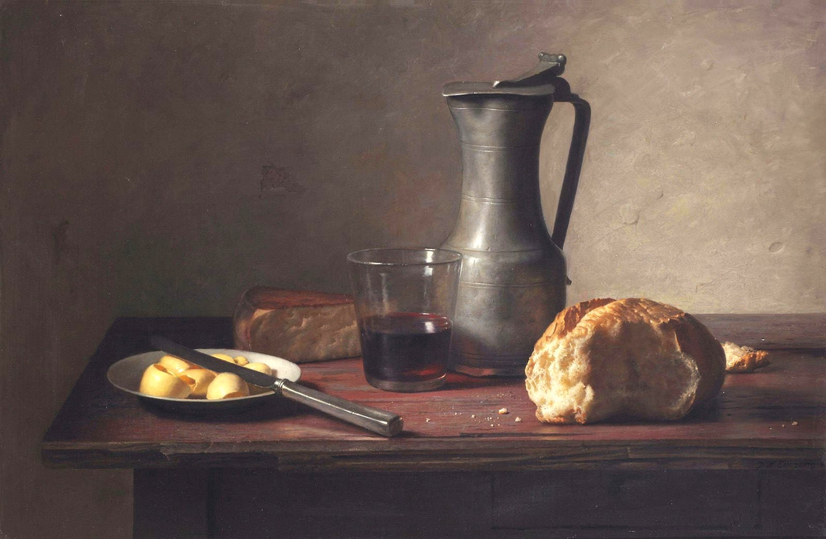

Slide 3
Make a list of 10 words or phrases to describe things you see.

Slide 4
10 x 2
H

Slide 5
10 x 2
H

Slide 6
Pick one word and write more 10 words that
further describe or elaborate on your original word.

Slide 7
'A still life with cheese, bread, butter and wine'
Jan Eversen (Dutch painter, 1963)

Slide 8
Marilyn (Vanitas) Audrey Flack 1977

Slide 9
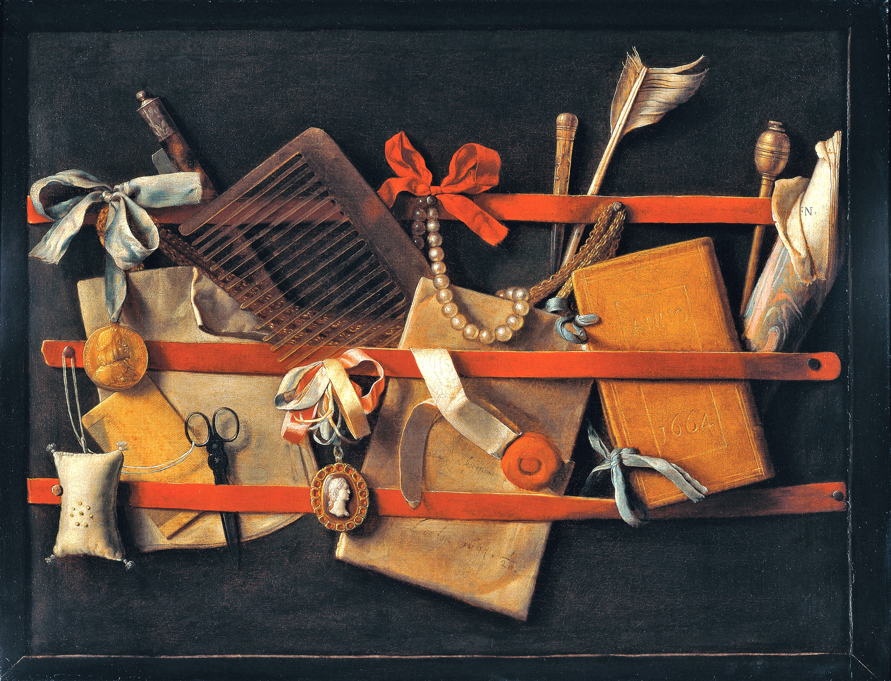

Slide 10
Evert Collier
Körül
Victoria and Albert Museum
1699

Slide 11
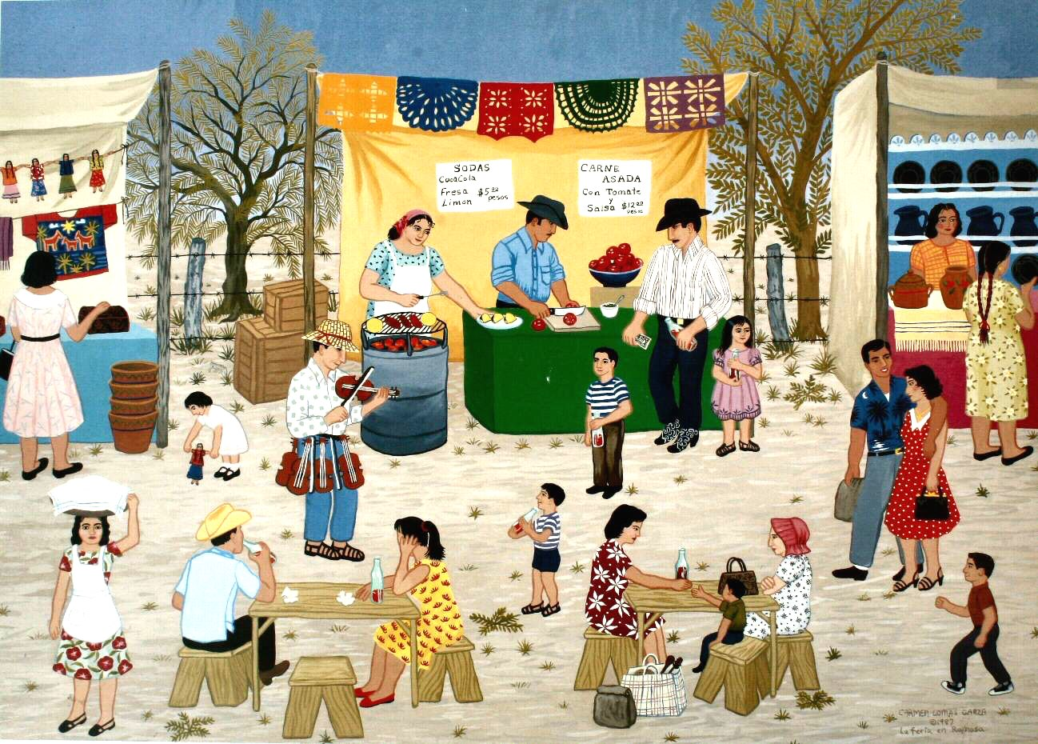

Slide 12
Carmen Lomas Garza The Fair at Reynosa 1987

